Slide 1

Future Challenges and Solutions for Education and Training in Aviation

Slide 2
Educators' opinion on new occupations regarding technological progress

Slide 3
Preferences for training
Employee opinion
HEIs should provide the education that the employees really need. We questioned the employees about their education preferences in topic and in the way the education is given.

Slide 4
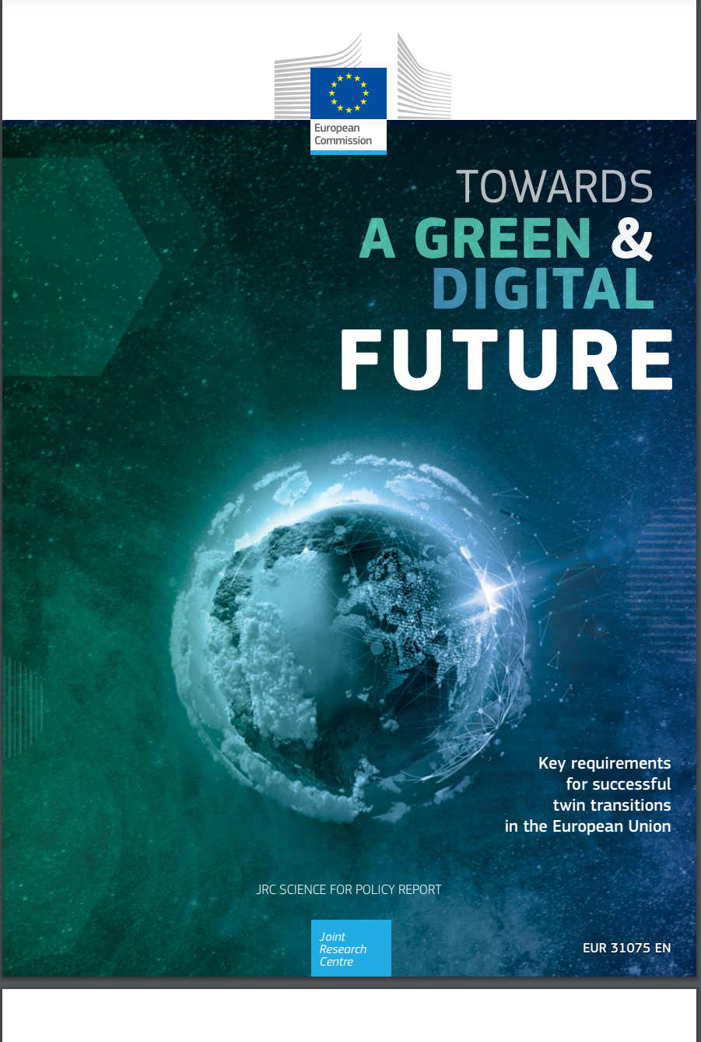
Emerging occupations in aviation
Specialist in environment
Sustainable Aviation Policy
Sustainable Aviation Engineer
Sustainable Airport Planner
Climate change specialist
Consumer energy analysts
Air Quality Analyst
Sustainable Aviation Educator
Green Fuels Researcher
Battery technicians
Solar flight specialists
Pilots for UAV
Drone Traffic Manager
Thermal
The digitalisation and the sustainability are a cross sectorial actions which suppose advanced skills and competences in aviation, ICT and sustainability simultaneously.

Slide 5
Interdisciplinary occupations
Categories of occupations | Groups | Occupations
Aviation and ICT | Big Data applied in aviation | Big Data Architect, Data Scientist, Data Analyst, Chief Data Officer, Data Protection Officer
 | Cybersecurity | Auditor, Crisis Management Specialist, Expert intrusion tests, Head of the Information Systems Security, Secure communication supervisor
 | Data Storytelling | Data Storyteller, Data Scientist, Business Analyst, Web Analyst
 | Data Science | Chief Data Officer, Data Steward, Data Analyst, Data Scientist, Data-Miner, Developers and integrators of blockchain and virtual technology, AI engineer
 | Piloting | Remote pilot
 | New management approaches | Expert in flight procedure design, managers for ACDM and APOC implementation

Slide 6
Interdisciplinary occupations
Categories of occupations | Groups | Occupations
Aviation, ICT and Marketing | Search Engine Optimization (SEO) | SEO Manager, SEO Consultant, Content Manager, Traffic Manager
 | E-CRM ( Electronic Customer Relation Management) | CRM Responsible, Consultant, CRM Manager, Project Manager, Data Analyst
 | E-reputation | E-reputation Manager, E-reputation Consultant, Advisor / Watchman in e-reputation, Community Manager, Content Manager
 | User eXperience (UX) / User Interface (UI) design | Service Designer, UX Manager, UI Designer, UX Designer, Ergonomist Designer

