Slide 1




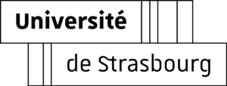

Interactive game created on the Moodle platform using HTML5
2022-1-RO01-KA220-HED-000086424

Slide 2
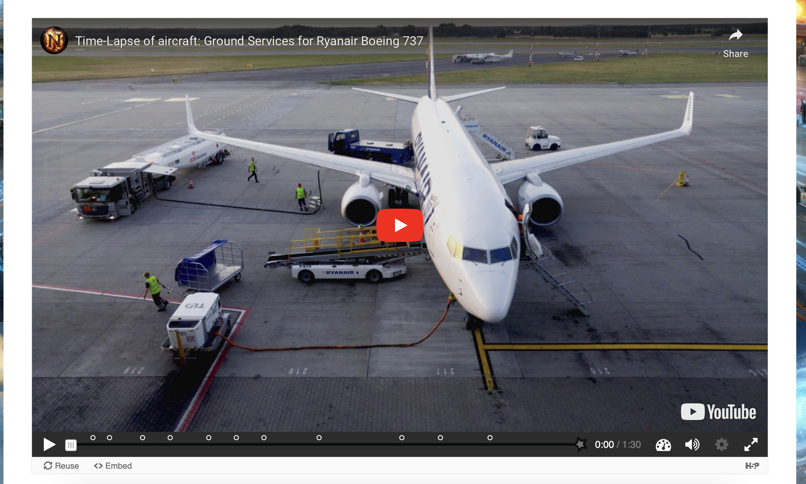
The video scenario shows the ground crew procedures for a Ryanair Boeing 737. The student is required to make decisions at key moments.
The initial scene shows the Ryanair aircraft arriving at the gate. The interactive video starts with this introduction.

Slide 3
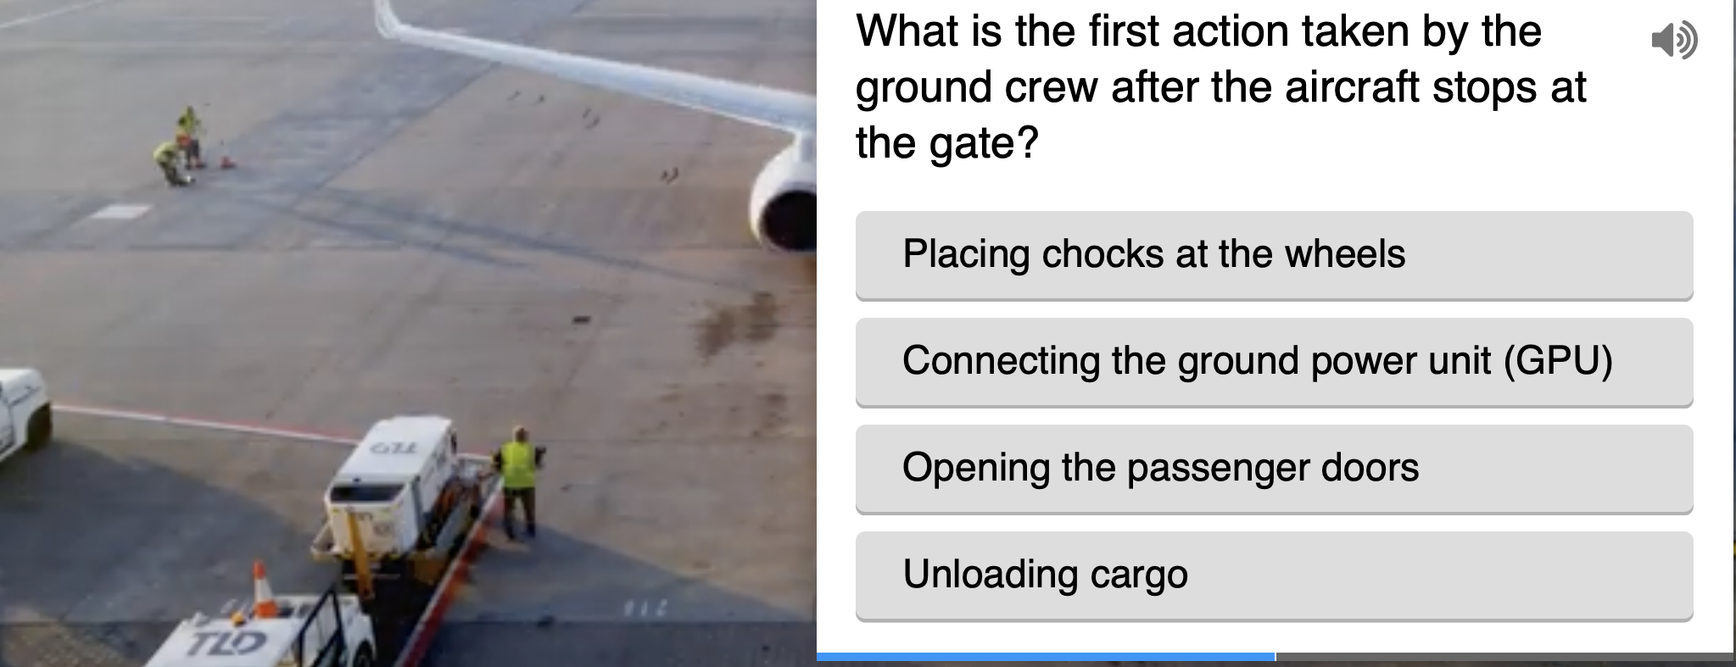
The student needs to choose the first action taken by the ground crew.

Slide 4
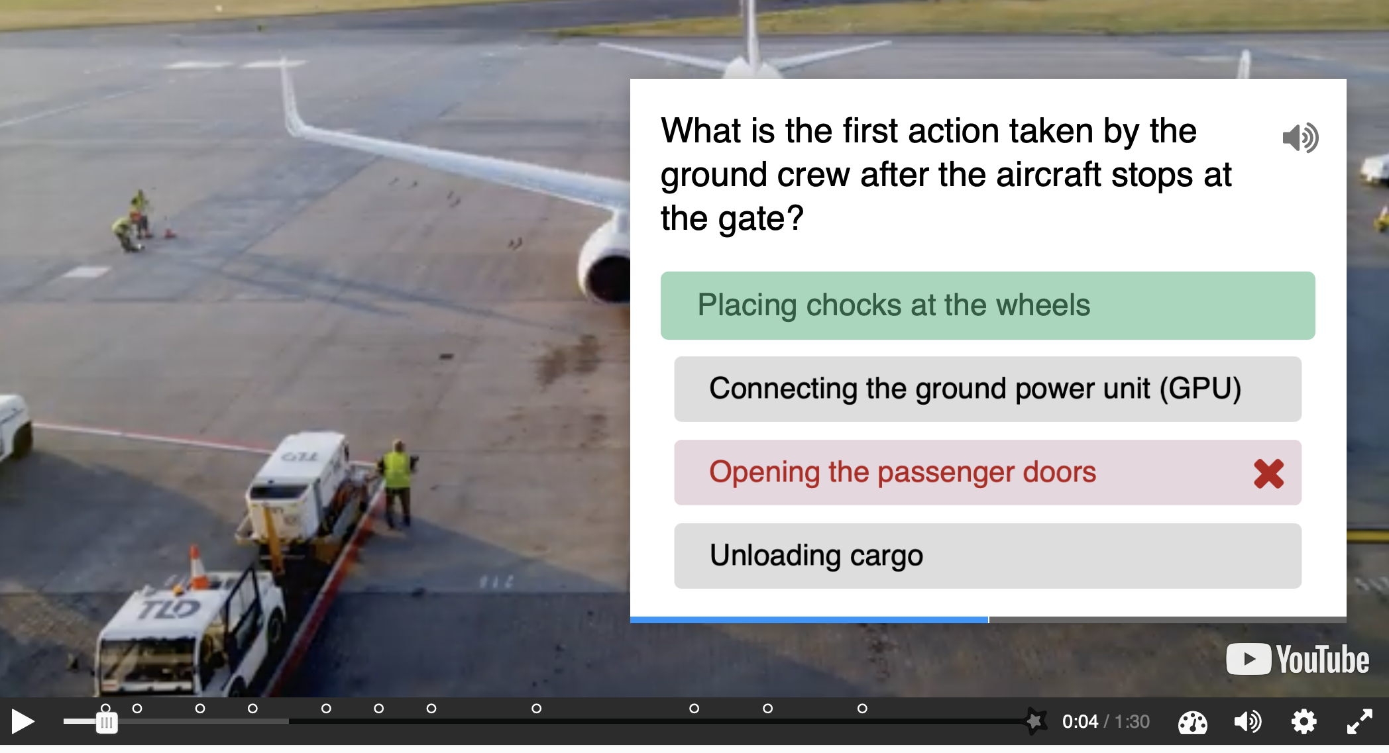
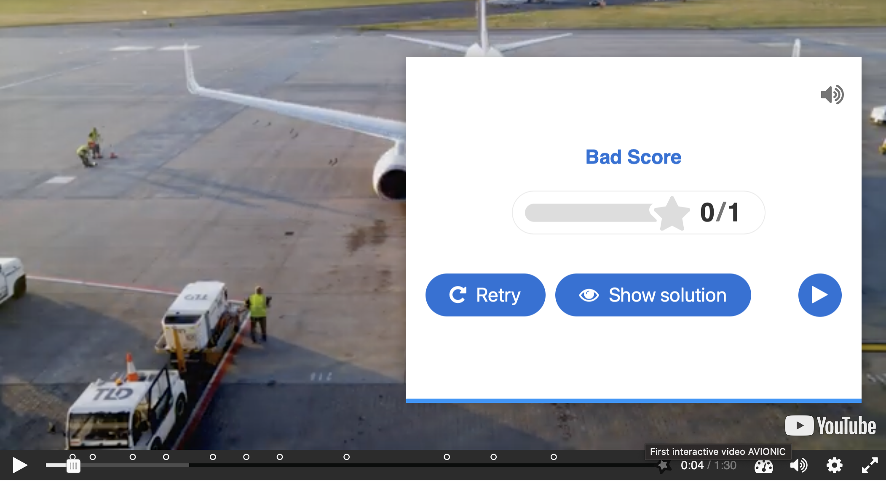
If the student selects an incorrect answer, they receive negative feedback (“Bad Score”) and are given the option to retry.

Slide 5
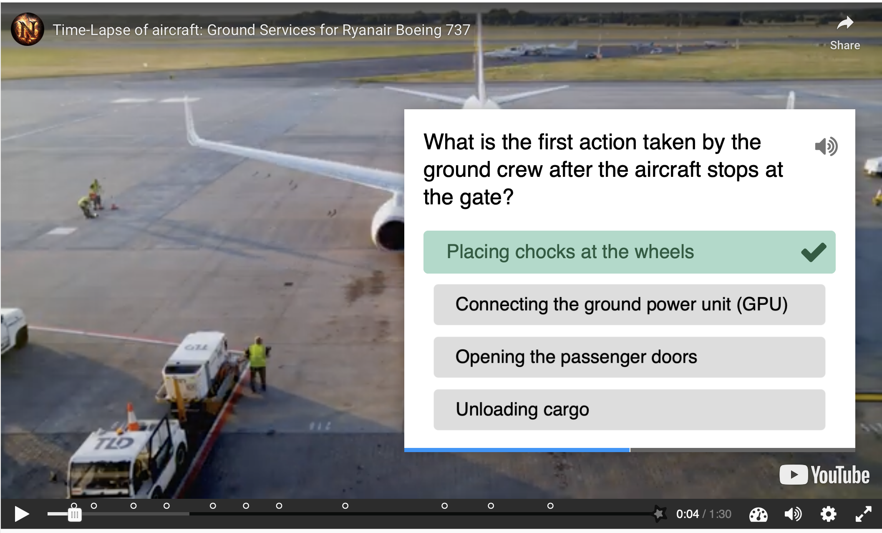
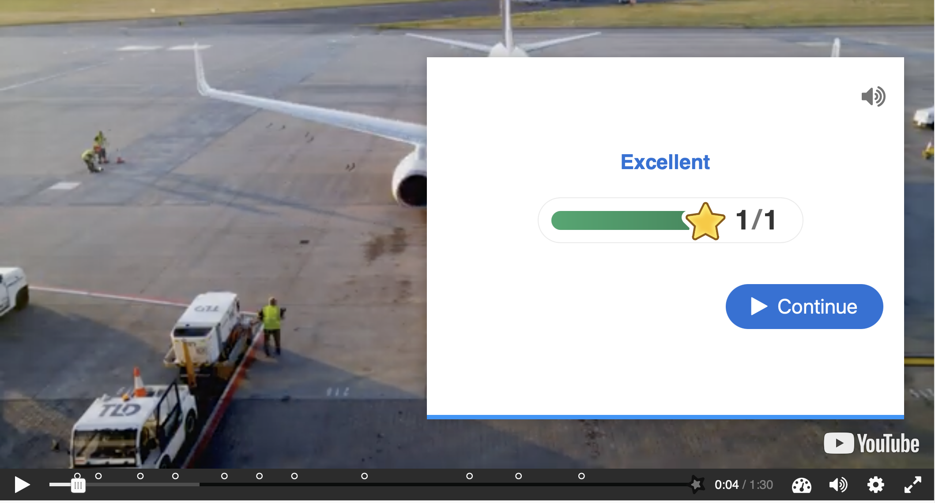
If the answer is correct (“Placing chocks at the wheels”), the student receives positive feedback, and the game continues with the next actions.
At the end of the game, a final score is displayed based on the correct decisions and the response time.

Slide 6
At the end of the game, a final score is displayed based on the correct decisions and the response time.
If the answer is correct (“Placing chocks at the wheels”), the student receives positive feedback, and the game continues with the next actions.

Slide 7
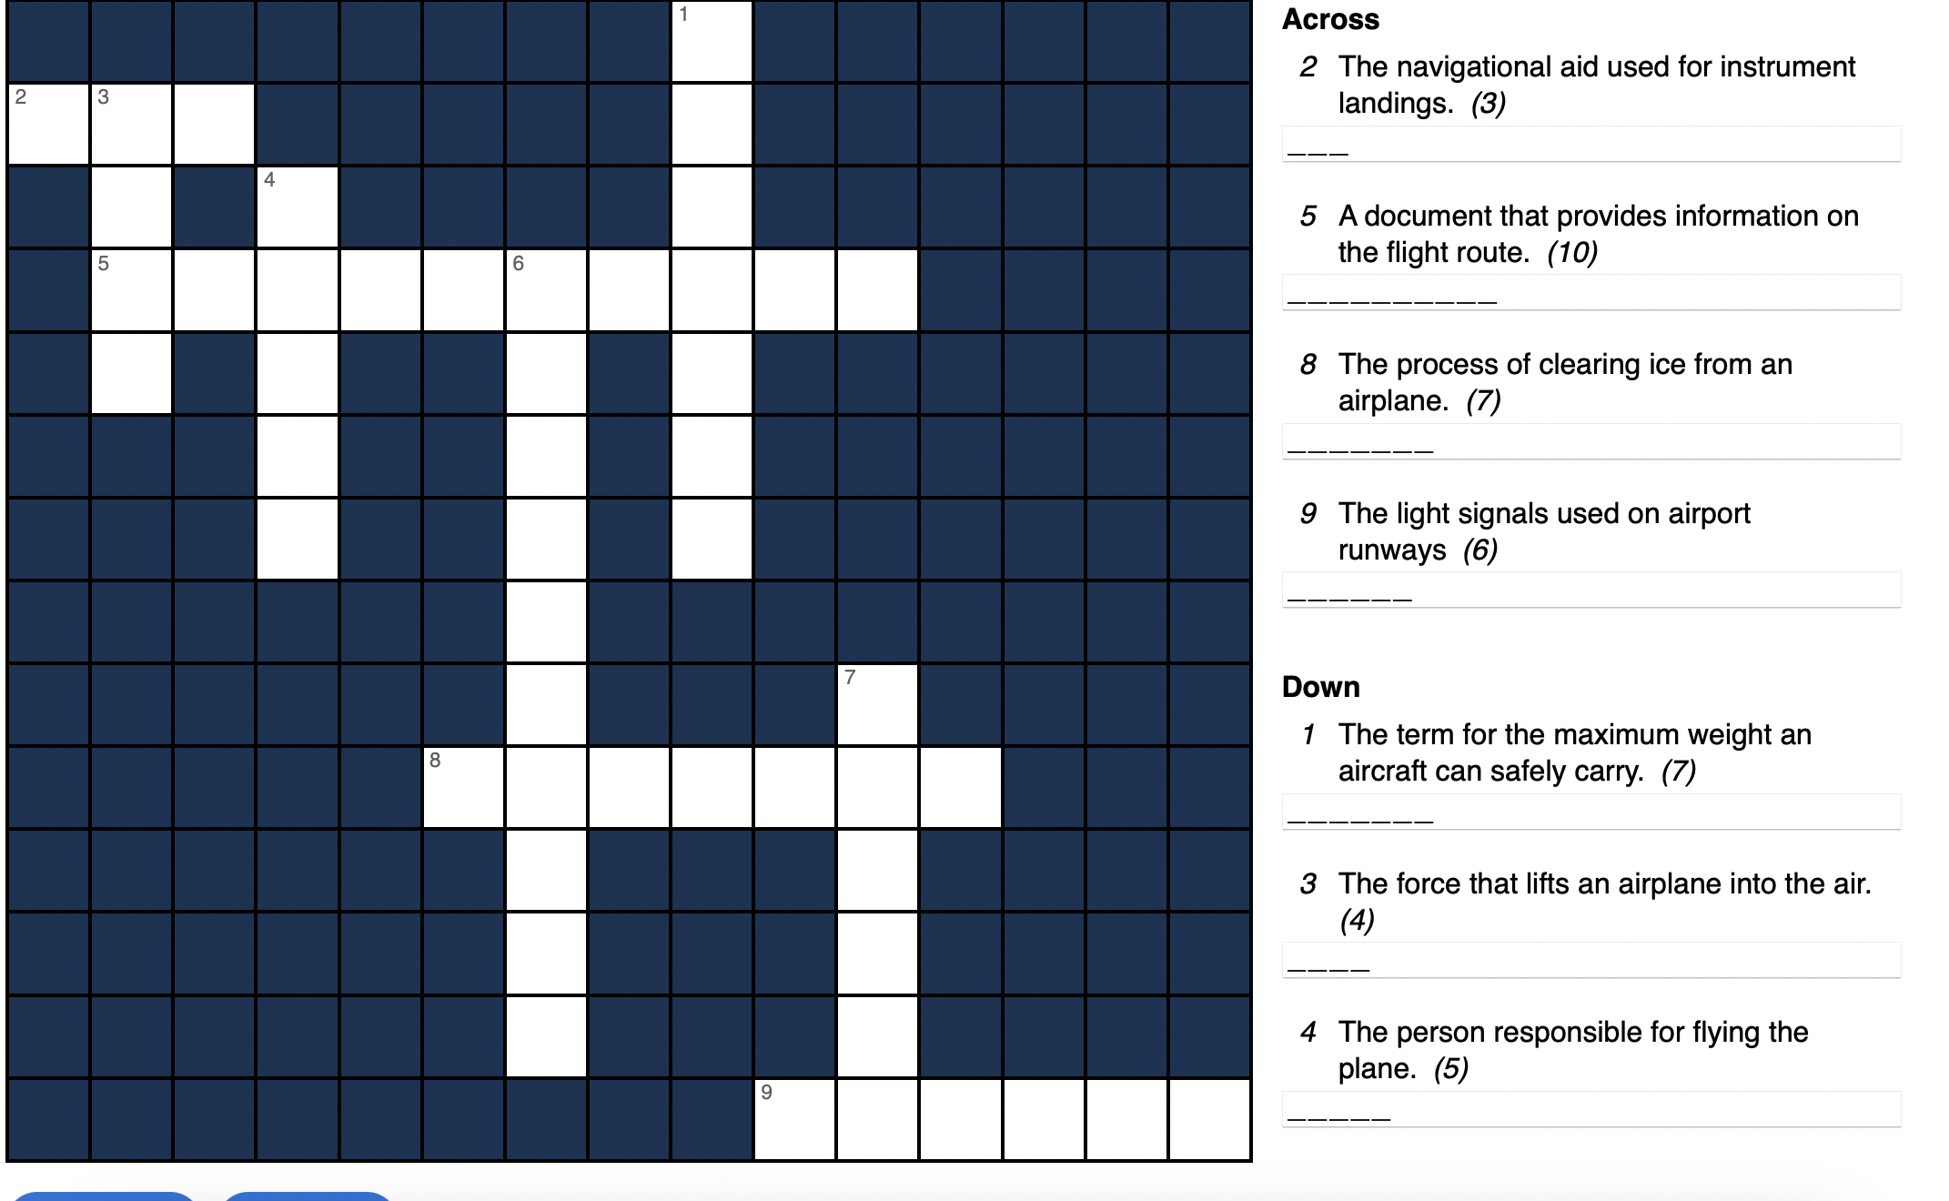
Aviation Crossword
This game aims to reinforce aviation-specific vocabulary.
The student must complete a crossword puzzle with aviation-related terms.

Slide 8
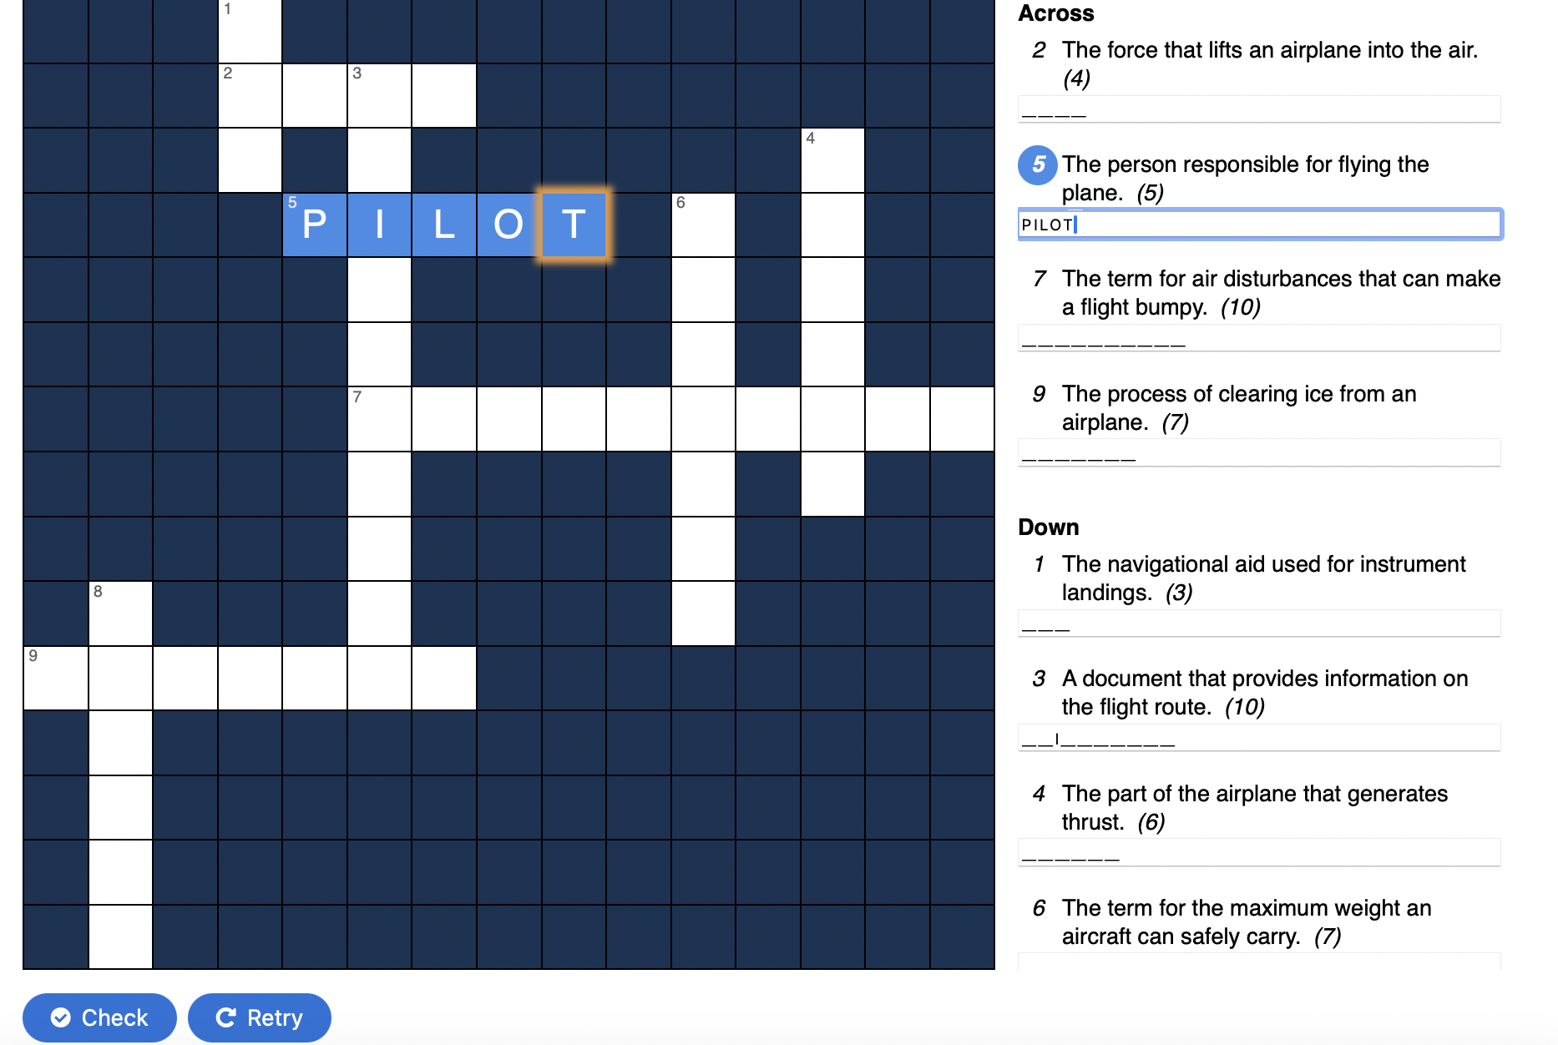
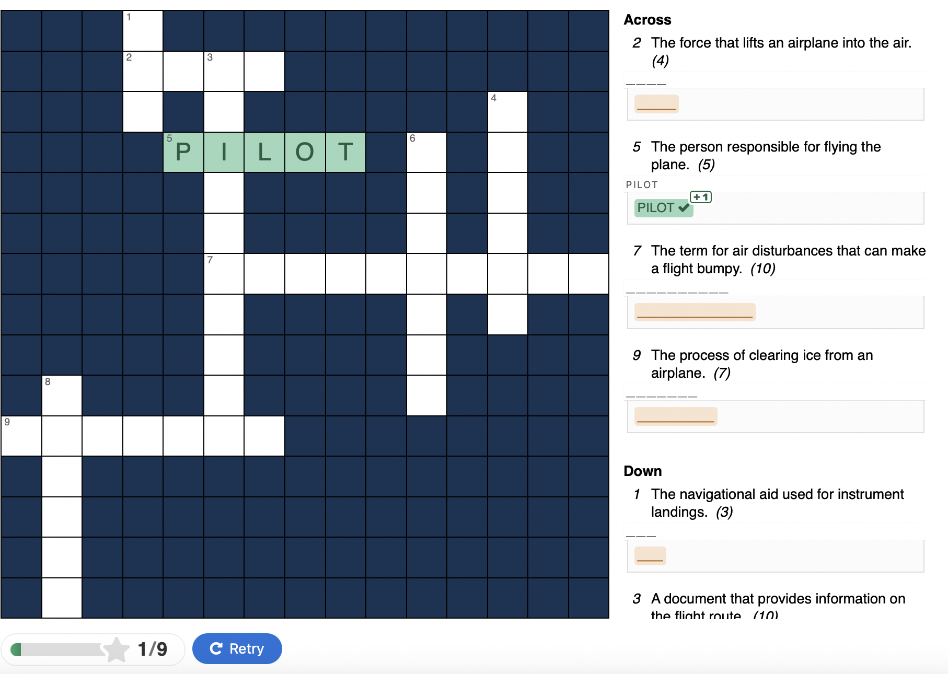
Similar rules to a classic Sudoku: each row, column and block must contain unique aviation symbols.
For every correct symbol placement,
the student receives feedback.
The game ends with a final score based
on accuracy and speed.

Slide 9
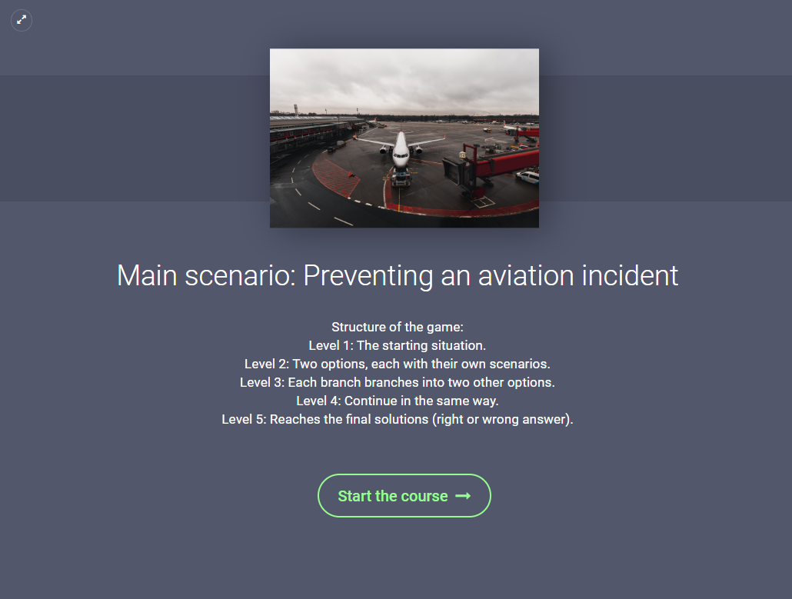
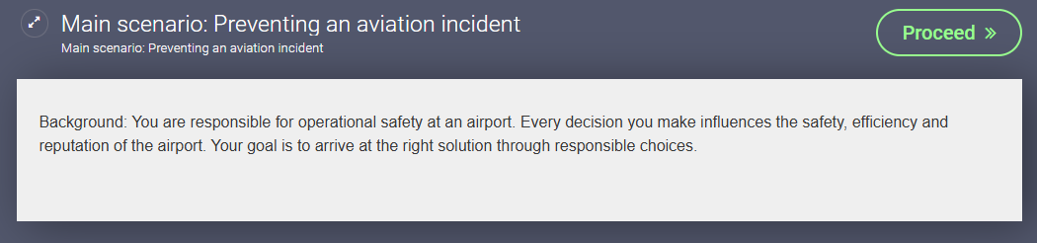
Bratching scenario Main Scenario: Preventing an Aviation Incident
Responsibility: You are responsible for the operational safety of the airport.
Objective: Make the right decisions to prevent aviation incidents.
Game Structure:
Level 1: Initial situation
Level 2-4: Decisions and scenarios branching
Level 5: Right or wrong outcome

Slide 10
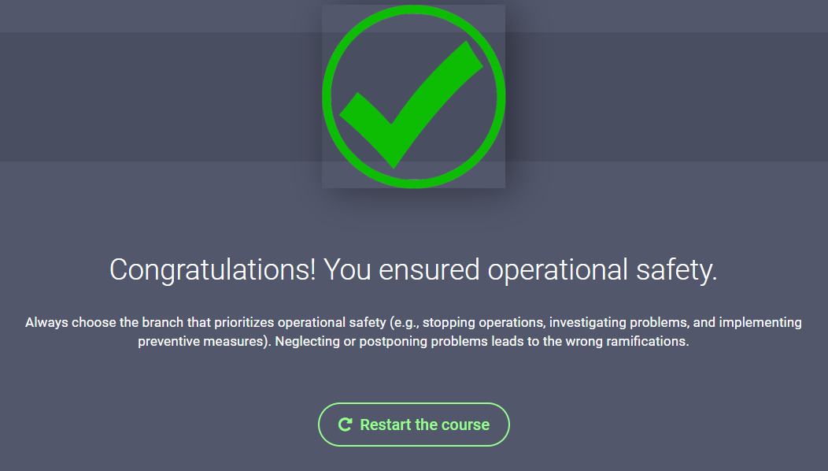
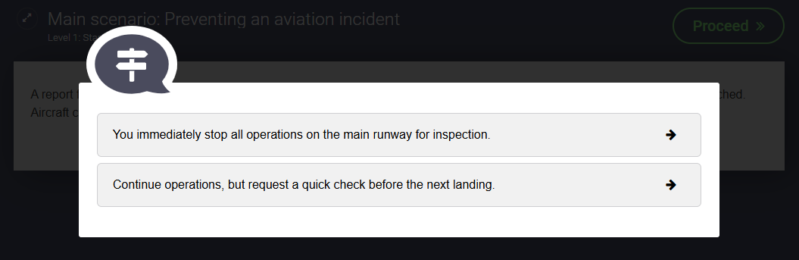

Decision-Making and Outcomes
Situation: Control tower reports an obstacle on the main runway. Aircraft continue to approach for landing.
Initial options:
Branching after the initial choice:
If you stop operations:
The problem is identified and remedied.
✔️ Result: You ensured operational safety.
If you continue operations:
The obstacle may cause an incident.
❌ Result: The problem persists and is getting worse.

Slide 11
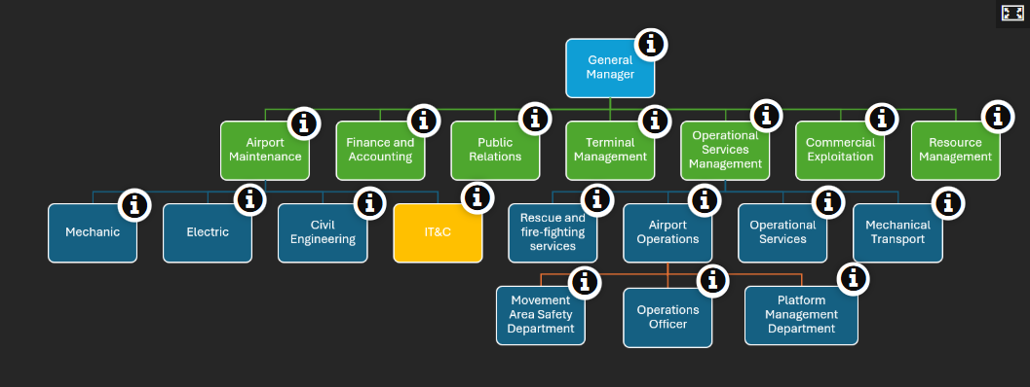
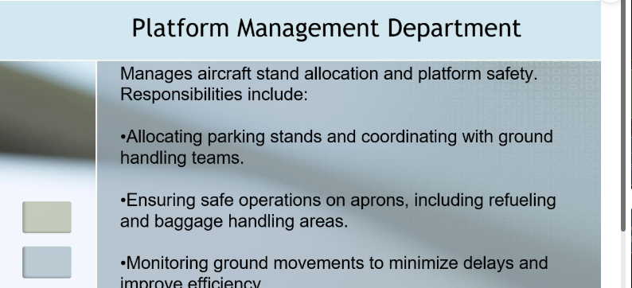
Organizational Chart Overview Organizational Structure – Operational Departments
This organizational chart visually outlines the operational departments and hierarchy. Interactive "i" icons offer details on each role. Exploring the chart helps users understand team organization and collaboration for the airport's efficient and safe operation.

Slide 12
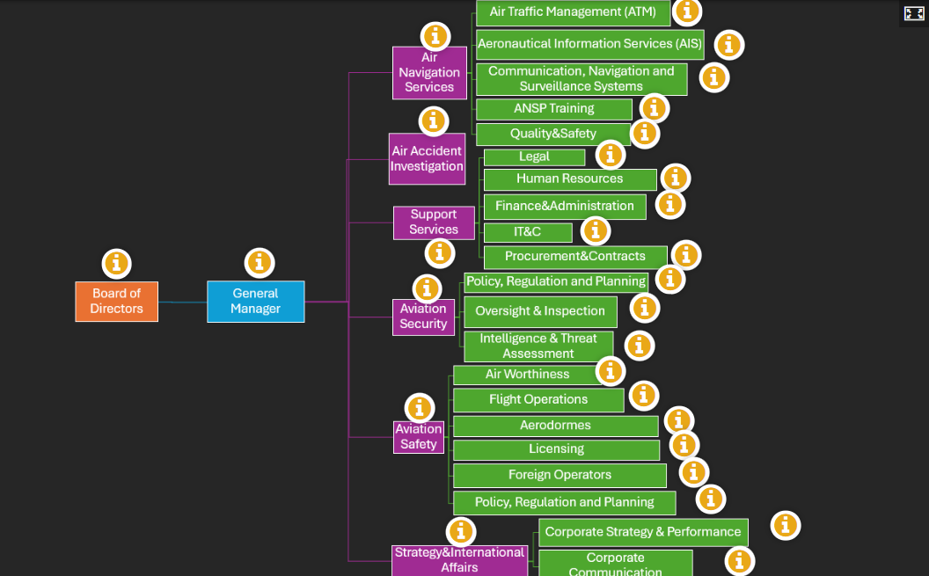
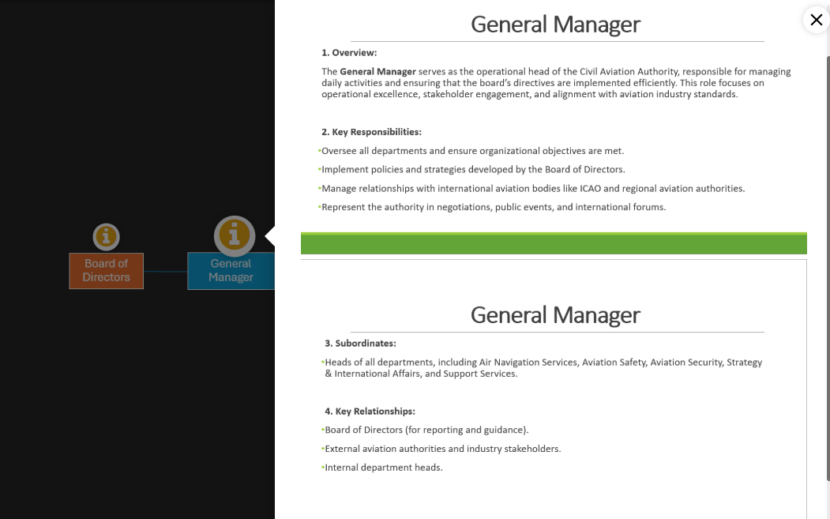
Organizational Structure – Regulatory and Support Divisions
This chart clearly presents the organization’s structure and hierarchy. Interactive "i" icons provide details about each department’s roles. Exploring the chart shows how teams work together for safe and efficient airport operations.

Slide 13
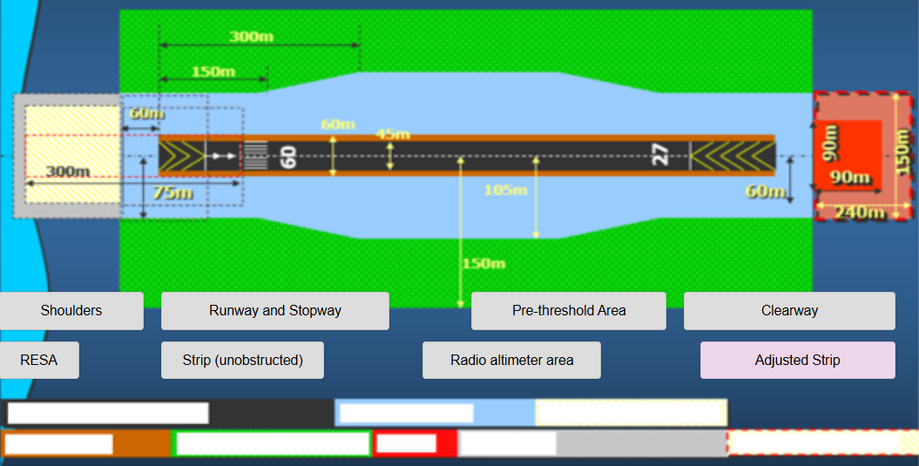
Drag & Drop – Runway Components Overview
This interactive Drag & Drop activity helps to correctly identify the components of a runway.
Each label must be placed correctly on the runway diagram.

Slide 14
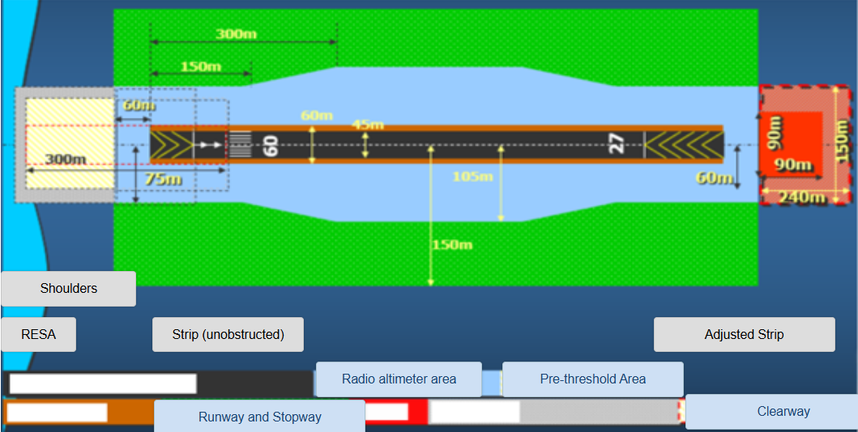
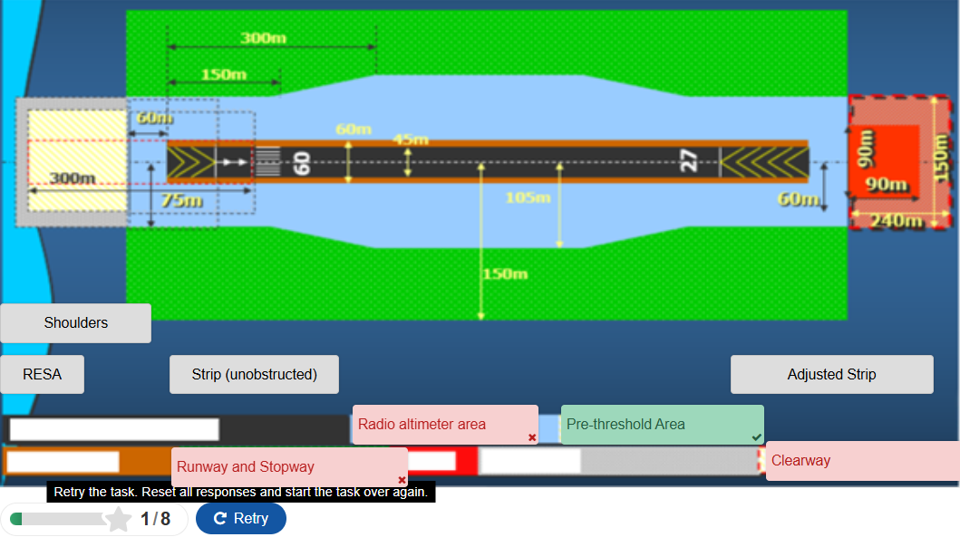
Drag & Drop - Feedback and Correction
After label placement, the system provides visual feedback:
Green: Correct answer.
Red: Incorrect answer, requires correction.
You can use the Retry button to redo the exercise.
This activity supports hands-on learning and error correction.

