Slide 1
Student Evaluation Tools
Enhancing Learning through Interactive Quizzes in Aviation Training
Tudor-Costel BULGARU, Eng. UNESCO Chair Engineering for Society
January 21, 2025
Notes:
Hello everyone. My name is Tudor Bulgaru, and today, I’ll present Student Evaluation Tools. Specifically, I’ll discuss how we designed and implemented interactive quizzes for the AVIONIC Learn platform. Quizzes are essential in modern education—they don’t just test knowledge but also reinforce learning and provide valuable insights for both students and teachers.

Slide 2
Agenda
01 | | | Introduction
02 | | | How Quizzes Are Created
03 | | | Benefits of Quizzes for Students
04 | | | Benefits of Quizzes for Teachers
05 | | | Types of Questions
06 | | | Conclusions
Notes:
Over the next 10–15 minutes, I’ll take you through the creation process, goals, the benefits of these tools and the types of questions used in the quizzes.

Slide 3

Introduction
AVIONIC Learn platform specializes in aviation courses, offering comprehensive learning resources for students.
To enhance learning outcomes, each lesson includes a tailored quiz designed to reinforce and assess knowledge.
The primary goals of these quizzes are:
To evaluate students' progress in real-time.
To create a dynamic, interactive, and engaging educational experience.
To support continuous learning by aligning with the objectives of each course module.
Notes:
The AVIONIC Learn platform is dedicated to provide high-quality aviation courses. To ensure effective learning, we’ve created a tailored quiz for each lesson in every course.
These quizzes serve three primary goals:
first, to evaluate students' progress in real-time;
second, to create a dynamic and engaging learning experience;
and third, to align assessments with the objectives of each course.
By doing so, we’re not just testing knowledge—we’re actively reinforcing it. This approach ensures that students can build on a strong foundation as they advance through their learning process.
Think of these quizzes as the co-pilot for your brain—they’re here to keep you on course.

Slide 4
How to Create Quizzes in AVIONIC Learn platform
Define Learning Objectives
Choose Question Formats
Utilize Quiz Design Tools
Focus on Accessibility and Usability
Pilot and Refine
Integrate into the Course
Notes:
Creating a quiz begins with defining clear objectives. What should students learn, and how can we measure that effectively?
Once objectives are set, we choose question types that best suit the content.
Using specialized tools, we ensure quizzes are clear, accessible, and visually engaging.
Each quiz undergoes testing before being implemented, ensuring quality and alignment with learning outcomes.
This systematic approach ensures that the quizzes meet both educational and technical standards.

Slide 5
Benefits of Quizzes for Students
Reinforce knowledge through immediate testing
Instant feedback to improve performance
Increased engagement through interactivity
Critical thinking development
Notes:
For students, quizzes offer significant benefits.
They reinforce key concepts by encouraging immediate review and application of knowledge. This helps students retain information more effectively over time.
Quizzes also provide instant feedback, which allows students to identify and address their weaknesses right away.
Interactive question formats—such as drag-and-drop—make learning more engaging, while open-ended questions help develop critical thinking and communication skills.
Ultimately, these quizzes empower students to take an active role in their learning journey.

Slide 6
Benefits of Quizzes for Teachers
Monitor students' progress through reports.
Save time with automated grading.
Adjust lessons based on quiz results.
Encouraging students' active engagement.
Notes:
For teachers, quizzes simplify the assessment process.
Automated grading saves time, allowing teachers to focus on refining their teaching strategies.
Performance analytics highlight areas where students excel or struggle, providing actionable insights.
Additionally, interactive quizzes foster greater student engagement, making lessons more dynamic and impactful.
So, in conclusion, with quizzes, everyone wins—except maybe the students who didn’t study.

Slide 7
Types of Questions -Overview-
Using a variety of question types ensures a thorough and engaging assessment process.
Each type is carefully chosen to match the specific learning objectives of the lesson.
A balanced mix of question types helps to:
Address different learning styles.
Test both foundational knowledge and higher-order thinking skills.
Keep students engaged with interactive and diverse activities.
Notes:
To evaluate different skills and knowledge, we use a variety of question types.
These range from simple formats like true/false questions to more complex ones like drag-and-drop and open-ended responses.
Each type is chosen based on the skills being tested.
In the next slides, I’ll explain how each question type works and where it’s most effective.

Slide 8
Types of questions used in the quizzes
Single Choice Question
Multiple Choice Questions
Fill in the Blanks
Drag and Drop Questions
True/False Questions
Open-Ended Questions
Matching Questions

Slide 9
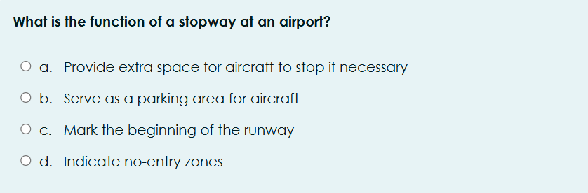
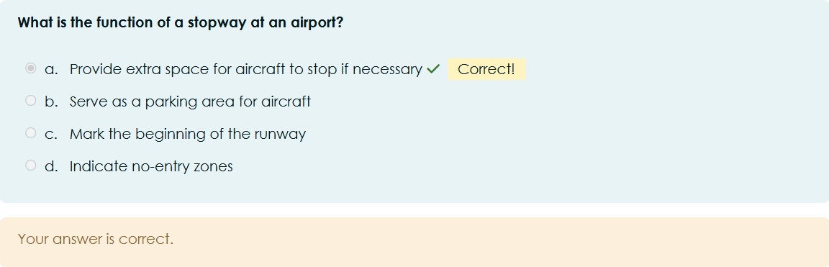
Types of questions used in the quizzes
Single Choice Question
Multiple Choice Questions
Fill in the Blanks
Drag and Drop Questions
True/False Questions
Open-Ended Questions
Matching Questions
Notes:
Single-choice questions are ideal for testing foundational knowledge.
Students are presented with a question and must select the single correct answer from multiple options.
These questions are straightforward and efficient for both students and teachers.
They are particularly useful for assessing basic concepts and facts.

Slide 10
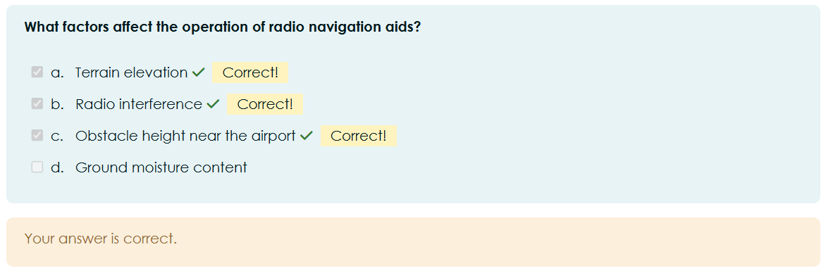
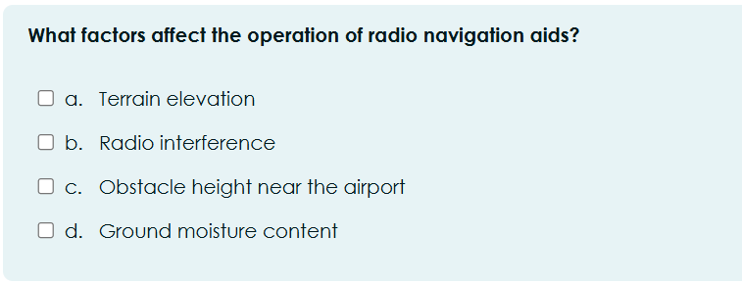
Types of questions used in the quizzes
Single Choice Question
Multiple Choice Questions
Fill in the Blanks
Drag and Drop Questions
True/False Questions
Open-Ended Questions
Matching Questions
Notes:
Multiple-choice questions require students to analyze a question and select all applicable answers.
This type of question encourages critical thinking, as students must carefully evaluate each option.
Multiple-choice questions are especially useful for assessing topics with multiple layers or perspectives.

Slide 11
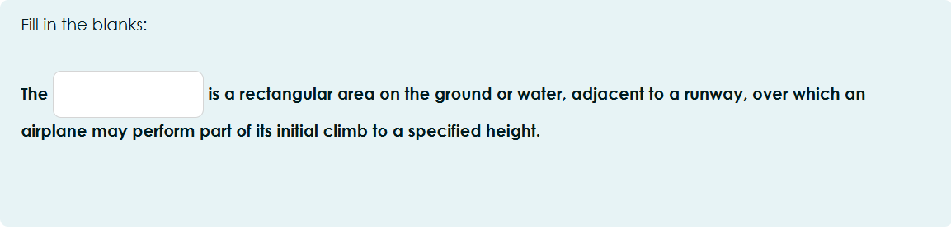
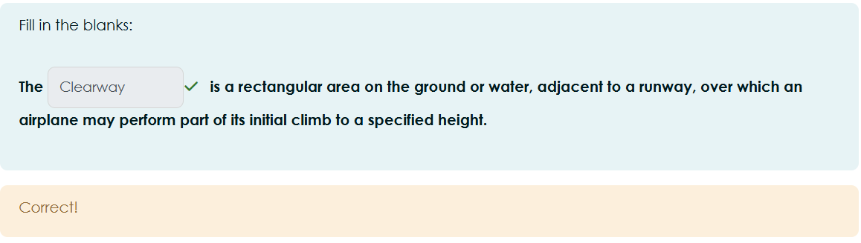
Types of questions used in the quizzes
Single Choice Question
Multiple Choice Questions
Fill in the Blanks
Drag and Drop Questions
True/False Questions
Open-Ended Questions
Matching Questions
Notes:
Fill-in-the-blank questions test memory and attention to detail.
These questions are excellent for reinforcing specific facts and terminology.
They also encourage active recall, which is critical for long-term retention.
Nevertheless, these questions are great because there’s no guessing—you either know it, or you don’t.

Slide 12
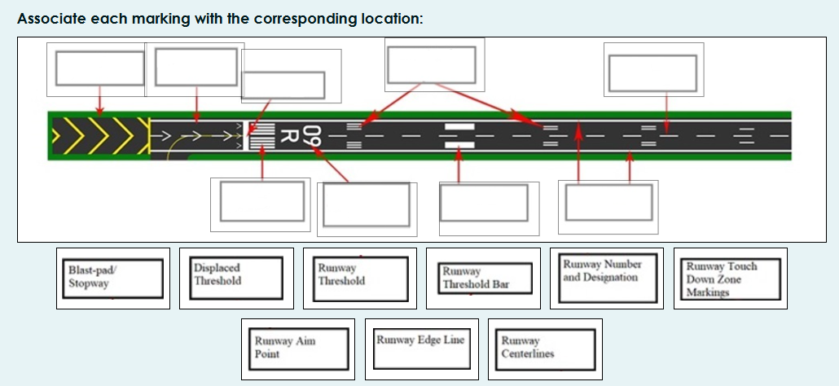
Types of questions used in the quizzes
Single Choice Question
Multiple Choice Questions
Fill in the Blanks
Drag and Drop Questions
True/False Questions
Open-Ended Questions
Matching Questions
Notes:
Drag-and-drop questions are highly interactive.
They require students to arrange items in a specific sequence or match them to corresponding categories.
These questions are particularly effective for assessing practical knowledge and logical thinking.
They also make learning more engaging by involving hands-on interaction.

Slide 13
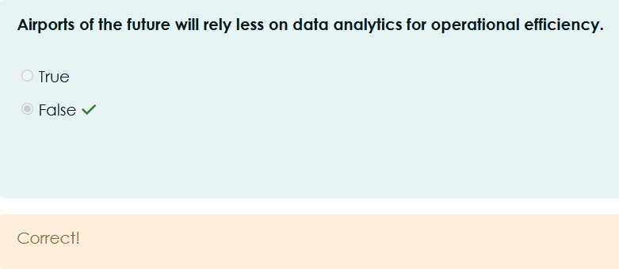

Types of questions used in the quizzes
Single Choice Question
Multiple Choice Questions
Fill in the Blanks
Drag and Drop Questions
True/False Questions
Open-Ended Questions
Matching Questions
Notes:
True/False questions are simple and quick to complete.
They are designed to evaluate a student’s understanding of basic facts or concepts.
These questions are ideal for reviews and are easy to grade, especially in large-scale assessments.

Slide 14
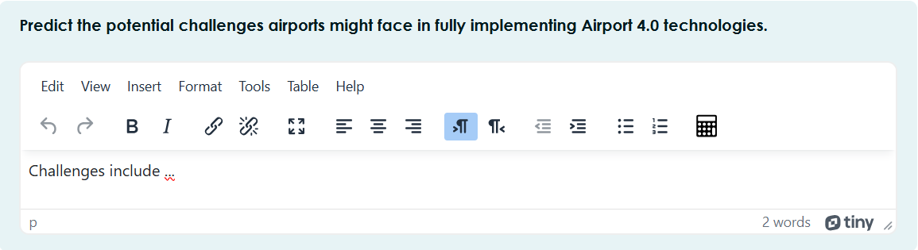
Types of questions used in the quizzes
Single Choice Question
Multiple Choice Questions
Fill in the Blanks
Drag and Drop Questions
True/False Questions
Open-Ended Questions
Matching Questions
Notes:
Open-ended questions challenge students to articulate their understanding in their own words.
This type of question develops critical thinking, problem-solving, and communication skills.
It’s particularly useful for assessing complex or subjective topics, as it allows students to apply the information gained in the course in real life scenarios.
Sure, they’re a bit more challenging to grade, but the insights they provide are extremely valuable.

Slide 15
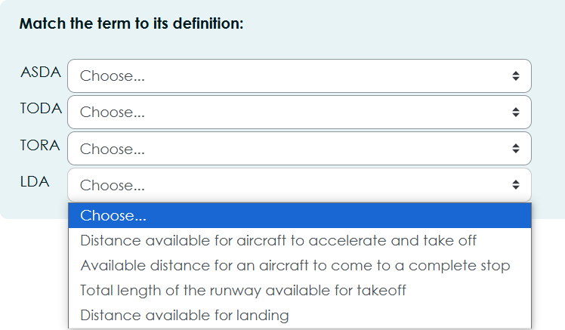
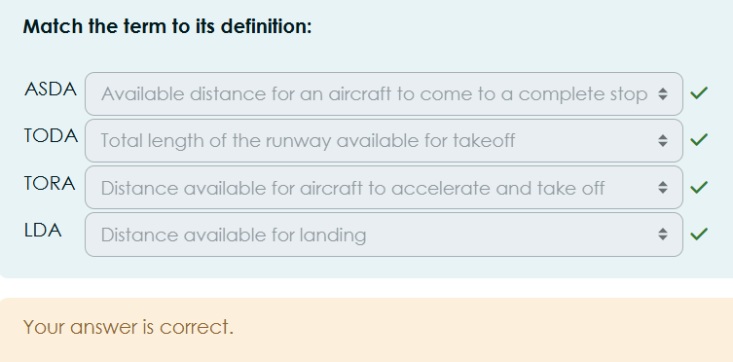
Types of questions used in the quizzes
Single Choice Question
Multiple Choice Questions
Fill in the Blanks
Drag and Drop Questions
True/False Questions
Open-Ended Questions
Matching Questions
Notes:
Matching questions test a student’s ability to pair related concepts.
This format is both interactive and effective for reinforcing relationships between terms or ideas.
Matching questions are especially useful for topics that involve terminology or paired processes.

Slide 16
Conclusions
Quizzes as learning tools
Increased Engagement and motivation for students
Personalized education
Teacher Efficiency
Alignment with modern education
Notes:
In conclusion, quizzes are a vital tool in modern education.
They reinforce learning for students, provide valuable feedback for teachers, and make the learning experience more dynamic and engaging.
By incorporating interactive and diverse question types, we ensure that our assessments are both effective and enjoyable.
As online learning continues to grow, quizzes will play a vital role in creating high-quality and impactful education.
Thank you for your attention, and don’t worry, there’s no quiz at the end of this presentation!

