Slide 1
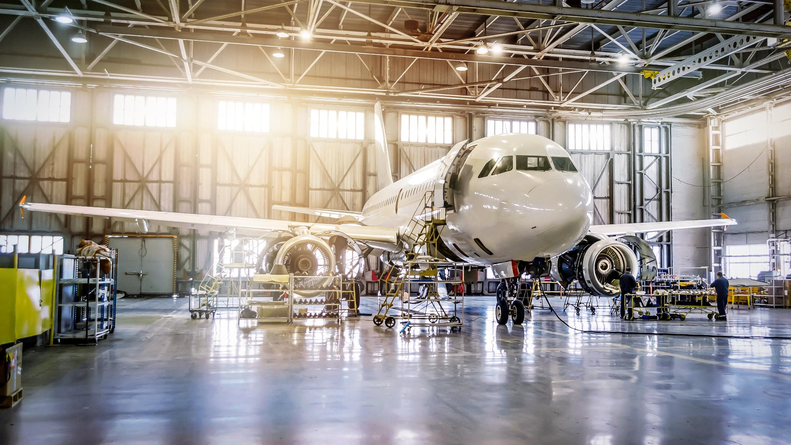
AVIONIC Learn Platform
Future-Proofing Aviation Education: Innovative Curriculum and Digital Tools
Ana Simona PRICA, UNESCO Chair Engineering for Society - AVIONIC Researcher
Daniel CRUCEANU, UNESCO Chair Engineering for Society - AVIONIC Researcher

Slide 2
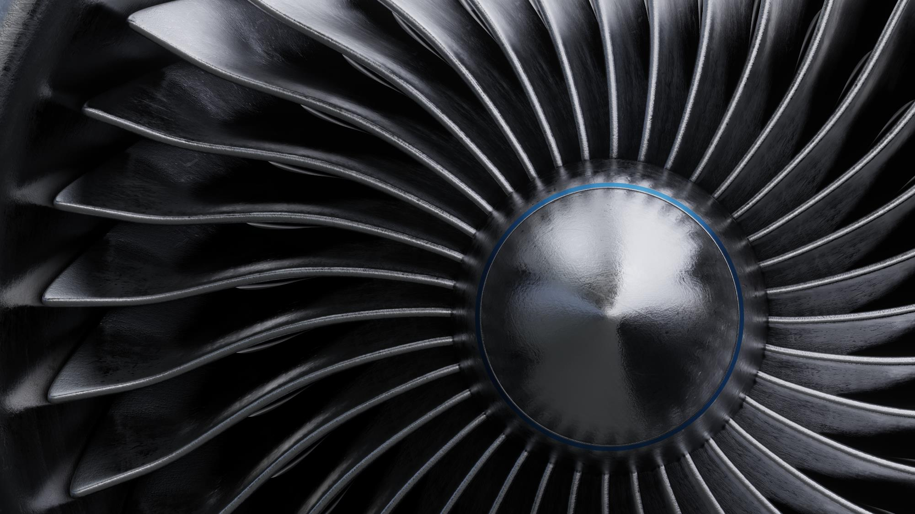
AVIONIC LEARN
ONE STOP SHOP APPROACH
GREEN AIR TRANSPORT AND LOGISTICS

Slide 3
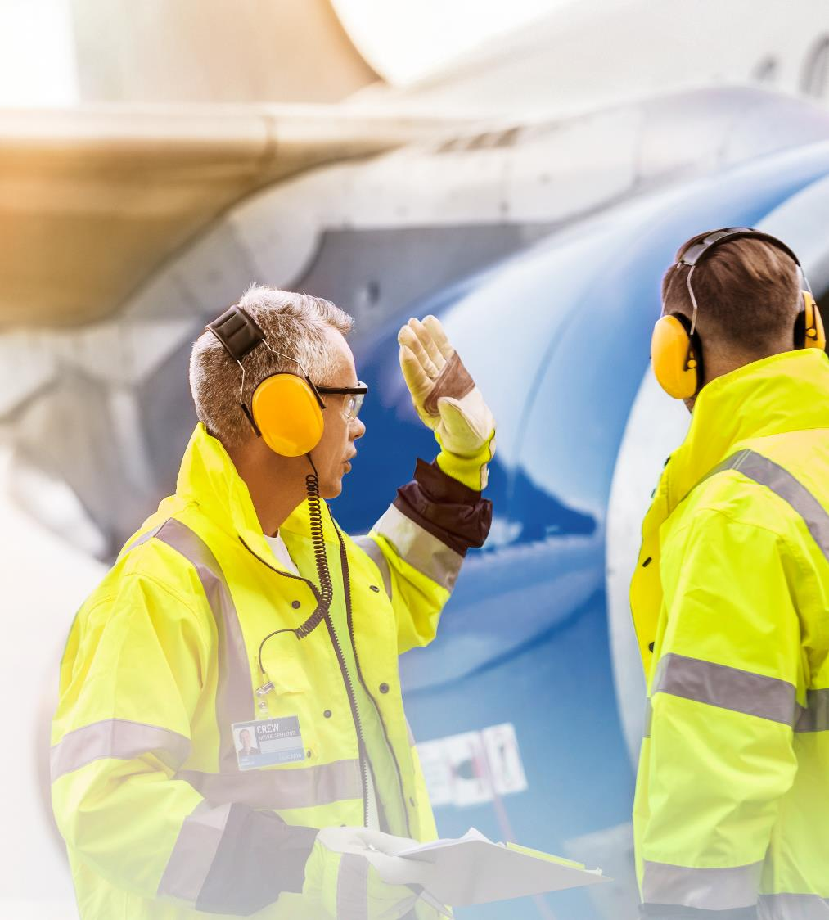
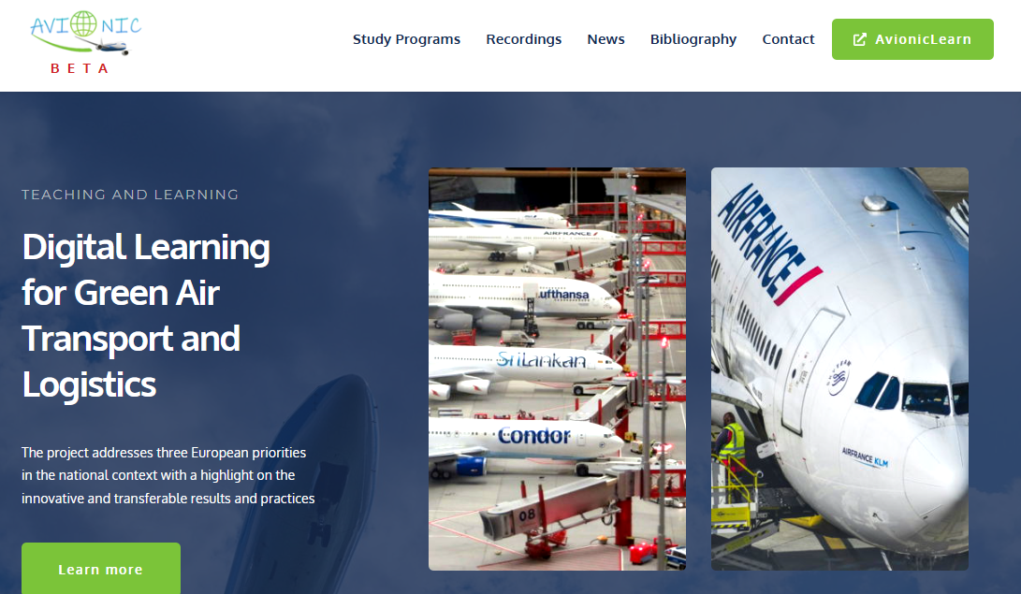
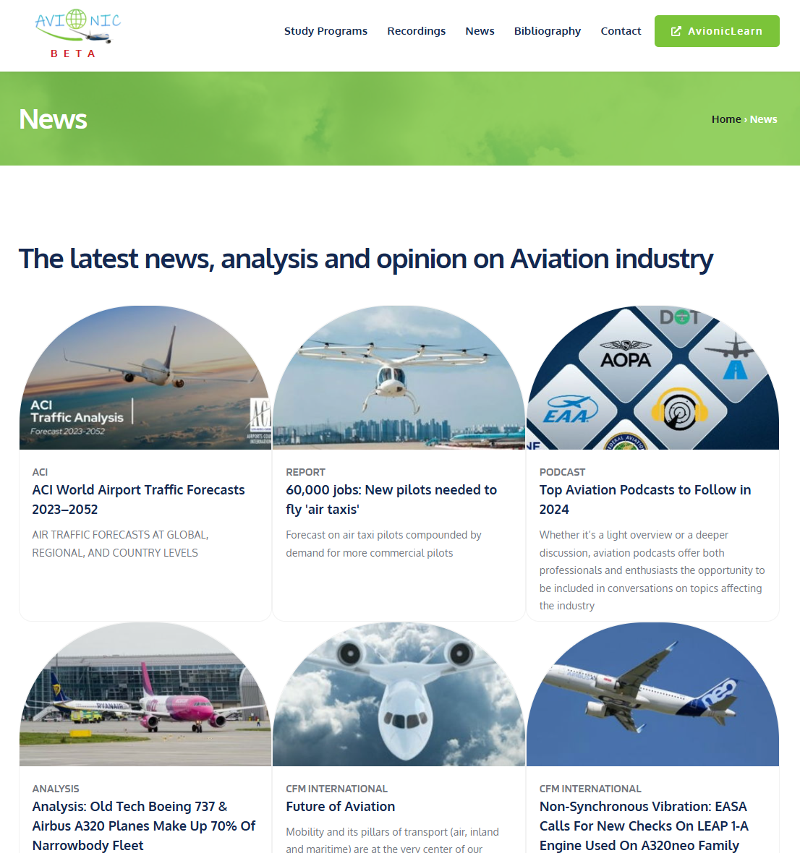
AVIONIC Learn
Landing Page
Access to latest global, regional, national NEWS on topic always available for:
  Professionals
  Students
  Industry
  Academia
Open
Educational Resources
Copyright © 2025, AVIONIC - Digital Learning for Green Air Transport and Logistics

Slide 4

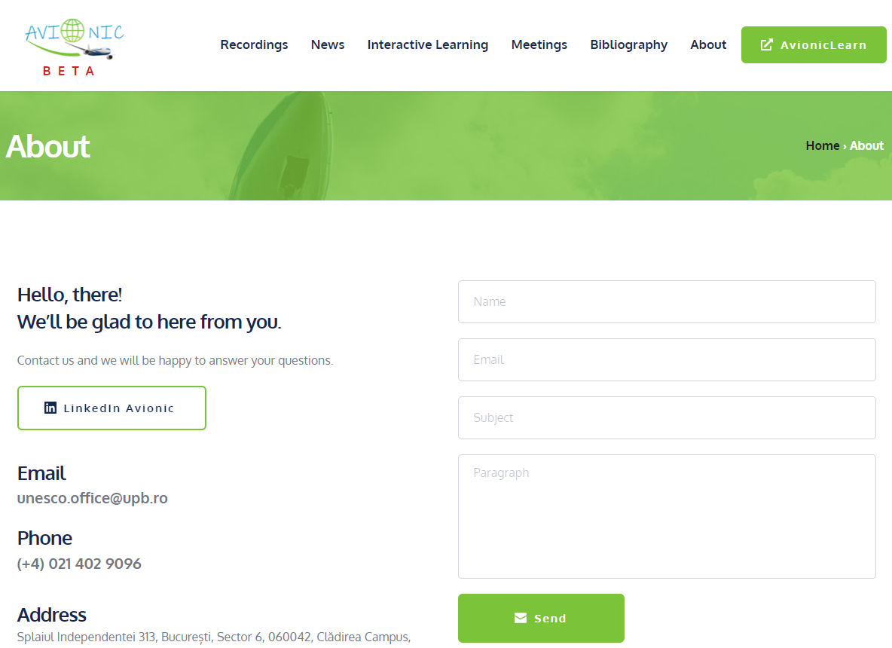
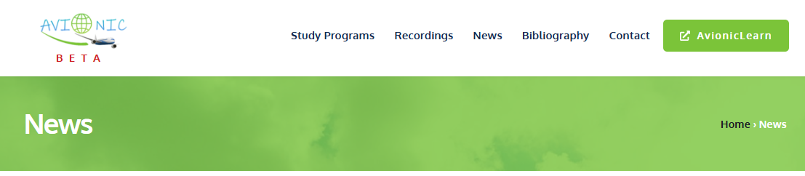
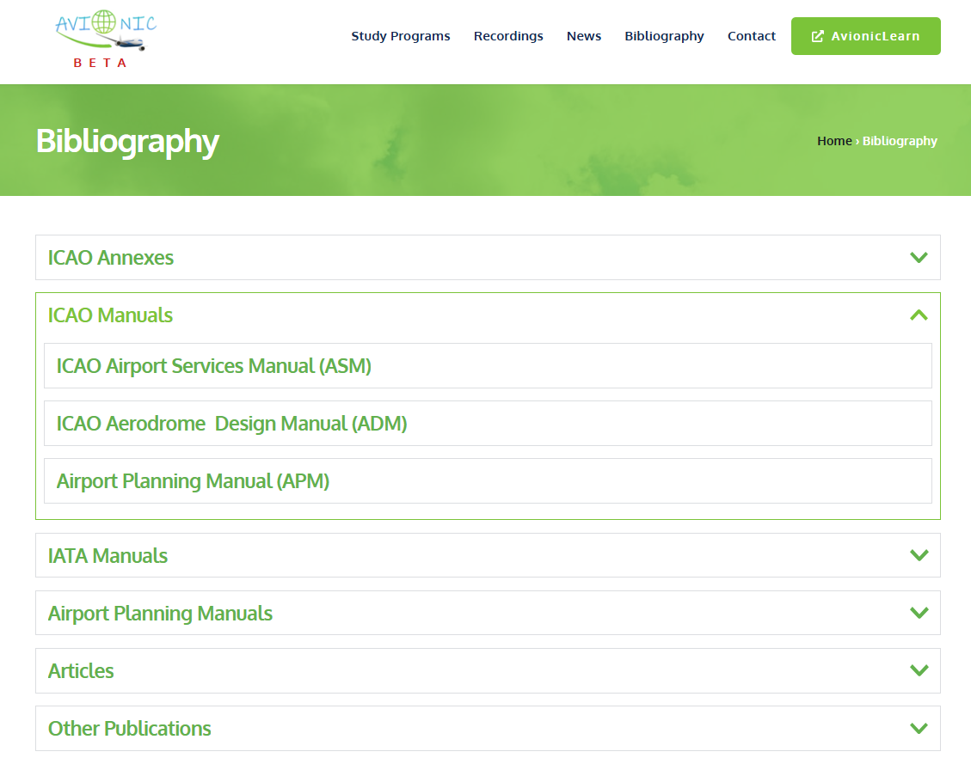
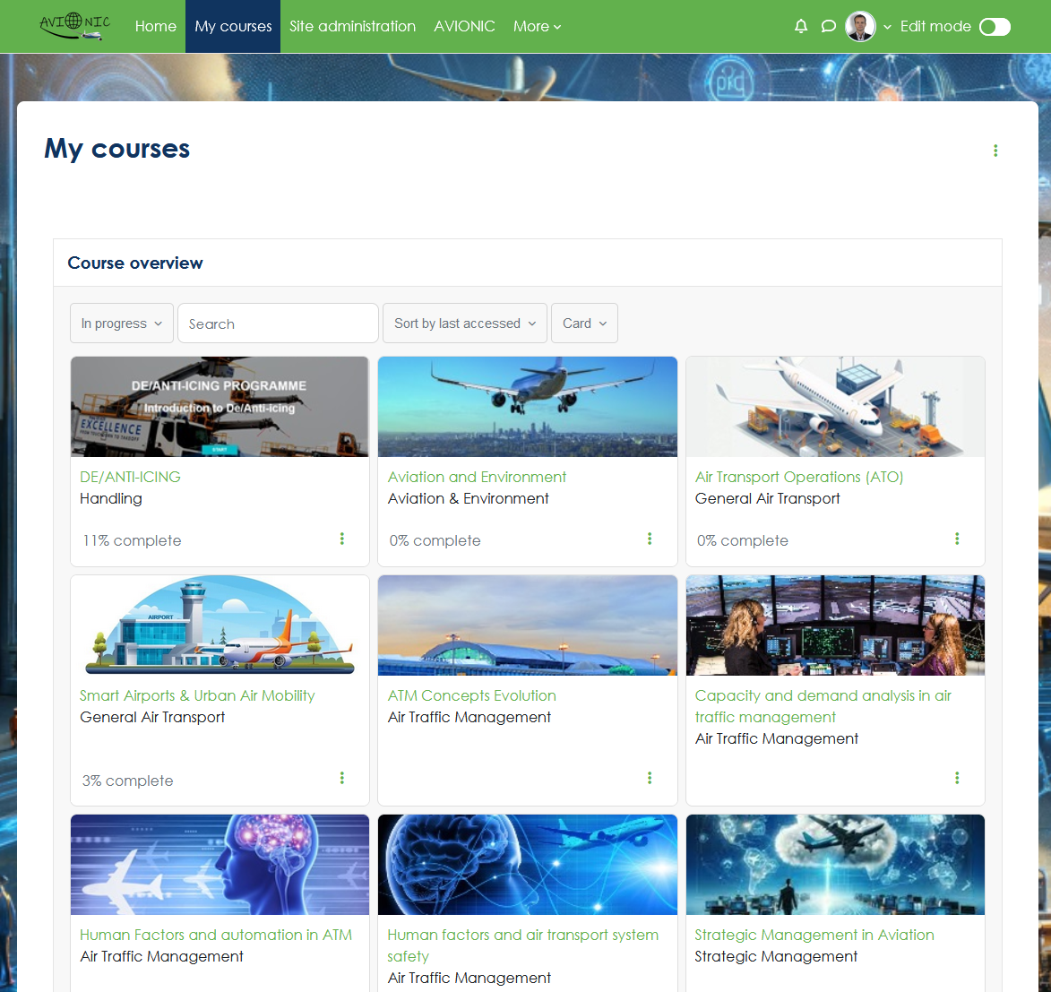
Copyright © 2025, AVIONIC - Digital Learning for Green Air Transport and Logistics

Slide 5
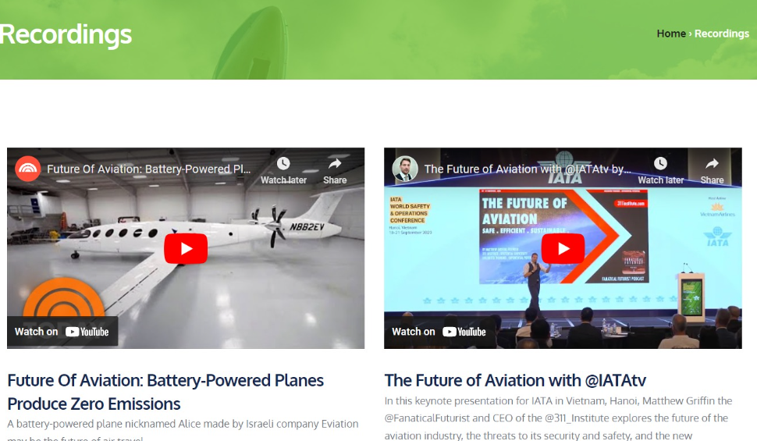
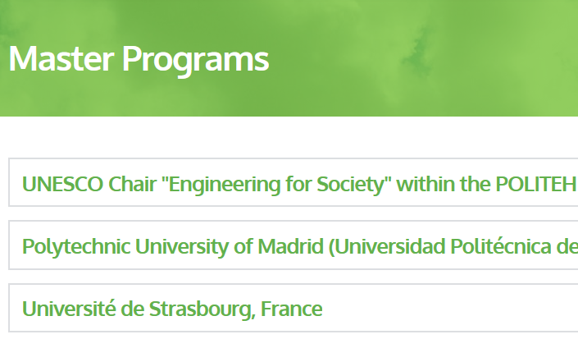
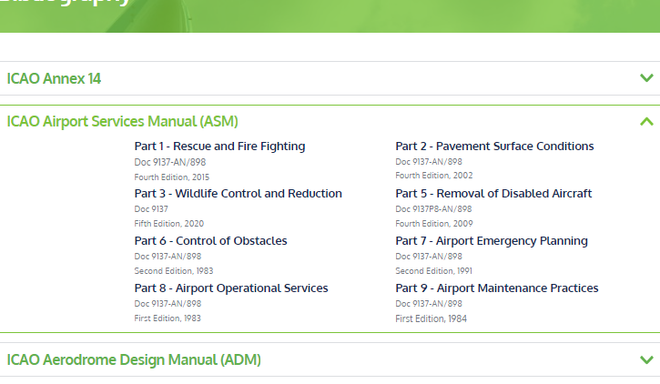
AVIONIC Learn landing page
Recordings
Master programs
Bibliography
Access to latest global, regional, national recordings, available for different levels of experience:
  Professionals
  Students
  Industry
  Academia

Slide 6
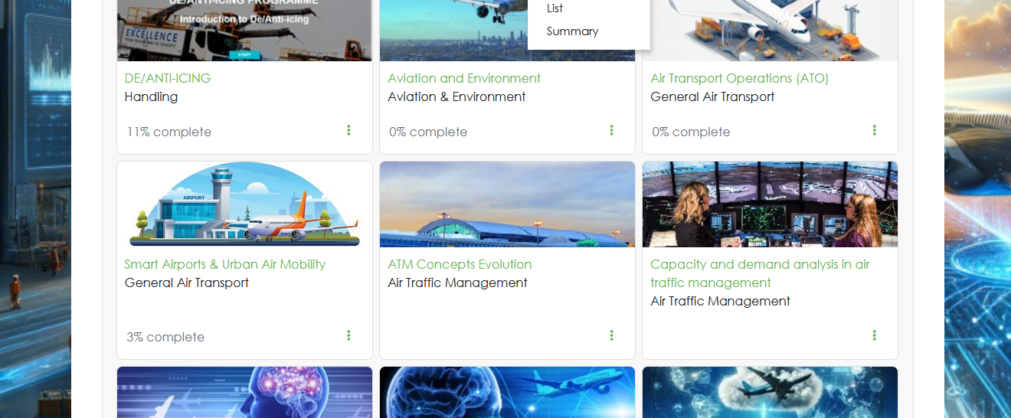
My learning journey
My courses
Copyright © 2025, AVIONIC - Digital Learning for Green Air Transport and Logistics

Slide 7
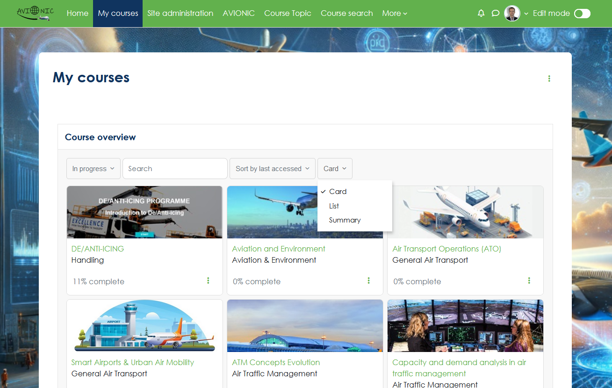
AVIONIC Learn- My courses
Courses overview from multiple stakeholders, multidisciplinary approach, one unified educational journey
Multiple display, search options, progress completion rate, save for later, forum with peers, discussion corner, badges upon completion
Copyright © 2025, AVIONIC - Digital Learning for Green Air Transport and Logistics

Slide 8
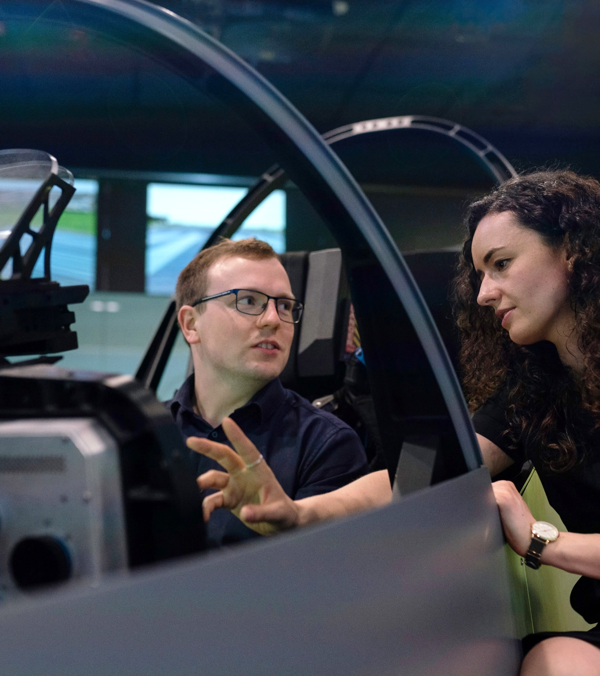
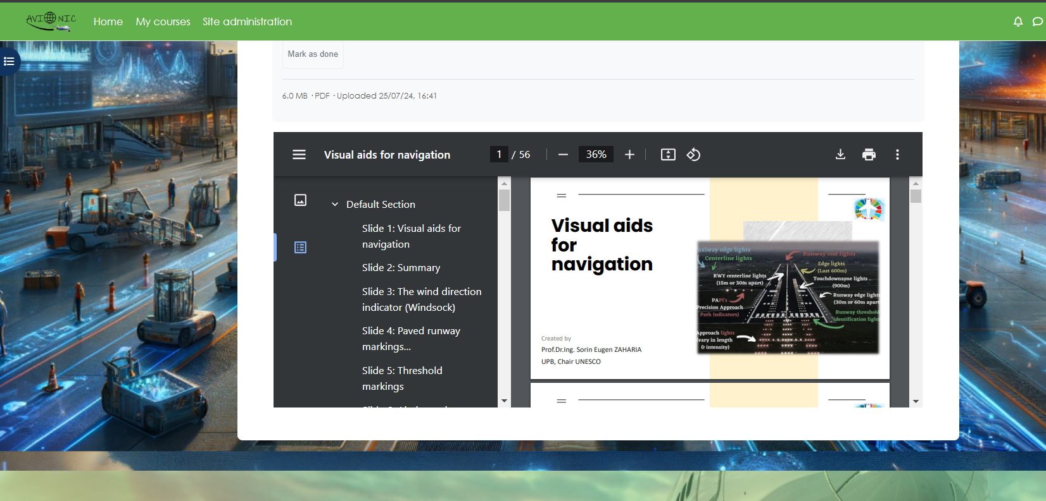
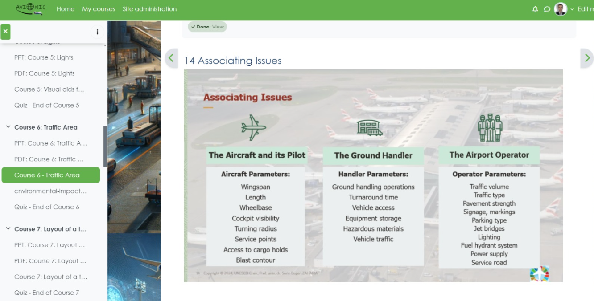
Curriculum design
Project branding
Intuitive navigation of the learning path
Copyright © 2025, AVIONIC - Digital Learning for Green Air Transport and Logistics

Slide 9
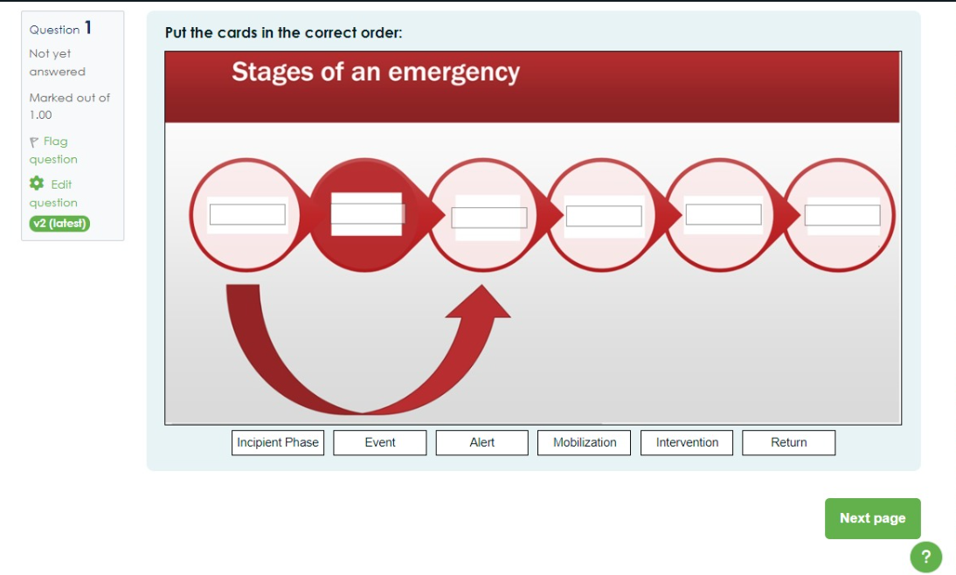
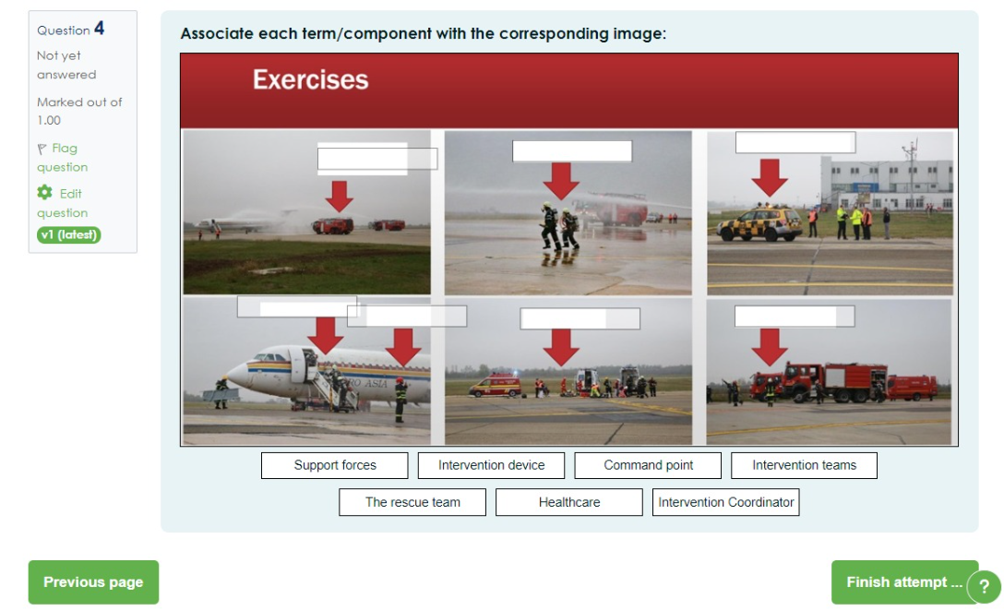
The AVIONIC project seeks to prepare future aviation professionals for a sustainable future by integrating gamified learning experiences into a comprehensive curriculum.
By integrating gamified learning experiences and engaging approach to learning, the project aims to equip learners with the digital and green skills necessary to navigate the complexities of the modern aviation industry
Copyright © 2025, AVIONIC - Digital Learning for Green Air Transport and Logistics

Slide 10
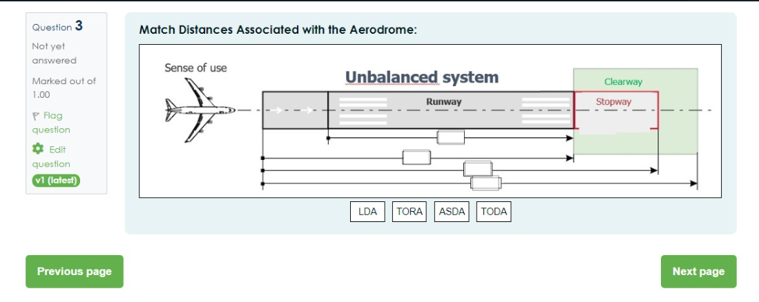
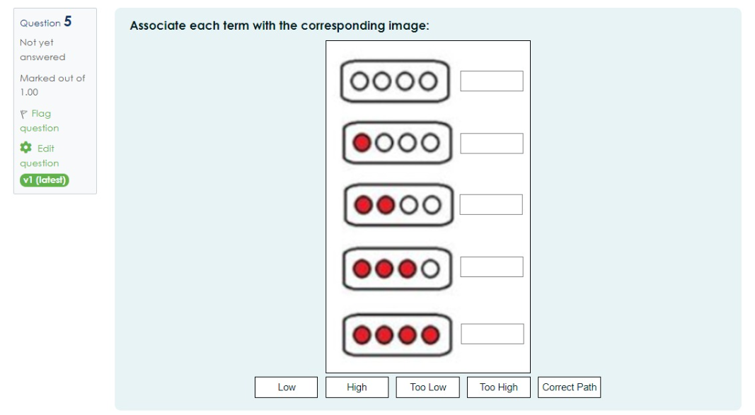
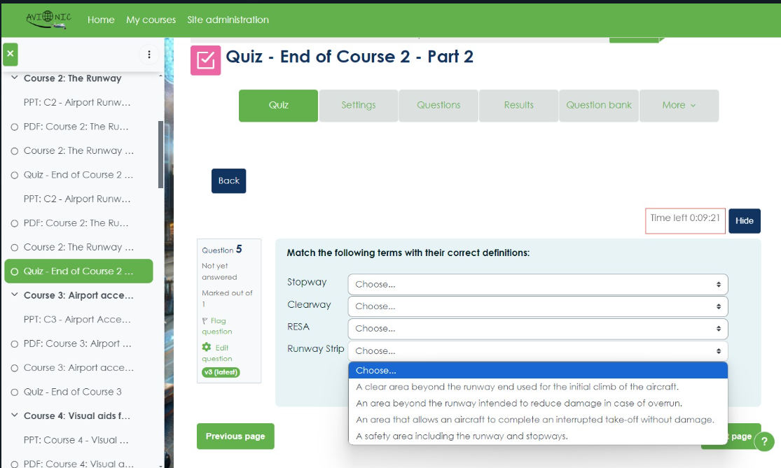
AVIONIC Learn- My courses, gamified learning
Copyright © 2025, AVIONIC - Digital Learning for Green Air Transport and Logistics
10

Slide 11
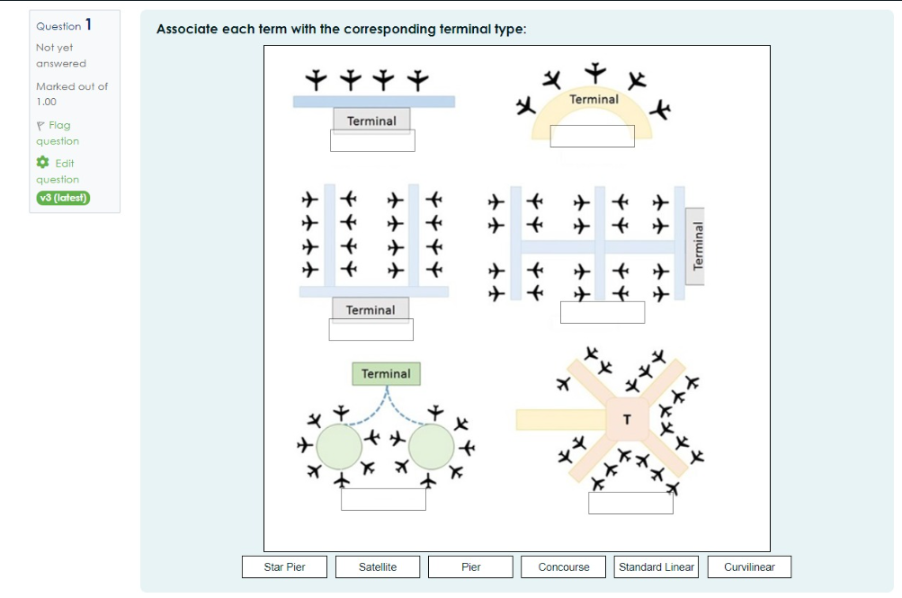
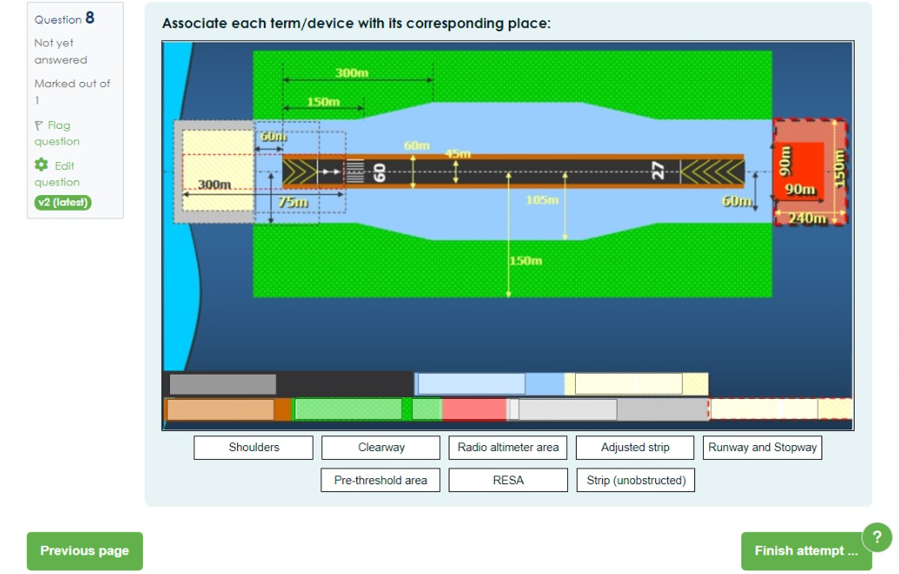
AVIONIC Learn- My courses, gamified learning
Copyright © 2025, AVIONIC - Digital Learning for Green Air Transport and Logistics
11

Slide 12
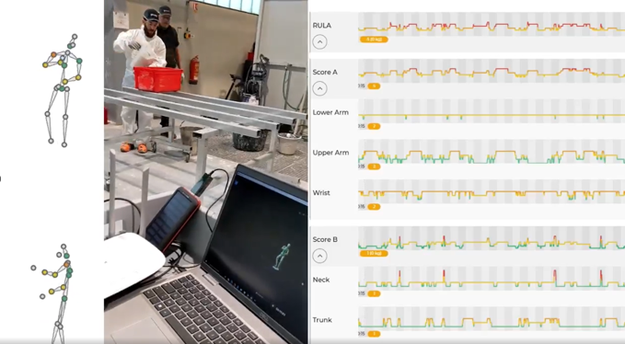
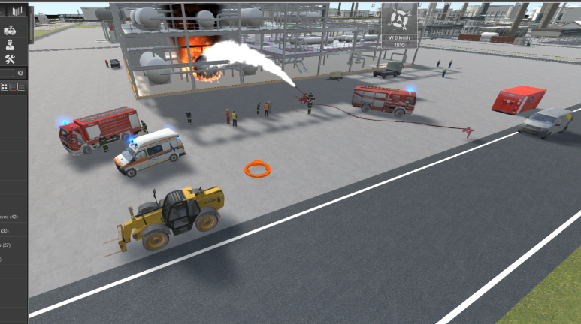
VR education, “Hands-on” learning scenarios
Immersive Learning Experience
Enhanced Knowledge Retention
VR training can be significantly more cost-effective than traditional methods, especially for industries that require specialized training or expensive equipment
Interactive Assessments
VR-based assessments offer real-time feedback and allow learners to practice skills repeatedly in a safe environment.
Copyright © 2025, AVIONIC - Digital Learning for Green Air Transport and Logistics

Slide 13

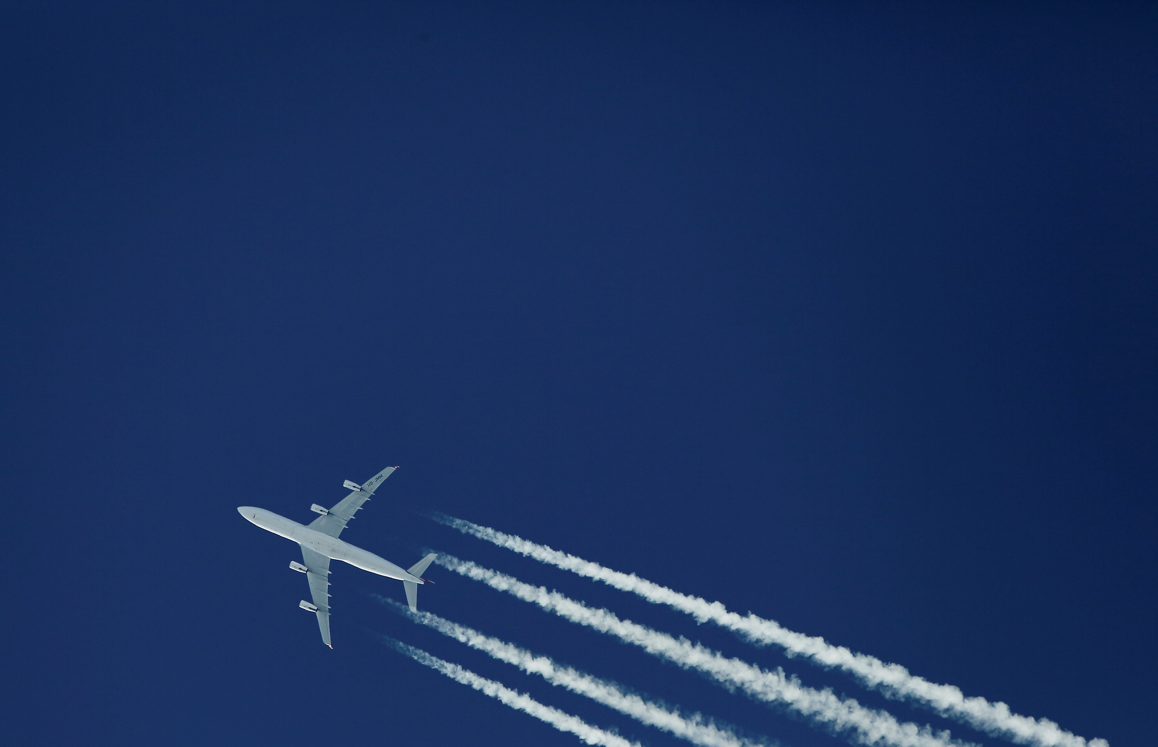

As we prepare to land from the AVIONIC learning journey, let us take a moment to appreciate the smooth flight we have experienced, navigating complex subjects and learning anew.
Thank you for joining us on this journey.
Copyright © 2025, AVIONIC - Digital Learning for Green Air Transport and Logistics

