Slide 1

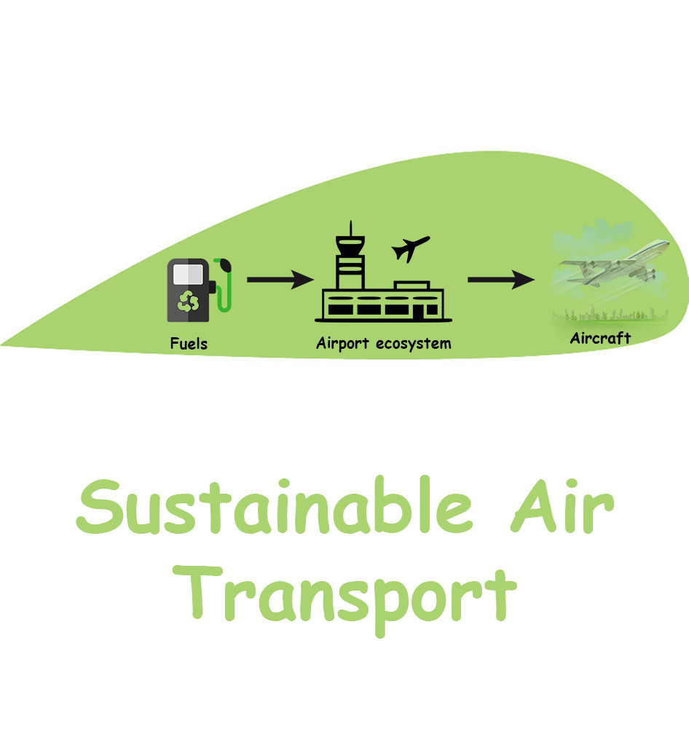

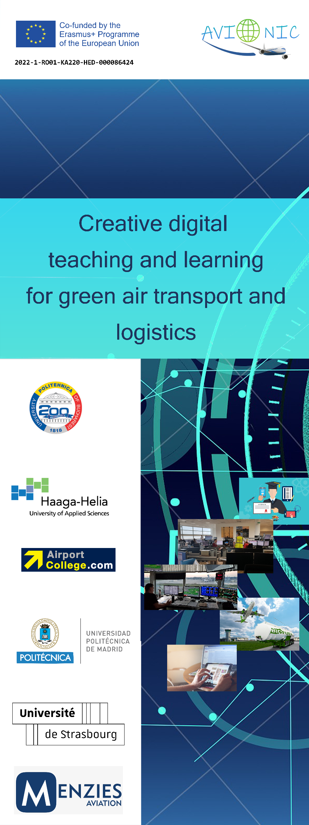



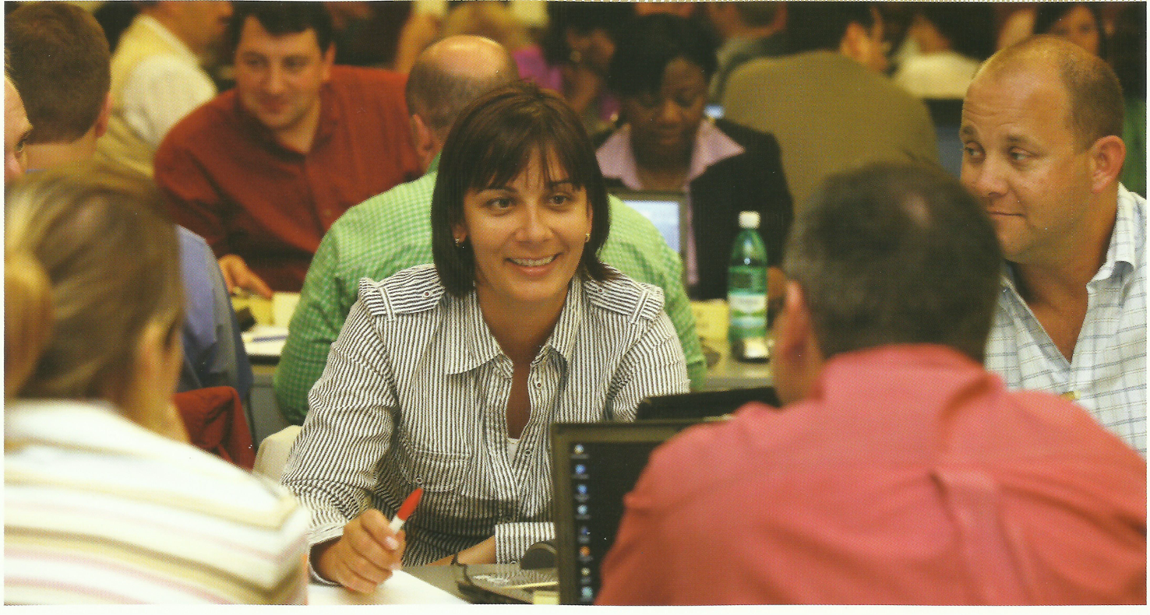
Project leader: “Politehnica” Bucharest Sorin Eugen ZAHARIA, University Professor Chairholder of UNESCO Chair “Engineering for Society” National University for Science and Technology POLITEHNICA of Bucharest (ROMANIA)
Creative digital teaching and learning for green air transport and logistics
AVIONIC

Slide 2
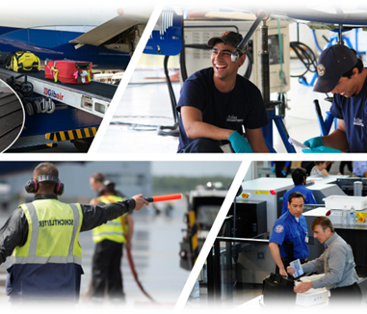
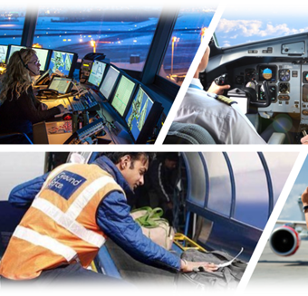
Content of the presentation
Part 1 Project overview
Part 2. Analyse: Occupations and qualifications generated by digitalization and sustainable development in the air transport

Slide 3
Part 1 Project overview
1.Project relevance
2. NEEDS and objectives
3. Implementation of the project
4. Partnership
5. Results

Slide 4


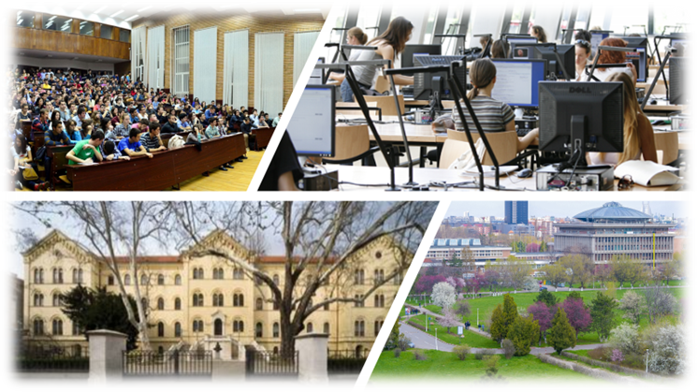
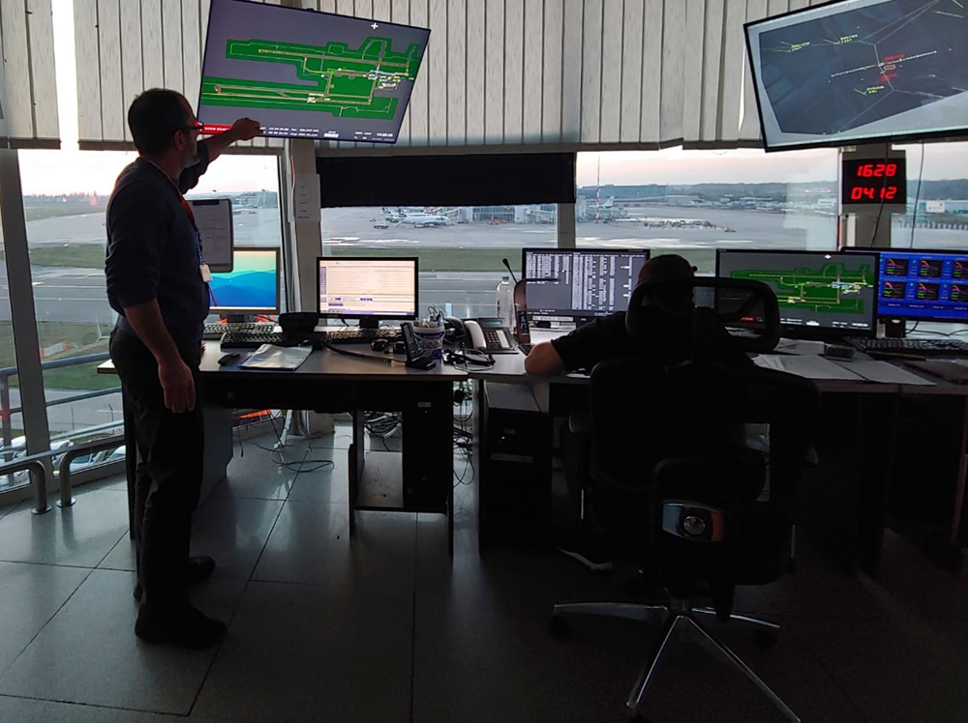

1. Project relevance

Slide 5

1.1 Long-term societal challenges
The air transport industry is one of the most “global” industries because it includes a network of airlines, commercial airports, air navigation service providers and manufacturers of aircraft and their components.
For these reason we need “global” work force.

Slide 6

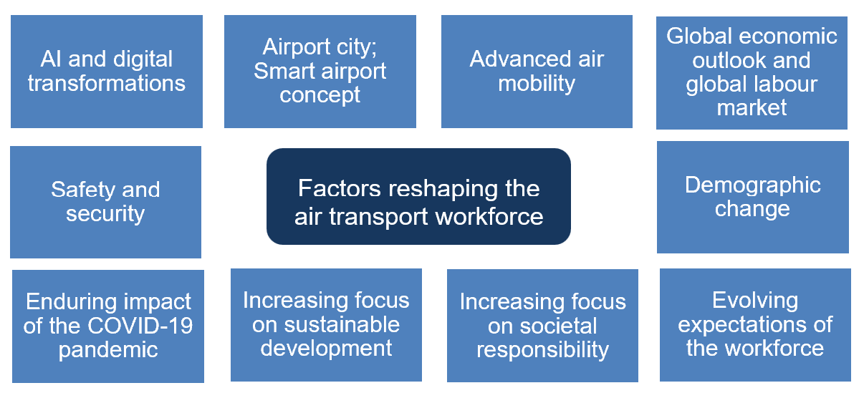
CHALLENGES:
FACTORS
Demographic changes
Urbanisation
Globalisation
Climate change
Digitalisation
Safety and security
Main trends:
Digitalisation
Sustainable development
New materials and technologies
New management
New training and education – new knowledge and skills

Slide 7
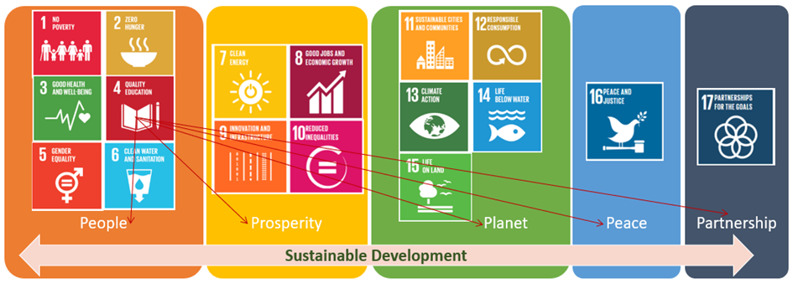
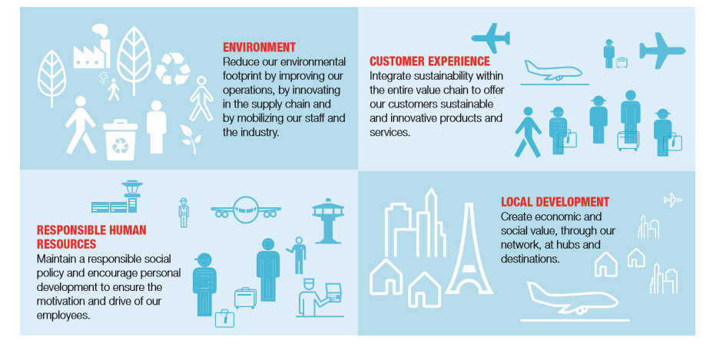
Societal responsibility in air transport
2030 Agenda for Sustainable Development → 15 Sustainable Development Goals (SDGs) involve aviation
The societal responsibility strategy can be centred around four pillars: environment, customer experience, employees and local development.
Organizations around the world and their stakeholders are becoming increasingly aware of the benefits and the need for a societal responsible behaviour.
Notes:
The objective of societal responsibility is to contribute to sustainable development.
The societal responsibility strategy can be centred around four pillars: environment, customer experience, employees and local development. These pillars should support the company’s business model.

Slide 8
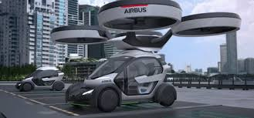
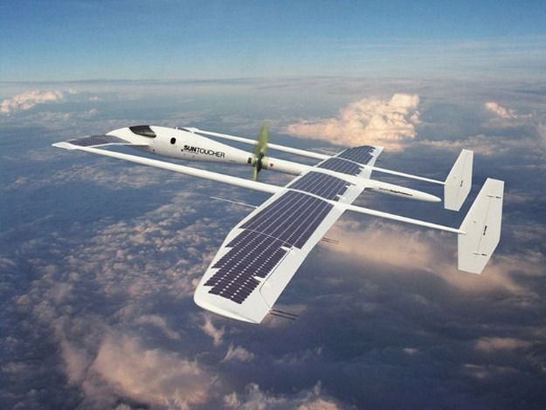
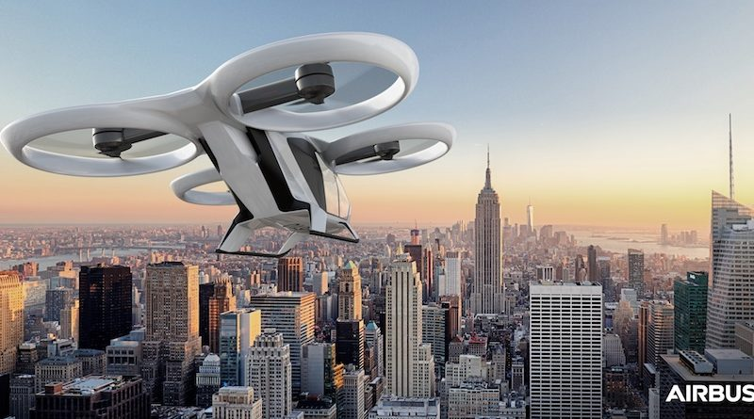
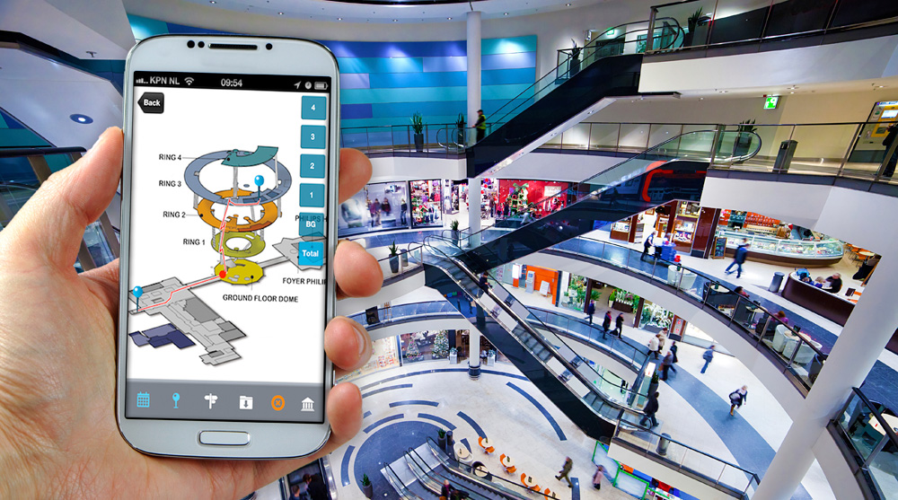
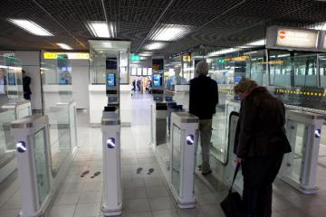

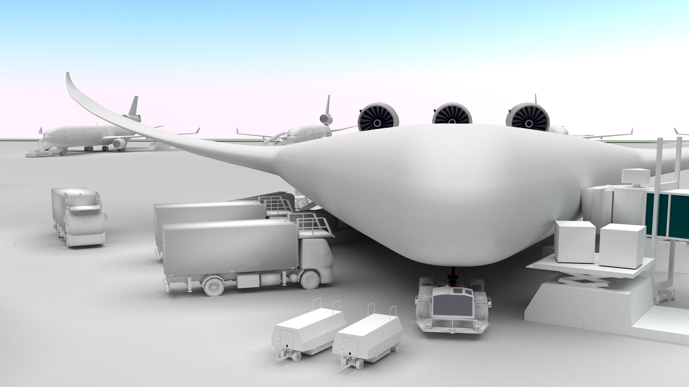
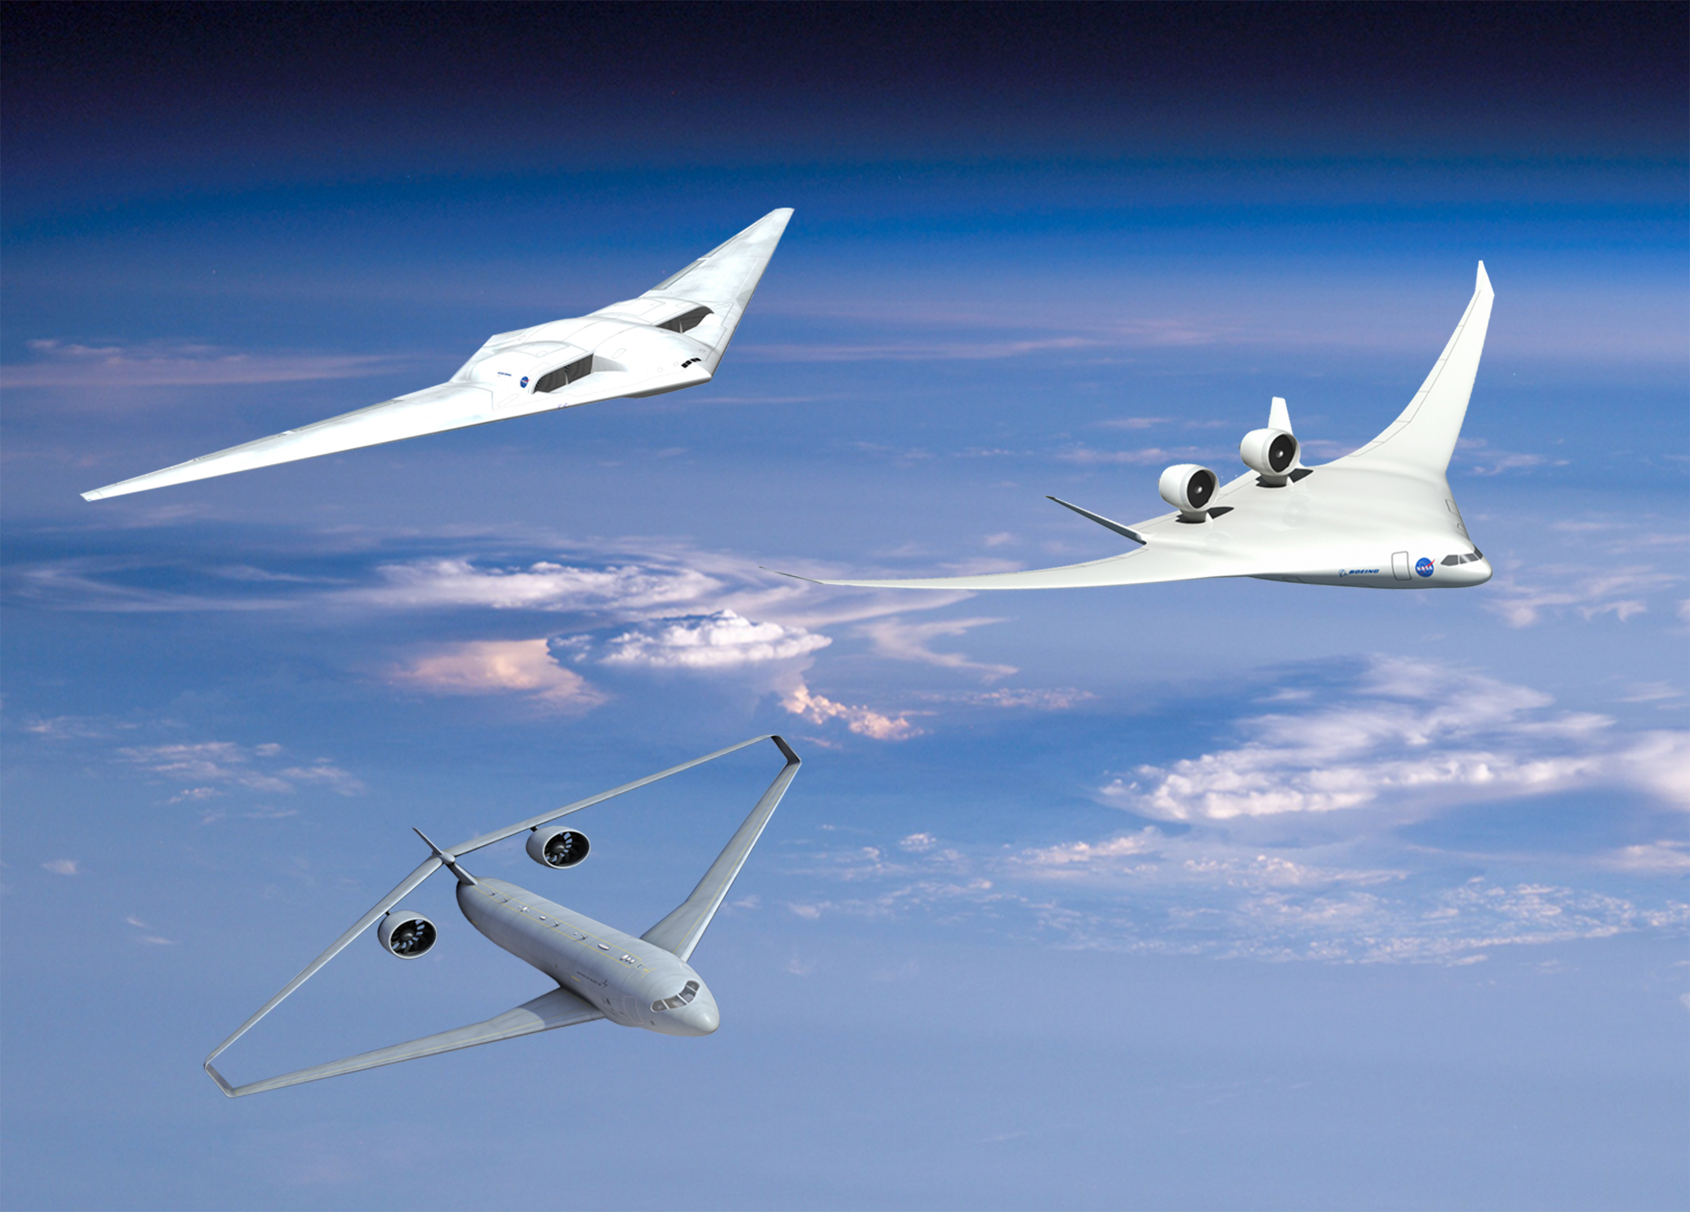
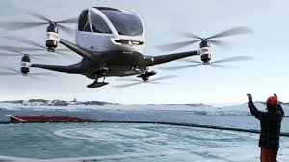
Multi air operations based on digital aviation infrastructure & SUSTAINABLE Development
Today, airspace is occupied mainly by traditional manned aviation
Tomorrow, Digital Aviation infrastructure to enable all air operations
Connected airplanes and rotorcrafts, drones, urban air mobility(UAM), Advanced Air Mobility (AAM) and taxi services
Smart airports, advanced airport digitalisation
Traditional piloted fixed-wing and rotorcraft with limited connectivity
Internet of things on airports
Airport digitalisation – ACDM and TAM
Thousands of aircrafts in the sky
Hundreds of thousands of connected flying vehicles in the sky
Highly qualified workforce with aviation, IT and green skills

Slide 9
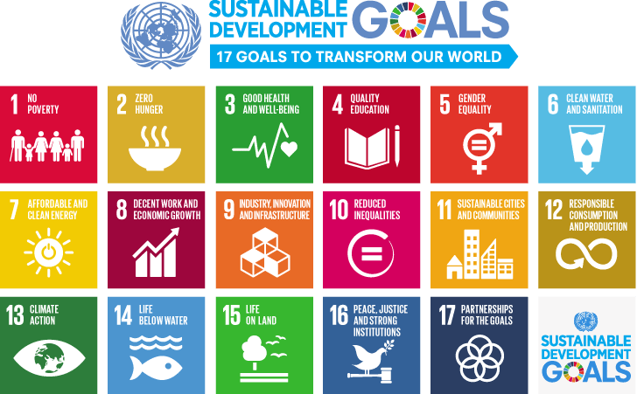
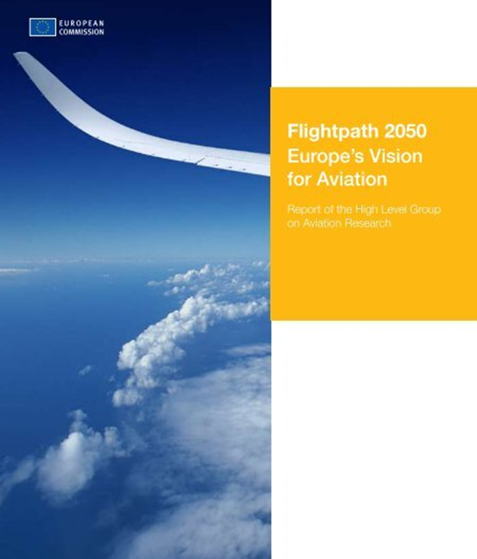

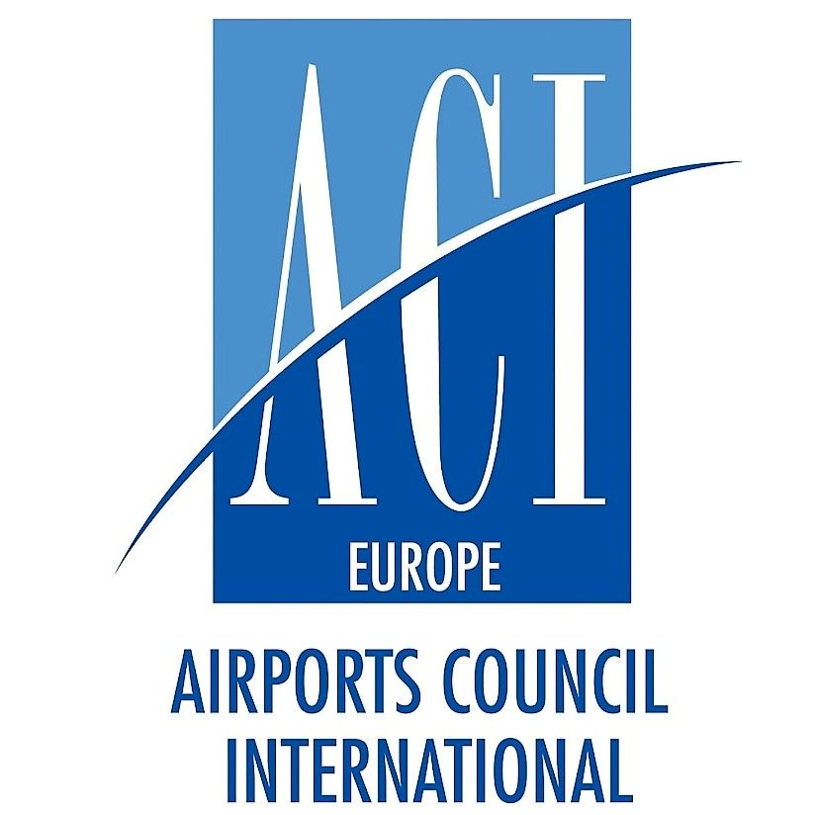
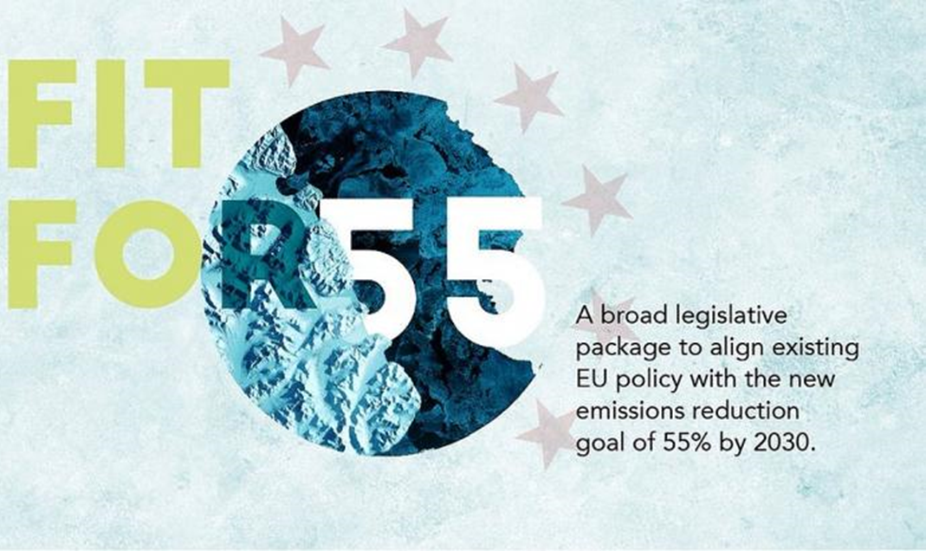

1.2 Documents and strategic
programmes for sustainable development

Slide 10
UNESCO Documents
Agenda 2030
The Sustainable Development Goals

Slide 11
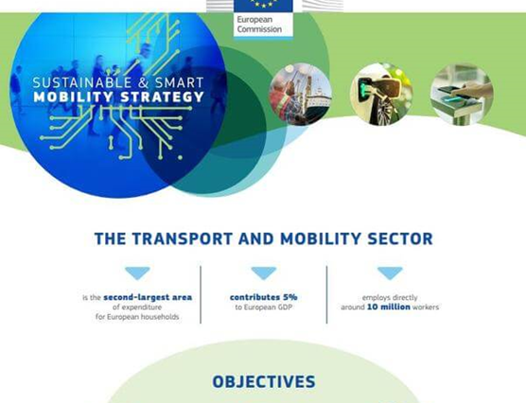


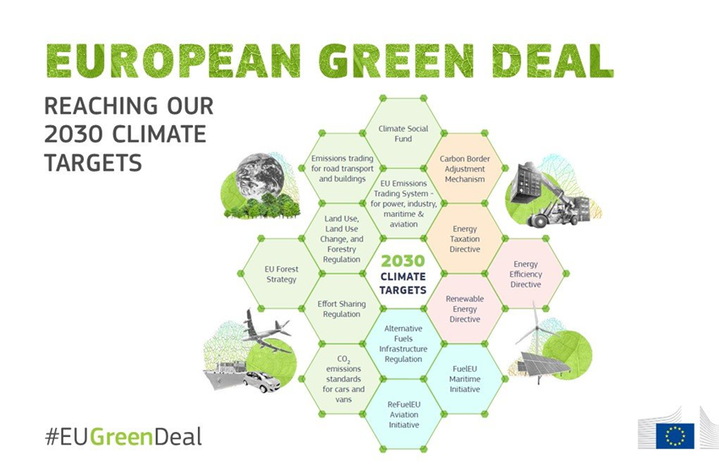
European Union actions and documents

Slide 12
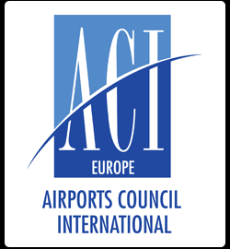

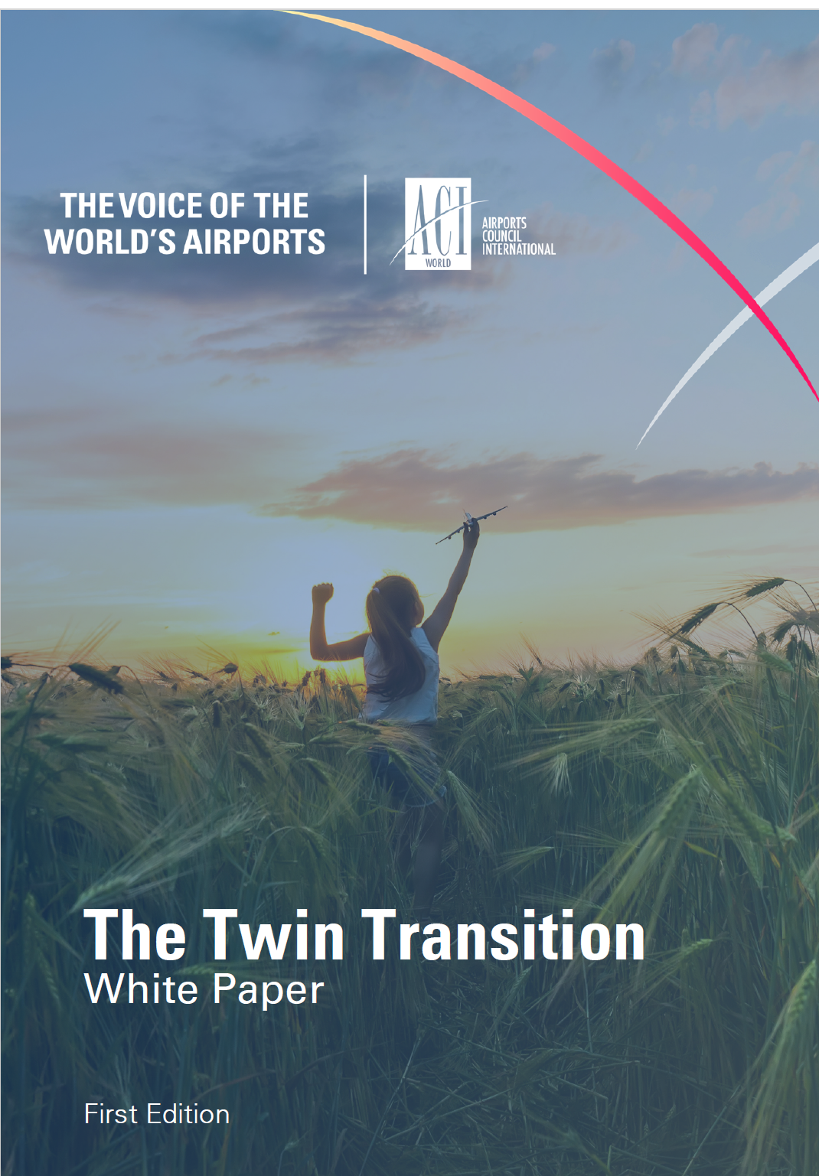
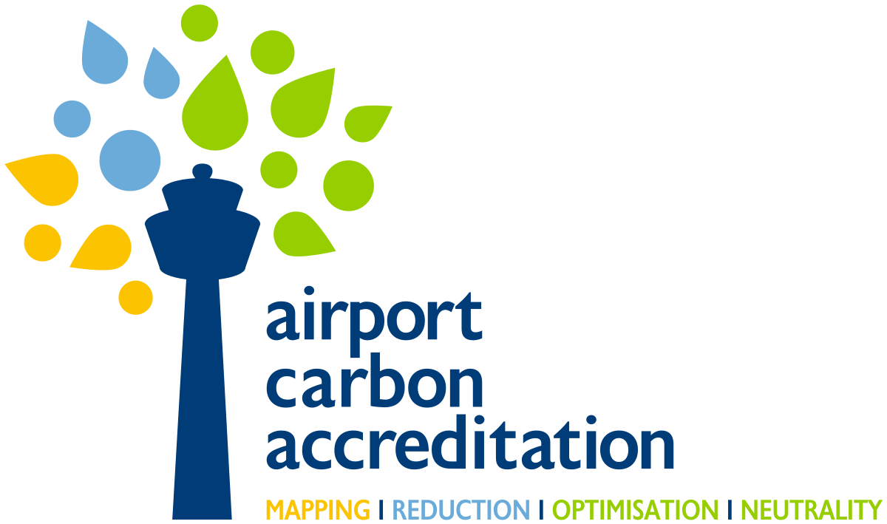
ACI actions: Carbon management
ICAO Actions
The programme independently assesses and recognizes the efforts of airports to manage and reduce their carbon emissions with four levels of award.
CORSIA is a global market-based measure designed to offset international aviation CO₂ emissions in order to stabilize them.

Slide 13
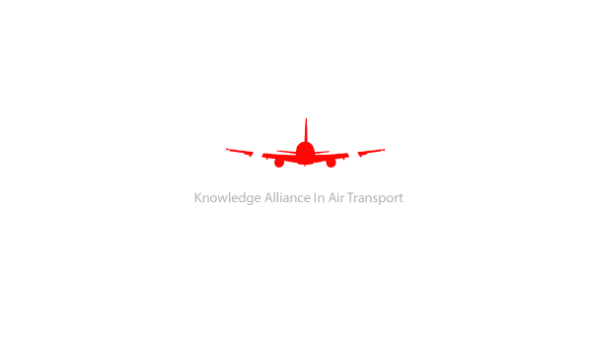
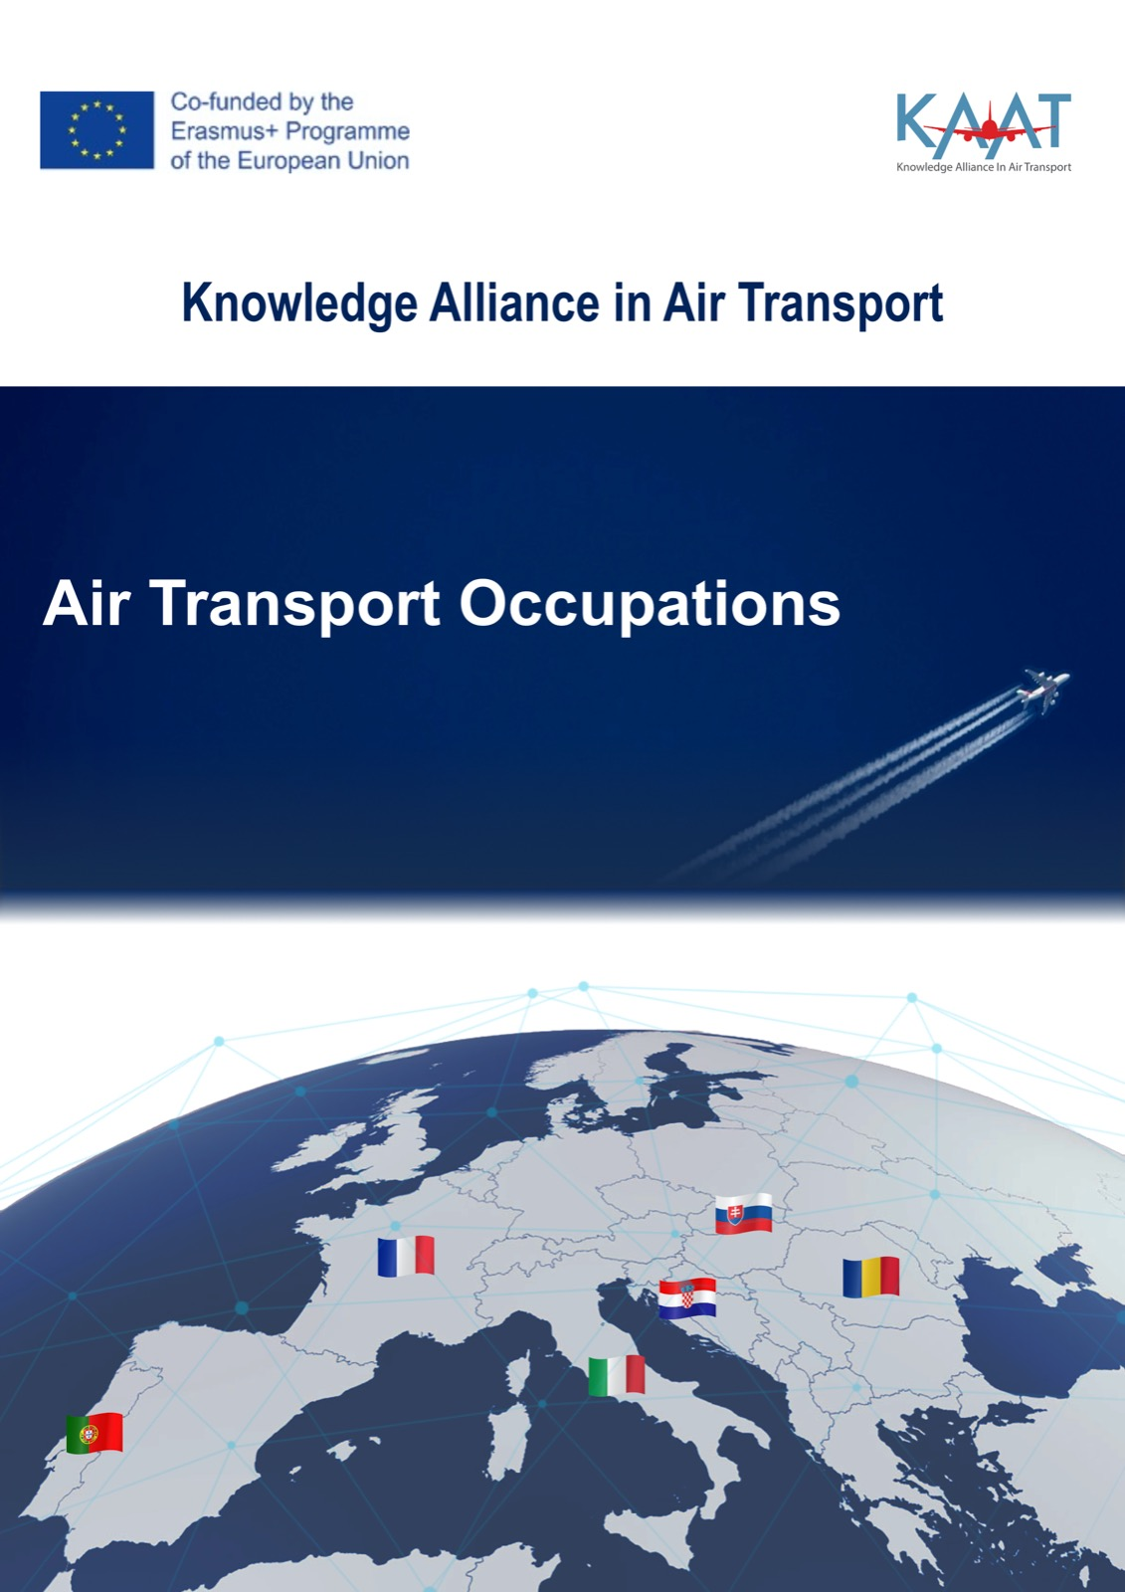
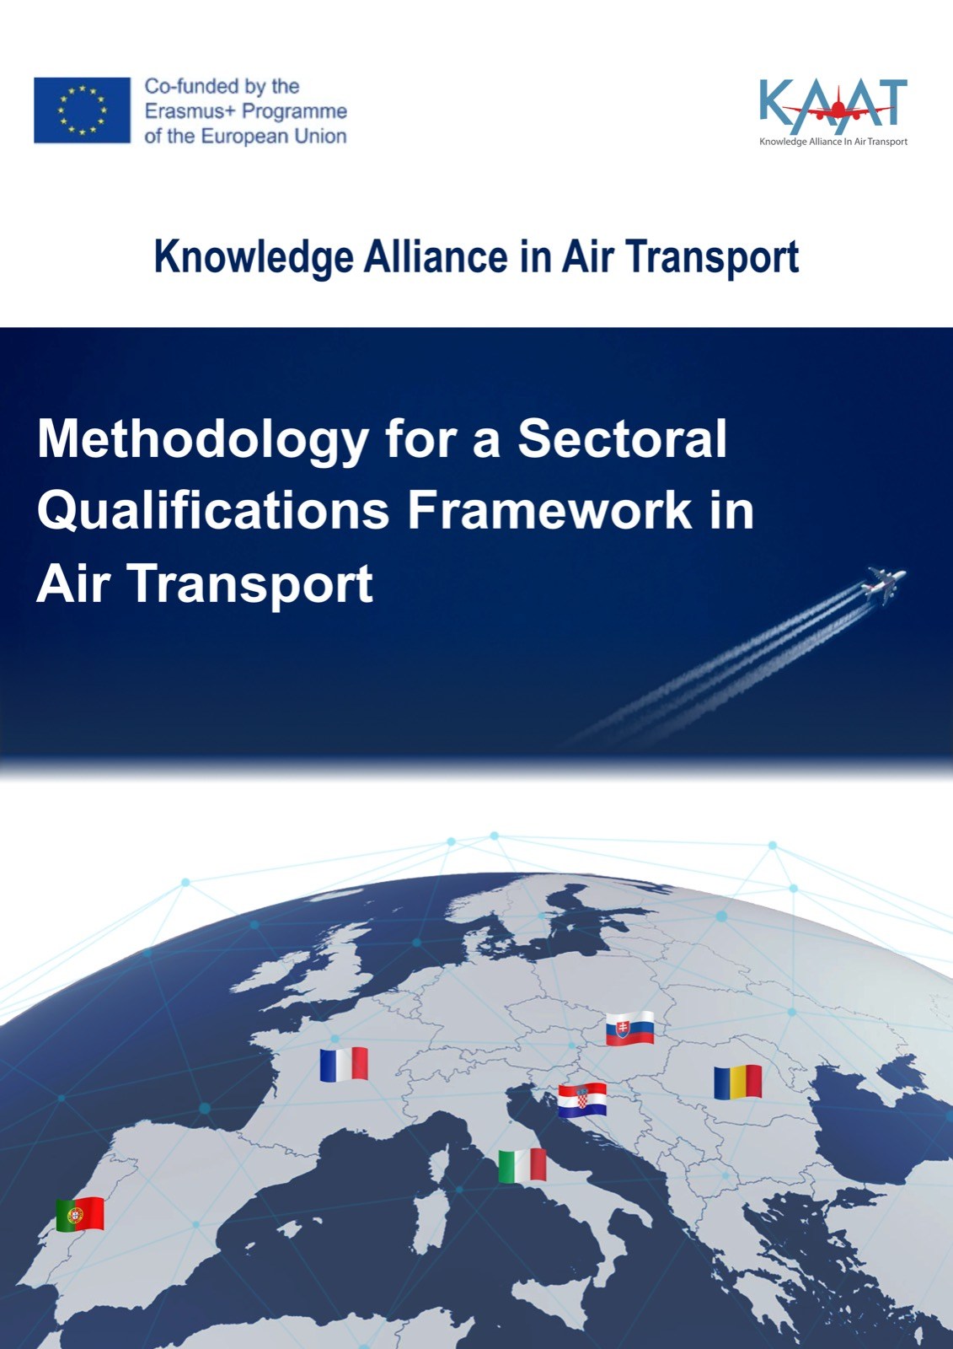

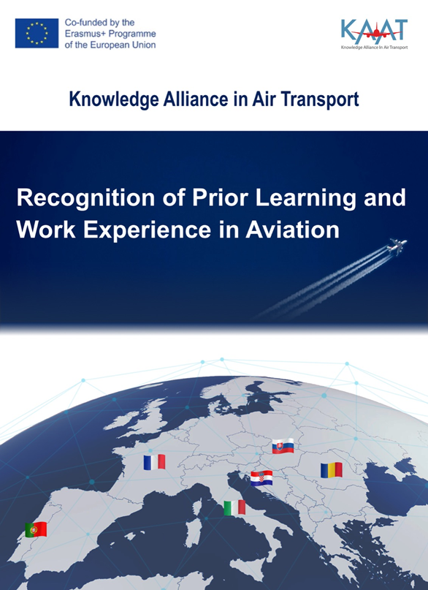
1.3 Avionic is a continuation of Erasmus+ Project “Knowledge Alliance in Air Transport” results

Slide 14
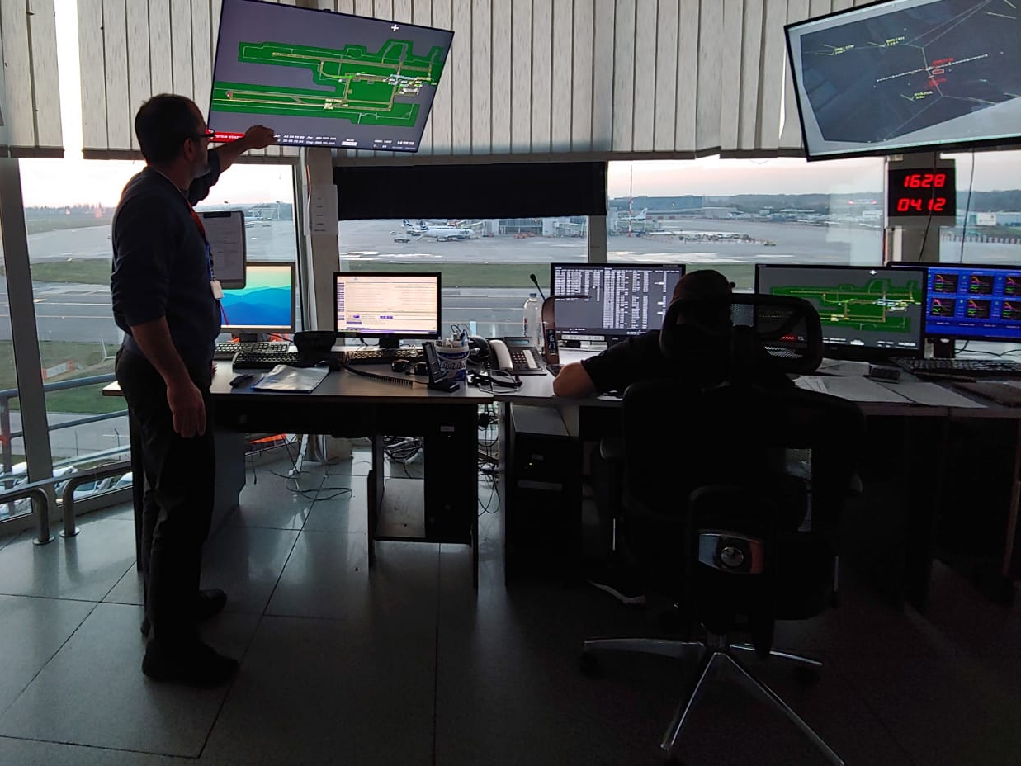
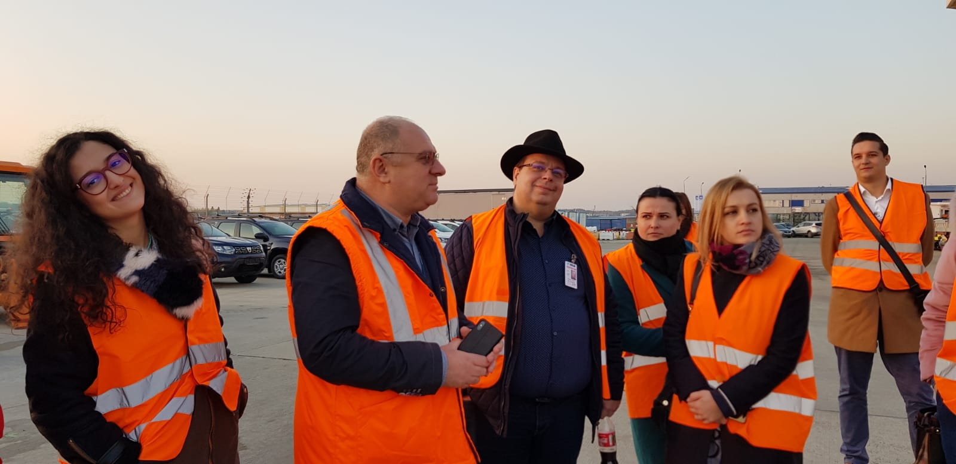
“European network for aviation training and education - ENATE
The aim of the EUROPEAN NETWORK FOR AVIATION TRAINING AND EDUCATION (ENATE) is to develop the European dimension of aviation education and training, by facilitating the transfer of knowledge in the field of air transport and developing innovative and multidisciplinary approaches to teaching and learning.

Slide 15


2. Needs and objectives

Slide 16
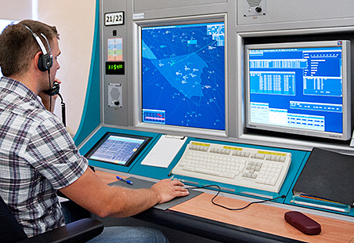
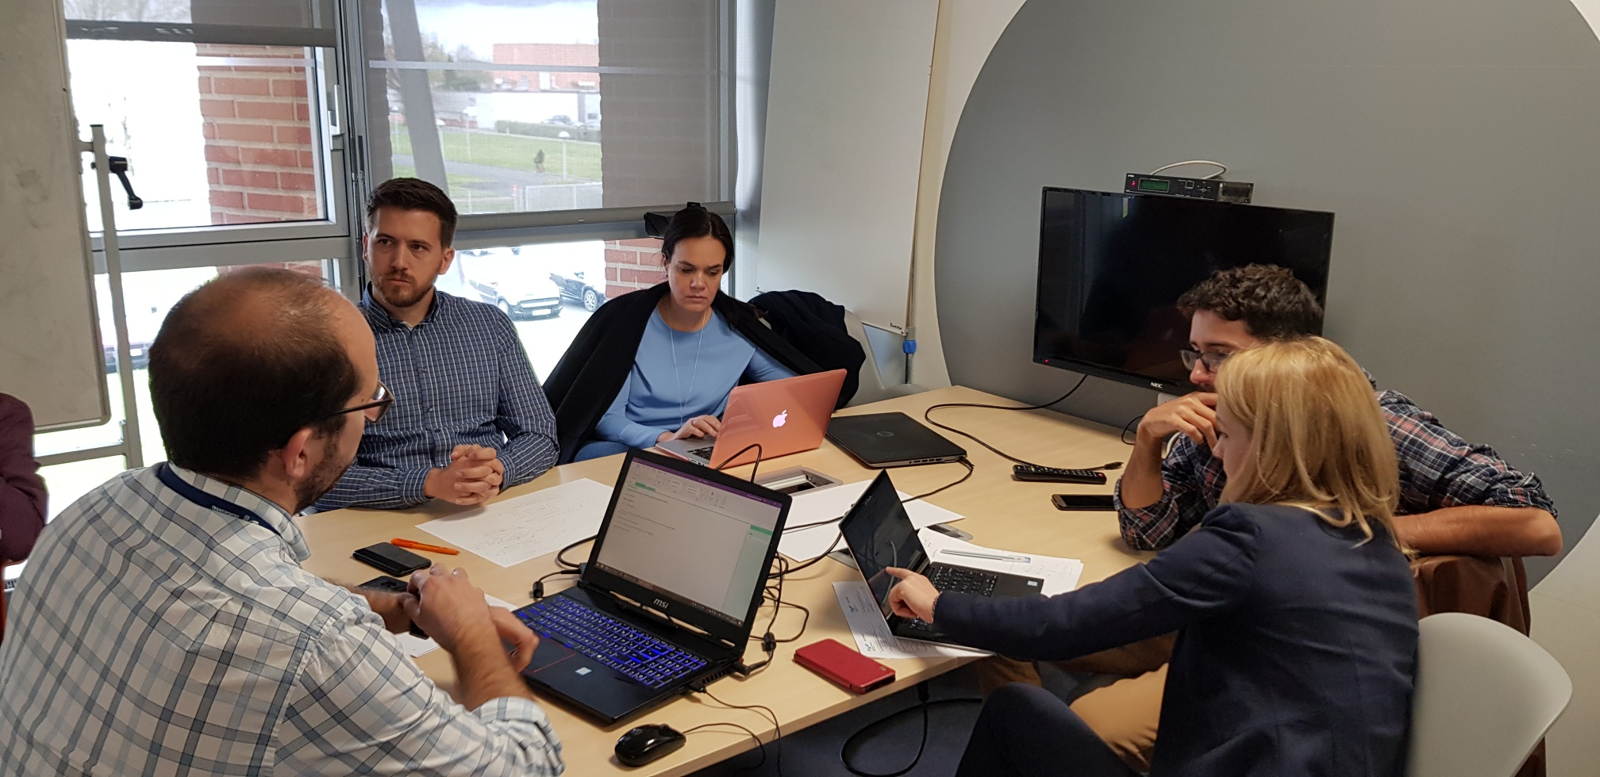
Overarching goal of the project
Improving the quality and relevance of knowledge and skills of new generations of professionals by designing, improving and implementing interdisciplinary study programs at European level to meet the re-structuring needs of air transport labour market with focus on digitalization, sustainable development and societal responsibility.

Slide 17
NEEDS
OBJECTIVES
1. A better qualified work force, especially with multidisciplinary competences
2. Re-skilling: the change of technology, the digitalization and sustainable development ask for new skills of employees
SO 1 Improving the skills of professionals on digital and sustainable development for AT by updating curricula of study programmes and syllabus of courses based on international and interdisciplinary co-creation of knowledge between higher HEIs and industry at European level.
3. Up-skilling: in aviation a vast number of people are retiring and new supervisors and managers need to be level up from the pool of employees having digital and green skills
4. An improved dialog university – employers for ensuring a new learning culture in aviation HE for sustainable development,

Slide 18
NEEDS
OBJECTIVES
SO 2 Fostering new, innovative and multidisciplinary approaches of teaching and learning for existing and new study programmes by developing tools for an international on-line teaching and learning based on interactive methods for a dedicated virtual environment.
5. Modernisation of curricula and fostering innovative and multidisciplinary approaches for HE and trainings in aviation
6. Implementation of teaching methods for improving the quality and relevance of digital and green skills by an innovative teaching.
SO 3 Developing new digital tools for supporting the international interactive teaching and learning for increasing quality of education and training and to equip students with digital & green skills and international work team behavior.
7. Expand students’ vision and perspective at an international level, throughout working in international teams with students, teachers and employers from different countries

Slide 19
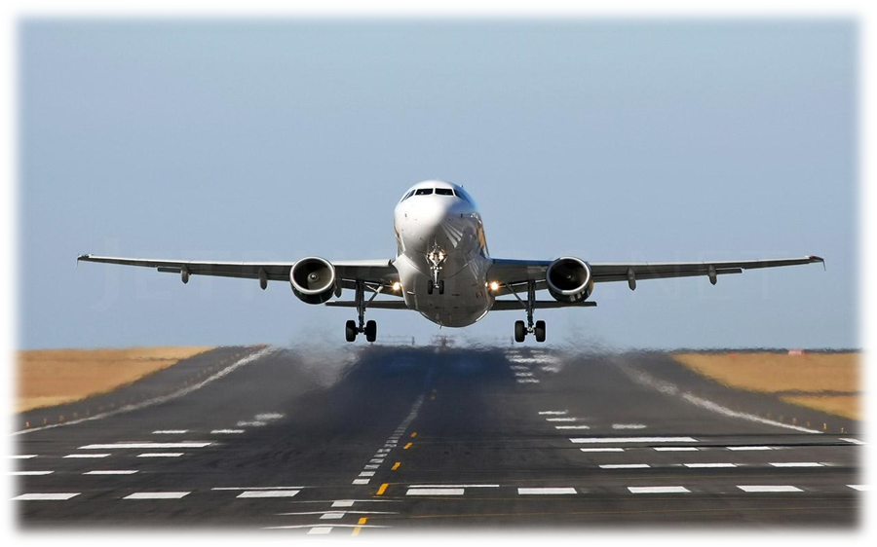

3. Implementation of the project

Slide 20
The overview of project structure and methodology
Life of the project
Beyond the
life of the project
WP Project Management (PM)
Exploitation beyond the life of the project
WP 1
Sharing the knowledge on innovative methods for teaching and learning and identification of digital and green skills in air transport
Report on occupations and qualification linked to digitalization and “greenization’’ of air transport
Learning outcomes for new occupations and qualifications for digitalization and ‘’greenization’’ of air transport
WP2
Design and implementation of new curricula and teaching and learning materials
WS1
Dissemination
Continuous of improved study programs
Report on the best practices on innovative didactical approaches and digital tools for teaching & learning
Identify appropriate digital tools for AT education & training
WP 3
Developing of new digital tools for interactive teaching and learning
Training programs deployment
WS
2
Application of informatic tools for teaching and learning
Launching conference
Closing conference
Improved green and digital skills for the graduates/ better skills for air transport professionals
WP 5 Impact and Dissemination
WP 4 Impact and Dissemination

Slide 21
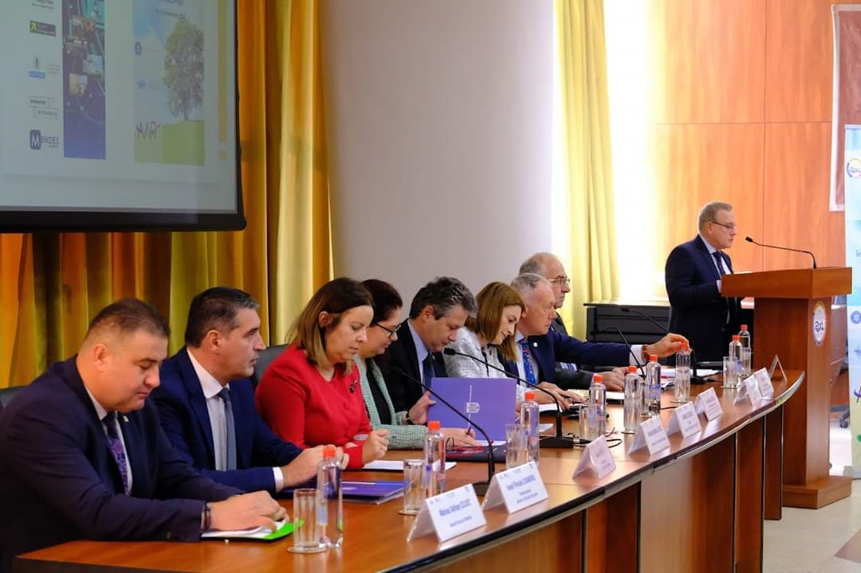
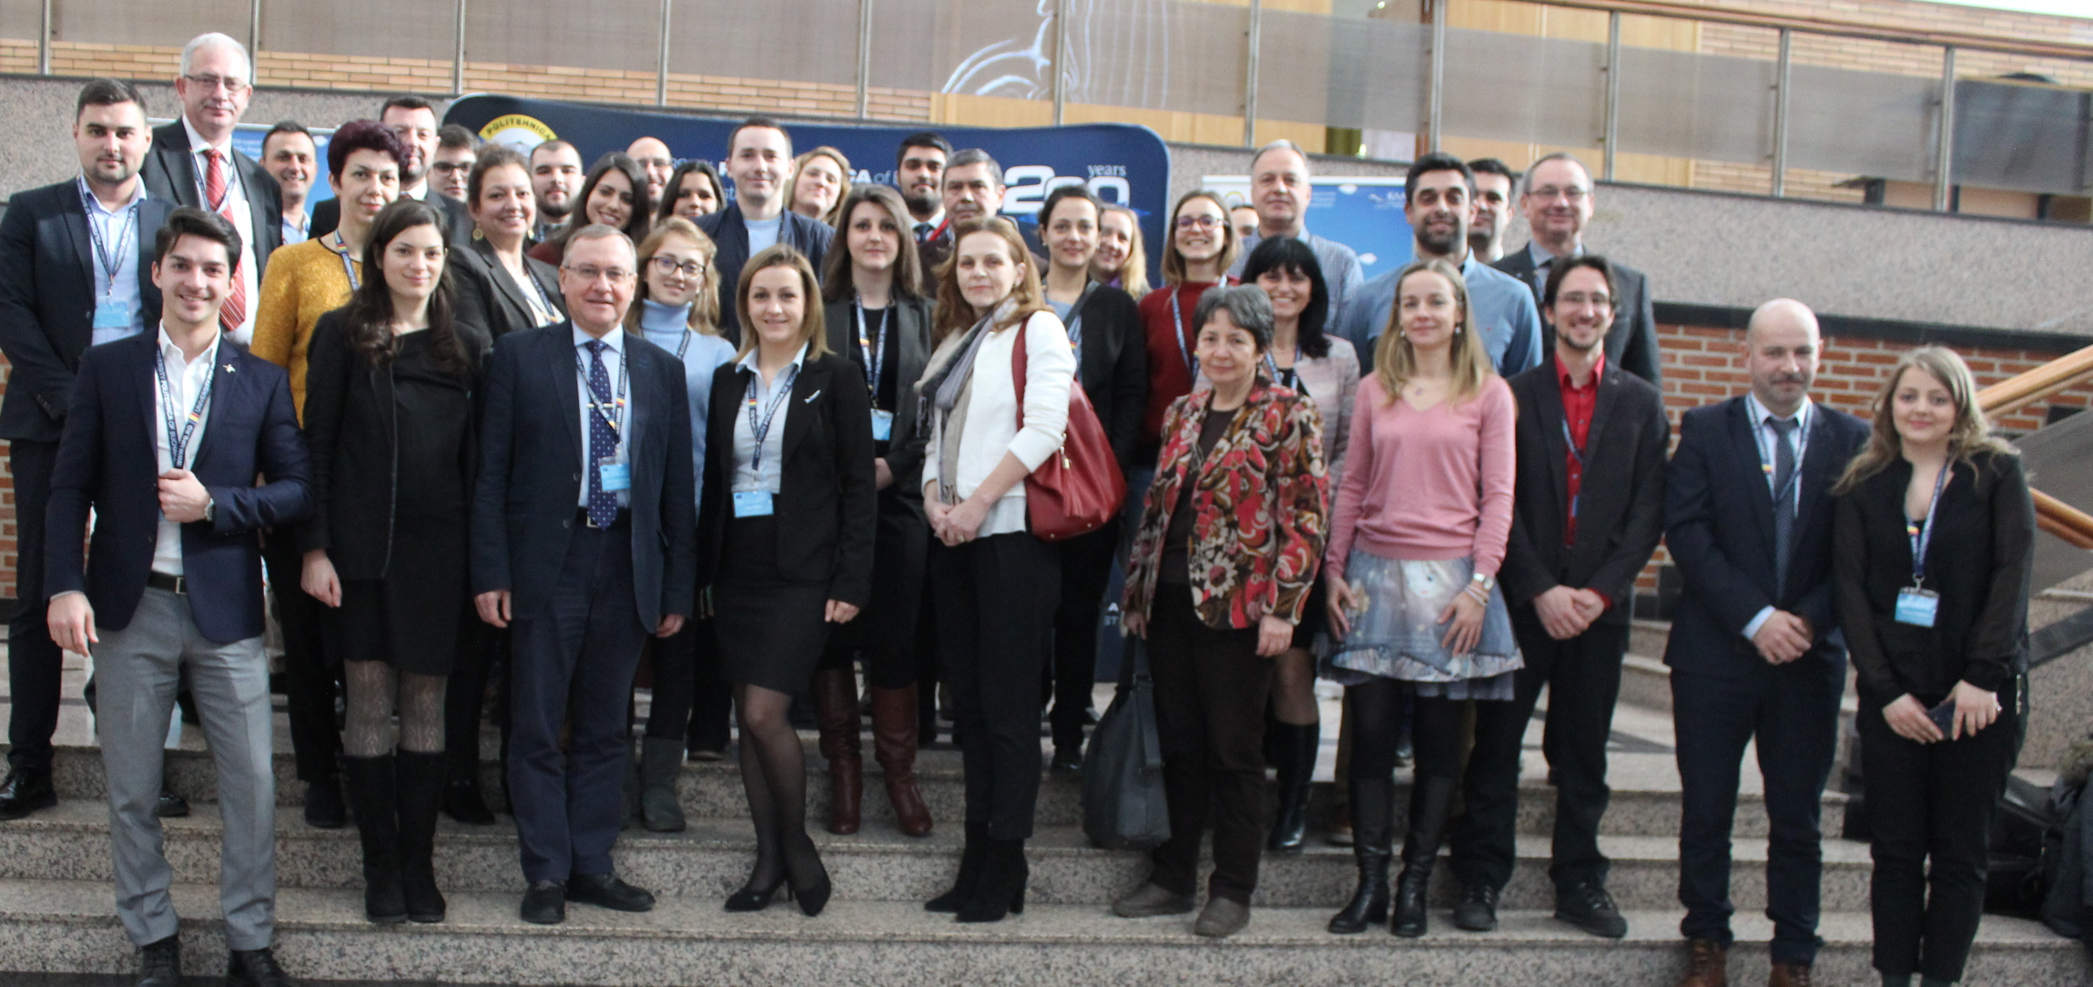
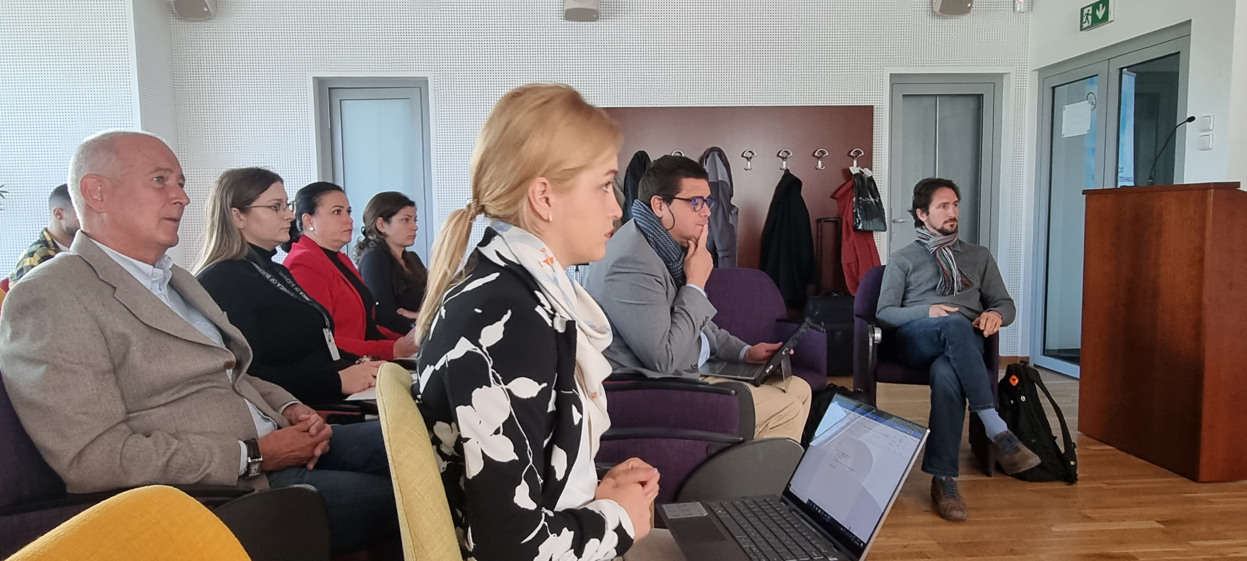
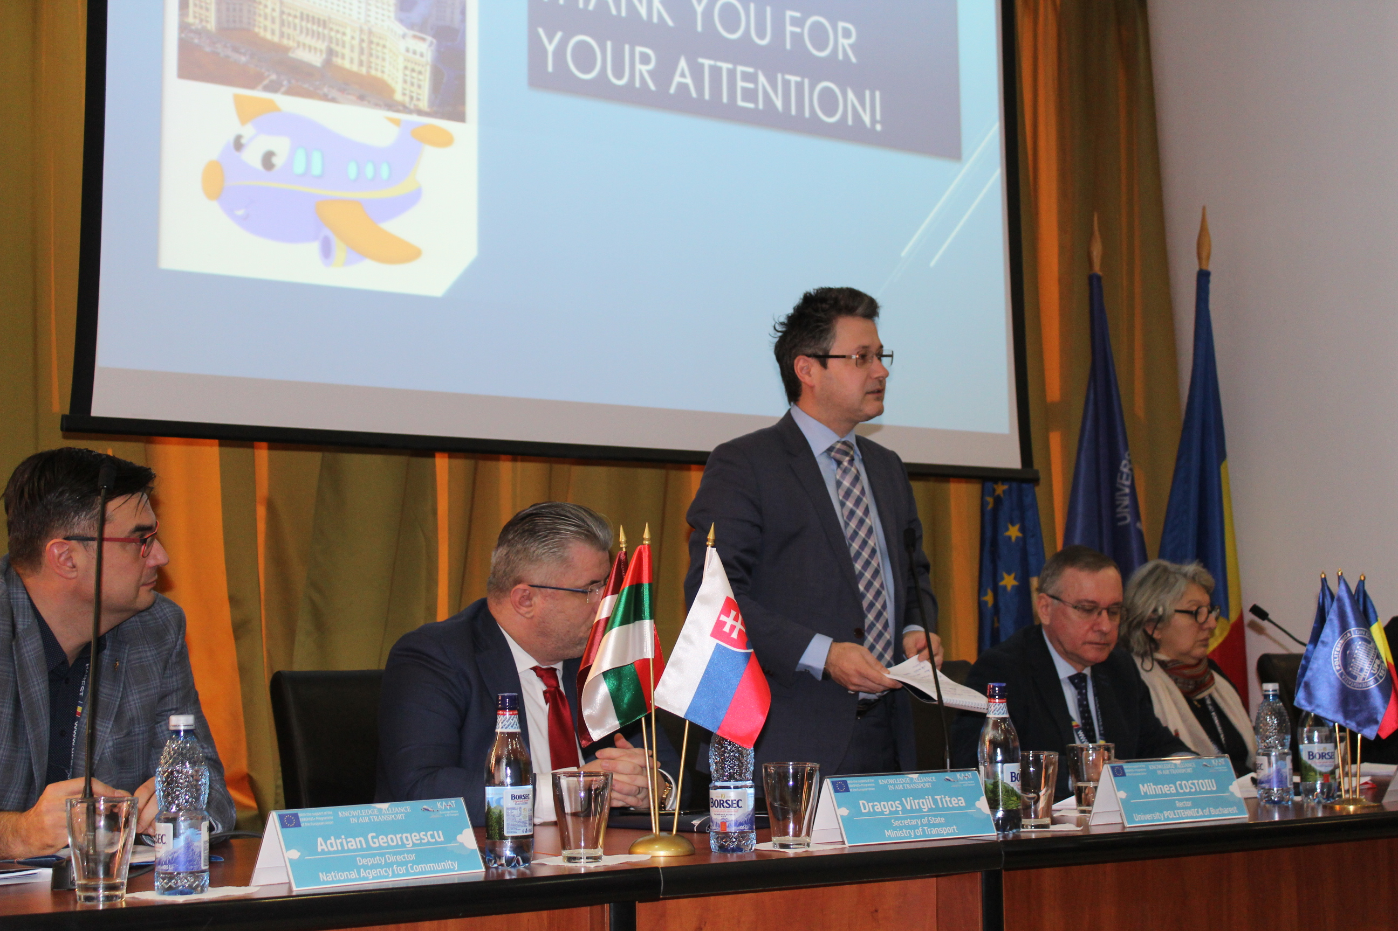
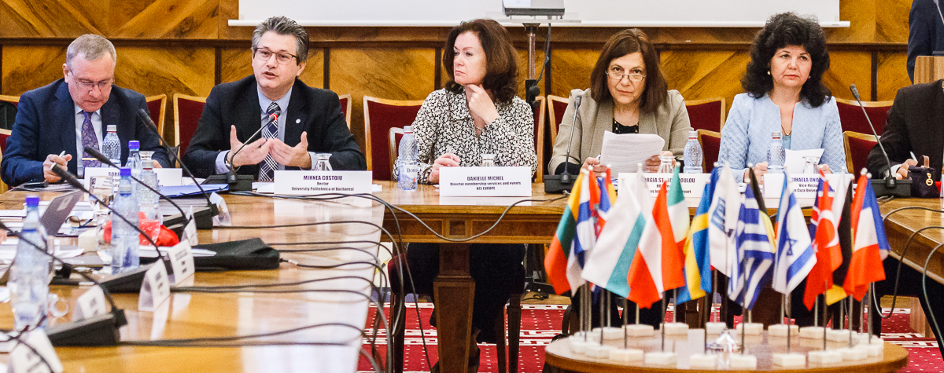
4. Partnership

Slide 22


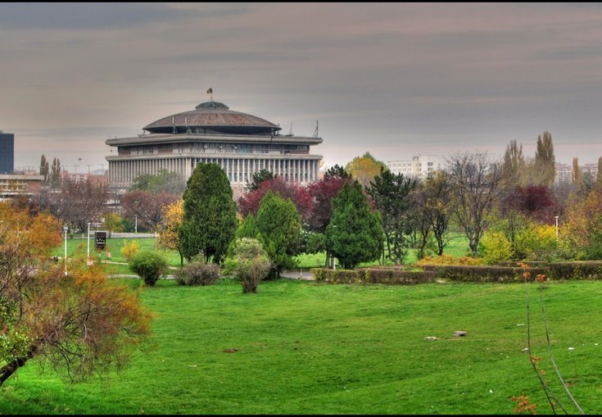

Project coordinator UNIVERSITY POLITECHNICA OF BUCHAREST Romania

Slide 23



Universidad Politecnica de Madrid, Madrid, Spain

Slide 24
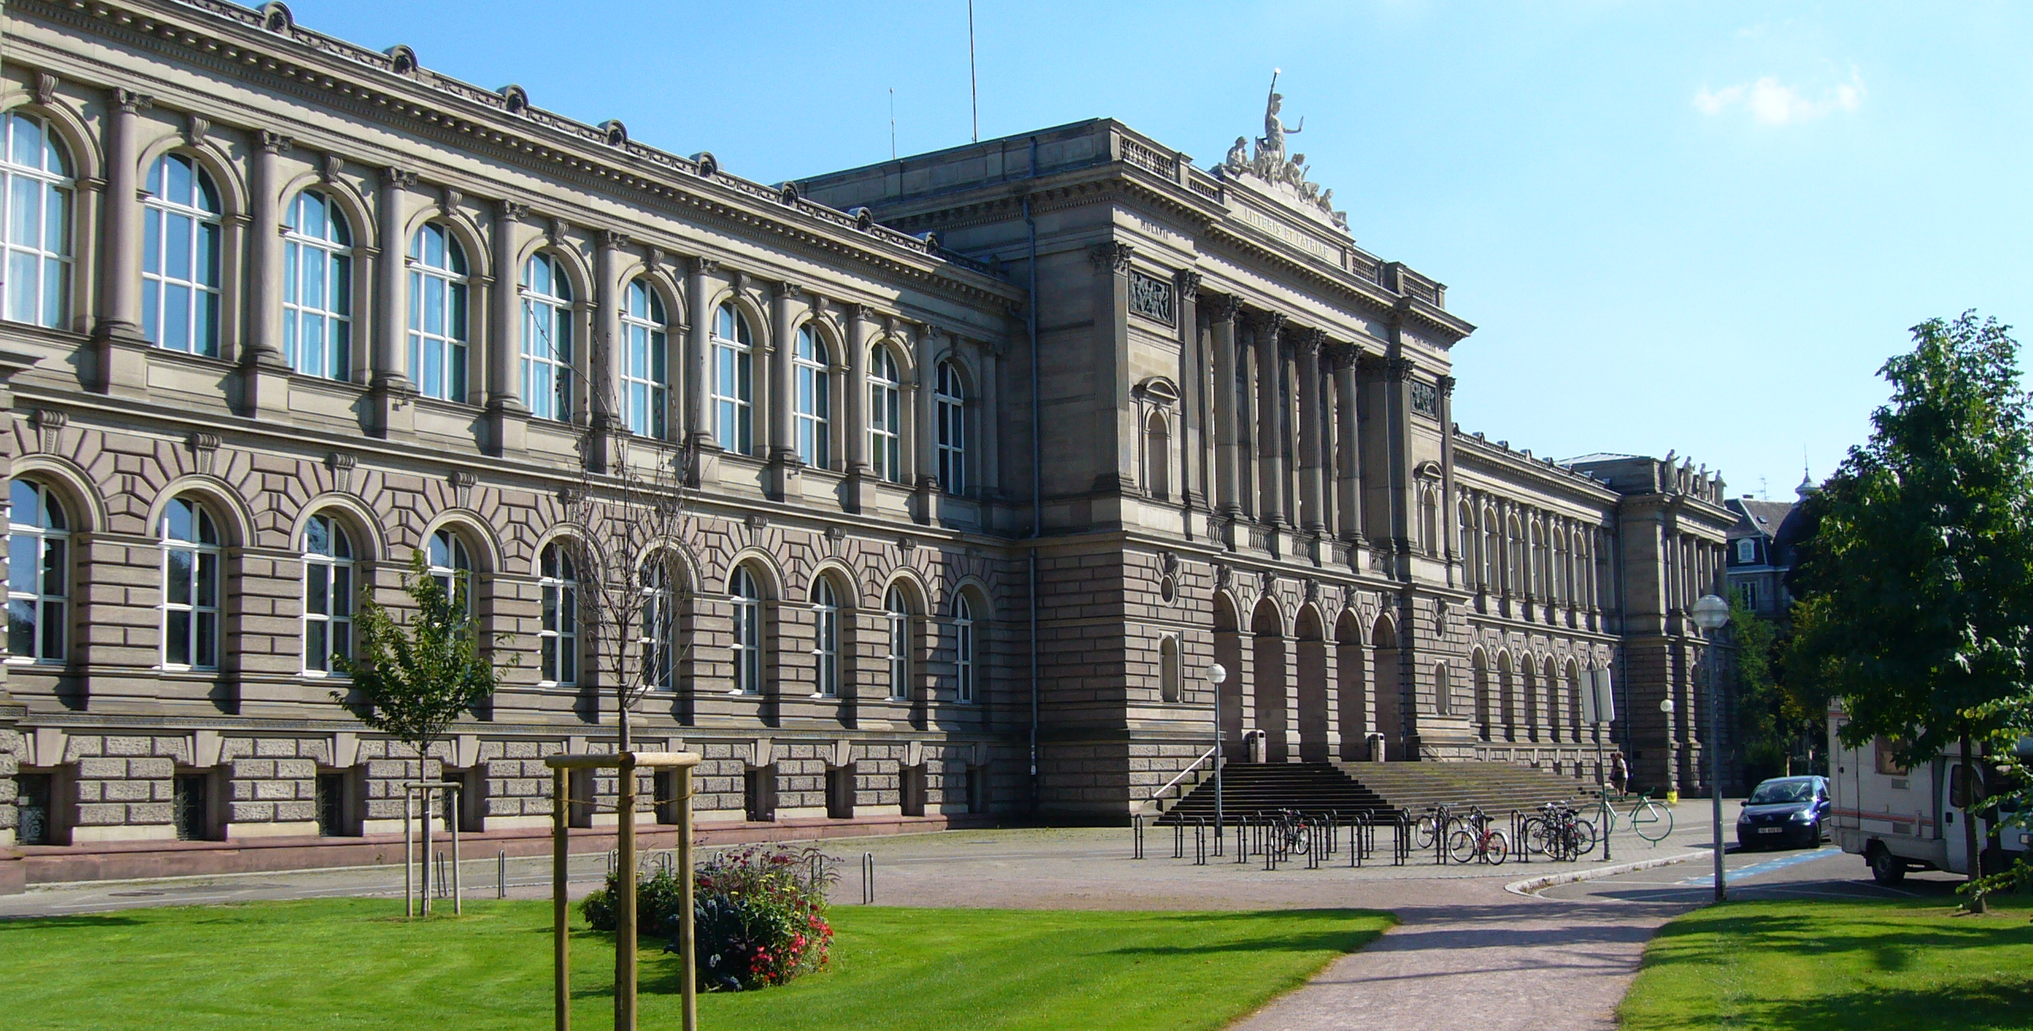


Université de Strasbourg, France

Slide 25
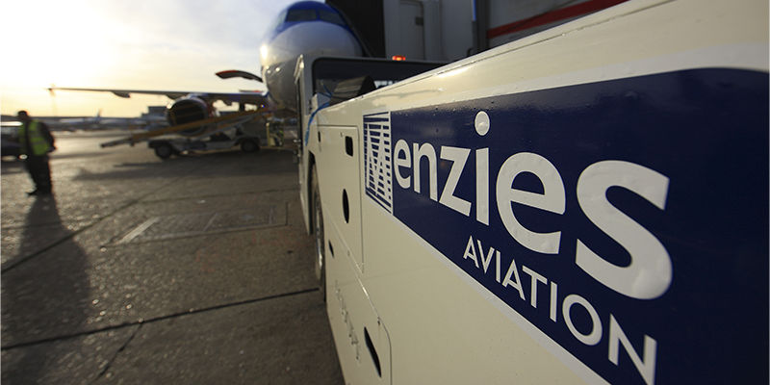


Menzies Aviation Romania SA, Bucharest, Romania

Slide 26



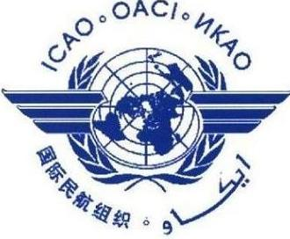

6 Associated partners: from 3 countries and 3 international bodies
European and North Atlantic (EUR/NAT) Office of the International Civil Aviation Organization (ICAO)
Ministry of Environment, Waters and Forests - Romania
Airport Council International – Europe(ACI)
European Network for Aviation Training and Education
Romanian Airport Association (RAA)
IATA – International Air Transport Association

Slide 27
Results
Report on occupations and qualifications generated by new technologies for digitalization & sustainable development of AT industry
Report on the best practices on innovative didactical approaches and digital tools for teaching and learning
10 study programs with new learning outcomes to better meet the learning needs and to reduce the skills mismatches with labour market demands for digitalization, sustainable development and intermodal transports.
Better skilled work force in digitalisation and sustainable development of air transport necessary for new interdisciplinary occupations.
New tools and methods for on-line teaching and learning: videos, serious/applied games, interactive presentations; digital content tools.
Dissemination: Project website and on-line networking tools, Media relation and public multiplier events organized within the project

Slide 28
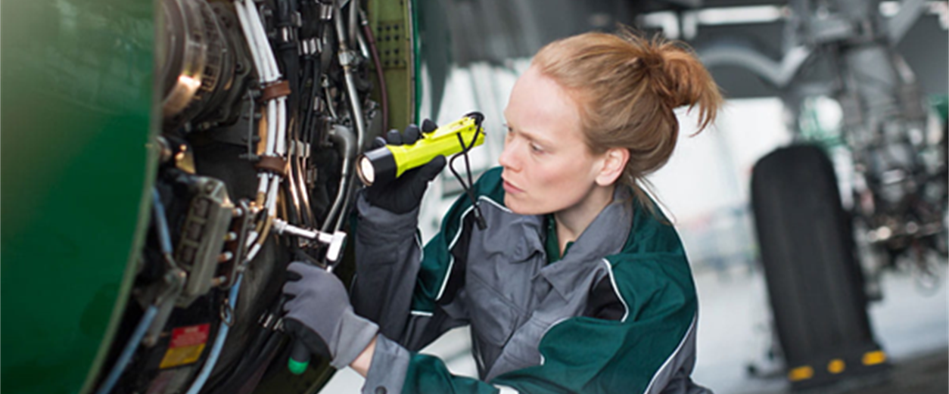

Occupations and qualifications generated by digitalization and sustainable development in the air transport
Part 2
27.10.2023

Slide 29
CONTENT Part 2
1. The methodology of research
2. Skill shortage and qualification development
3. New occupations link to digitalization and sustainable development and importance of skills required
4. Education and employee training
5. Conclusion – key findings

Slide 30
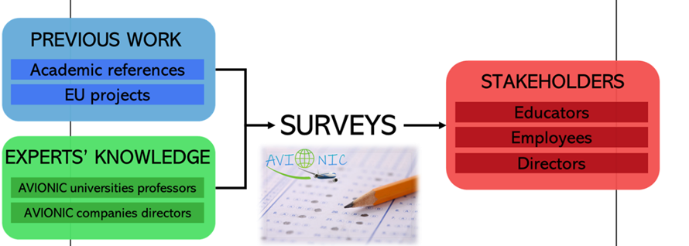
1. THE METHODOLOGY OF RESEARCH
The qualitative component:
- An examination of information related to occupations and qualifications in air transport from documents elaborated by
- European Commission, CEDEFOP , Organisation for Economic Cooperation and Development (OECD), ICAO, ACI, ATAG, previous projects and others scientificat papers.
The quantitative component:
A survey was carried out using the 3 different questionnaires:
SURVEY
DIRECTORS/ TOP MANAGEMENT
EMPLOYEES
EDUCATORS/ TRAINERS
Notes:
CONSIDERING ALL ASPECTS PREVIOUS MENTIONED, WE DRAFTED THE PROJECT PROPOSAL FOR AVIONUC. AND AMONG THE ACTIVITIES OF THIS PROJECT, WE HAVE A RESEARCH ABUT EXISTING AND EMERGING OCCUPATIONS IN AIR TRANSPORT CONSIDERING ATECHNOLOGICAL DEVELOPMENTT AND ALSO THE ENVIRONMNTAL IMAPCAT.1. a questionnaire designed for top management, the directors of companies within the industry,
2. a questionnaire for employees working within air transpo
3. A questionnaire for academic staff involved in air transport education and training.

Slide 31
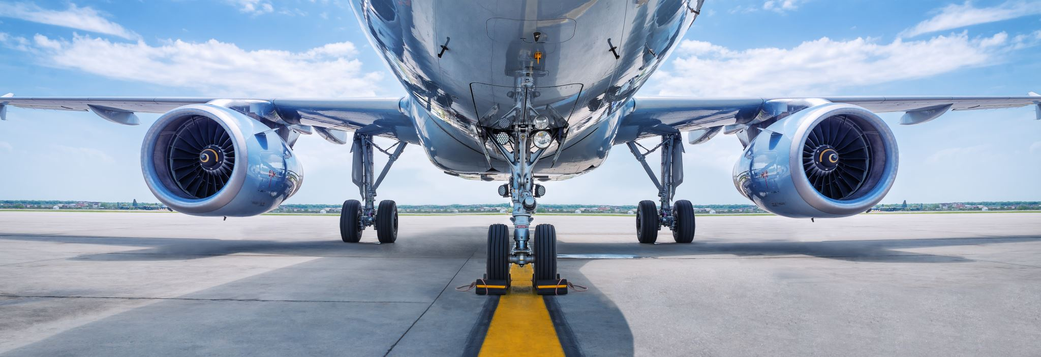
2. Skill shortage and qualification development

Slide 32


Green occupations and green skills - concepts -
GREEN SKILLS → the ability to apply green knowledge and use know-how to complete tasks and solve problems for sustainable development.
GREEN COMPETENCES ( sustainability competences) → the proven ability to use green knowledge, green skills and personal, social and/or methodological abilities, in work or study situations and in professional and personal development for developing and supporting a sustainable and resource-efficient society.
GREEN LEARNING OUTCOMES → statements regarding what a learner knows, understands and is able to do on completion of a learning process for develop and support a sustainable and resource-efficient society, which are defined in terms of green knowledge, green skills and responsibility and autonomy.

Slide 33
Survey for top management and employees in aviation
The questionnaire for top management is divided into the following sections:
Respondent identification
Present situation referring to jobs and training
Future of occupations and jobs
Key competences
Education and training
Contact information
Respondents’ profile
The employees who answered come from 15 countries : Romania, Spain, Italy, Germany, Greece, Finland, Canada, Belgium, Netherlands, Nigeria, Czech Republic, Austria, United Kingdom, Thailand, Luxembourg

Slide 34
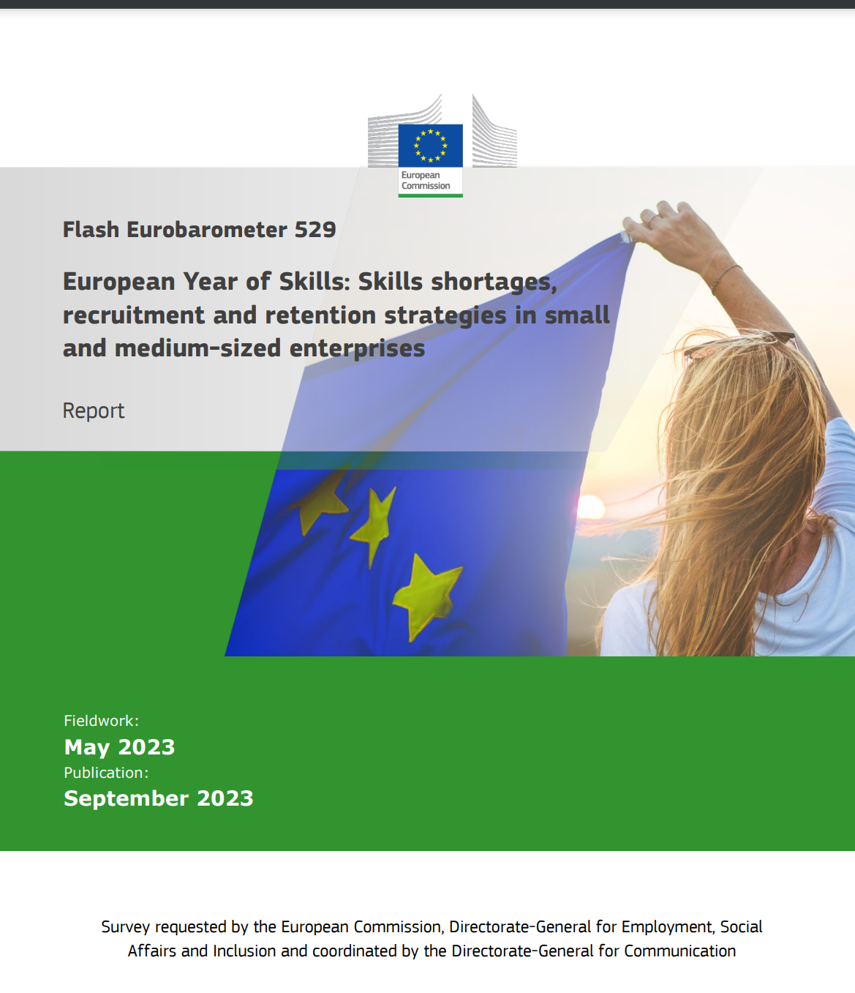
Skills shortages in air transport
A slim majority of SMEs (52%) say it is 'very difficult' to find workers with the right skills and about a quarter (26%) say this is 'moderately difficult'.

Slide 35
To what extent the following approaches and technologies affect your current occupation - Employee opinion

Slide 36
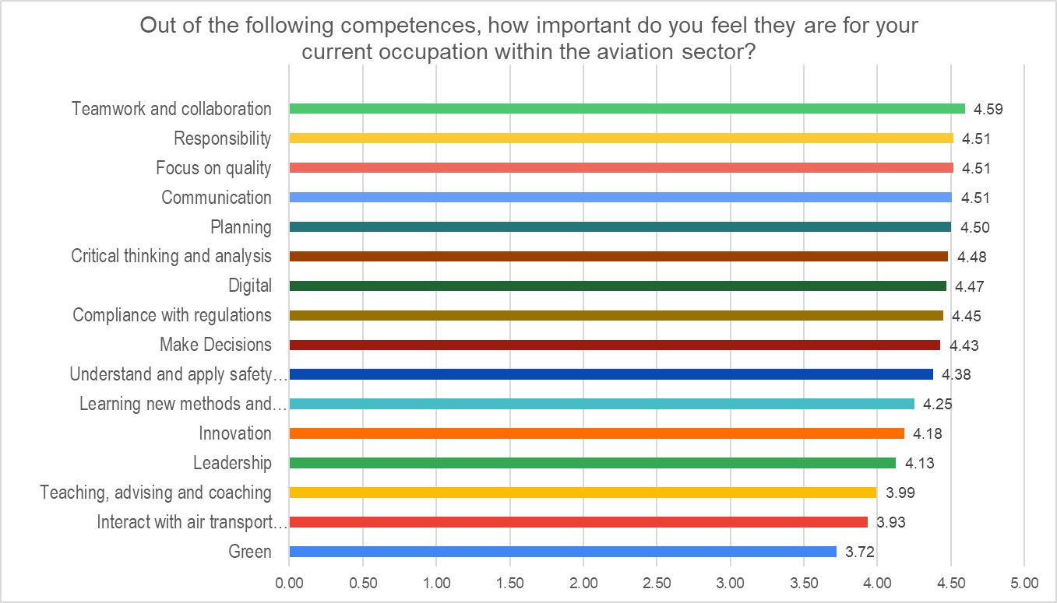
The opinion of employees from air transport about the importance of competences in their current occupation
teamwork and collaboration, communication, digital skills, quality, responsibility, critical thinking and analysis, and compliance with regulations as the most relevant skills for their current occupation
green competences were deemed unimportant for their current jobs in air transport, receiving the lowest average score among the listed competences

Slide 37



3. New occupations link to digitalization and sustainable development and importance of skills required

Slide 38
WHICH OCCUPATIONS DO YOU THINK ARE GOING TO DRASTICALLY CHANGE? WHICH OCCUPATIONS DO YOU THINK ARE GOING TO DISAPPEAR BY 2030? - directors’ perspective
Changing
Energy and maintenance engineer: thermal, solar;
Electric engineer/ Alternative vehicle developers;
Aviation Data Analyst;
Electric Aircraft Technician
ATC.
Pilot.
SMS specialist.
Customer service desk.
Disappear
Cashier.
On-board co-pilot.
Security control.
Ground handling drivers.
Companies counter for checking.
Manual data input occupations.

Slide 39
Which occupations do you think are going to drastically change or disappear by 2030 - Employee opinion
OECD made a bold forecast, it predicted: Within 15 to 20 years, new automation technologies were likely to eliminate 14% of the world’s jobs and radicaly transform another 32%.

Slide 40
Relevant new occupations identified by directors to be created in their organizations
new energy sources for aviation, new fuels
Notes:
have shown that all the proposed approaches are intended to play an important role in the next five years, from technological progress in the air transport industry to social responsibility and business ethics.
new energy sources for aviation

Slide 41

Emerging occupations
Specialist in environment
Sustainable Aviation Policy
Sustainable Aviation Engineer
Sustainable Airport Planner
Climate change specialist
Consumer energy analysts
Air Quality Analyst
Sustainable Aviation Educator
Green Fuels Researcher
Battery technicians
Solar flight specialists
Pilots for UAV
Drone Traffic Manager
Thermal
The digitalisation and the sustainability are a cross sectorial actions which suppose advanced skills and competences in aviation, ICT and sustainability simultaneously.

Slide 42
Educators' opinion on new occupations regarding technological progress

Slide 43
Future occupations – educators’ opinion
Future occupations that will lead the air transport in 5 and 10 years concerning ICT and sustainable development:

Slide 44
Interdisciplinary occupations
Categories of occupations | Groups | Occupations
Aviation and ICT | Big Data applied in aviation | Big Data Architect, Data Scientist, Data Analyst, Chief Data Officer, Data Protection Officer
 | Cybersecurity | Auditor, Crisis Management Specialist, Expert intrusion tests, Head of the Information Systems Security, Secure communication supervisor
 | Data Storytelling | Data Storyteller, Data Scientist, Business Analyst, Web Analyst
 | Data Science | Chief Data Officer, Data Steward, Data Analyst, Data Scientist, Data-Miner, Developers and integrators of blockchain and virtual technology, AI engineer
 | Piloting | Remote pilot
 | New management approaches | Expert in flight procedure design, managers for ACDM and APOC implementation

Slide 45
Interdisciplinary occupations
Categories of occupations | Groups | Occupations
Aviation, ICT and Marketing | Search Engine Optimization (SEO) | SEO Manager, SEO Consultant, Content Manager, Traffic Manager
 | E-CRM ( Electronic Customer Relation Management) | CRM Responsible, Consultant, CRM Manager, Project Manager, Data Analyst
 | E-reputation | E-reputation Manager, E-reputation Consultant, Advisor / Watchman in e-reputation, Community Manager, Content Manager
 | User eXperience (UX) / User Interface (UI) design | Service Designer, UX Manager, UI Designer, UX Designer, Ergonomist Designer

Slide 46
Big categories of Occupations | Groups | Occupations
Aviation and sustainable development | Sustainable aviation research | Sustainable experts. Green energy researchers, Climate Change Reversal Specialist, Green Fuels Researcher
 | Circular economy management | Alternative energy engineer, circular economy manager
 | Electrical engineers | Battery technician, Energy and maintenance engineers, electrical GSE engineers, Energy and maintenance engineer: thermal, solar; electric aircraft technician, engineer for maintenance hydrogen systems
 | Sustainable aviation experts | Sustainable airport engineer, Airport environmental system manager, Sustainability consultant, green lead airport operation manager, environment al risk manager, Sustainable Aviation Policy, Air Quality Analyst, Solar flight specialists, Director for sustainable aviation
 | Biofuels | Chemistry engineer, Biology experts

Slide 47




Big categories of Occupations | Groups | Occupations
Aviation, ICT and sustainable development | Airport operations optimization | Air traffic manager, chief operations officer, Sustainable Airport Planner. Consumer energy analysts, Optimization researcher or expert
 | Alternative vehicle developer | Project Manager, Data Analyst, Designers of autonomous vehicles Safety officers for unmanned systems, Pilots for UAV
 | Management of vertiports | Vertiport operation officer, CEO vertiports, Advanced ATC officers
 | Maintenance of new IT equipment based on green energy | Technicians/ engineers for green energy equipment

Slide 48
Skills for the green transitions
Technical: required to adapt or implement standards, processes, services, products and technologies to protect ecosystems and biodiversity, and to reduce energy, materials and water consumption. Technical skills can be occupation-specific or cross sectoral;
Transversal: linked to sustainable thinking and acting, relevant to work (in all economic sectors and occupations) and life.

Slide 49
The main skills demand by new occupations
Technological skills:
Non-technological skills:
Cross sectorial skills:
Connectivity
IoT
Network
Interoperability
Security of data
Virtual and augmented reality
Solve problems
Innovation
Energy non conventional sources
Green technologies
Knowledge management
Sharing information
Teamwork and collaboration
Autonomy and responsibility
Initiatives and decision making
Creativity
Communication
Project management
System Engineering
Quality of life at work (wellbeing)
Social networks

Slide 50

WHAT SKILLS LEVEL DO THESE NEW OCCUPATIONS REQUIRE?
Notes:
The table above (5.6) shows the different skills that respondents have set for each of the different occupations, as well as the level required for each of the occupations, from level 7 (Master) to level 4-5 (post-secondary). Within the different skills we can find the acquisition of the basics of industrial IoT architectures and AI technologies for high-skilled non-manual occupations, desktop research to form the organisation's portfolio of potential clients for skilled non-manual occupations. On the other hand, skilled manual occupations require skills such as managing new technologies and finally, elementary occupations are those accessible with basic education and on-the-job training.

Slide 51

The ranking of competences, according to top managers from air transport industry

Slide 52

The importance of green competences
Green competences are highly valued in the current period and are expected to become even more important in the future (employees' questionnaire)
Notes:
The survey conducted among D&E revealed that green competences are highly valued in the current perios and are expected to have even more importance in the future.
Nearly 70% of employees have observed an increase in the importance of green competences over the last 5 years and 87% of them ANTICIPATE THIS TREND will continue in the next 10 years. According to the survey, 64% of managers believe that the significance of green skills is on the rise.

Slide 53


4. Education and employee training

Slide 54
Education and employee training
Related with the occupations of the future, the surveys also ask the employees on the education. Something fundamental is that the training (education and on-the-job training) is useful for the employees.

Slide 55
Preferences for training
Employee opinion
HEIs should provide the education that the employees really need. We questioned the employees about their education preferences in topic and in the way the education is given.

Slide 56


SMART OCCUPATIONS → NEW AND IMPROVED QUALIFICATIONS
The everchanging nature of the jobs and dynamic transformations in aviation have an important technological pillar → must be supported by study programs that provide smart interdisciplinary qualifications.
The technological revolution in aviation and the environmental constraints favour the emergence of new occupations which demand new qualifications (defined by new skills and knowledge), in many situations interdisciplinary and with a very high level.
Notes:
As the air transport sector currently undergoes a dynamic transformation and provides a wide diversity of regulated occupations, study programs,continuous education and specialized training for employees must be offered, opening the door for high-level jobs based on interdisciplinary qualifications and driving long-term, sustainable economic growth.

Slide 57

AVIONIC LEARN
Future-Proofing Aviation Education: Innovative Curriculum and Digital Tools

Slide 58



AVIONIC LEARN
LANDING PAGE
Access to latest global, regional, national NEWS on topic always available for:
Professionals
Students
Industry
Academia
Open
Educational Resources
Copyright © 2024, AVIONIC - Digital Learning for Green Air Transport and Logistics

Slide 59







Copyright © 2024, AVIONIC - Digital Learning for Green Air Transport and Logistics

Slide 60



AVIONIC LEARN LANDING PAGE
RECORDINGS
INTERACTIVE LEARNING
BIBLIOGRAPHY
Access to latest global, regional, national recordings, available for different levels of experience:
Professionals
Students
Industry
Academia
Copyright © 2024, AVIONIC - Digital Learning for Green Air Transport and Logistics

Slide 61

MY LEARNING JOURNEY
MY COURSES
Copyright © 2024, AVIONIC - Digital Learning for Green Air Transport and Logistics

Slide 62
AVIONIC Learn- My courses
Courses overview from multiple stakeholders, multidisciplinary approach, one unified educational journey
Multiple display, search options, progress completion rate, save for later, forum with peers, discussion corner, badges upon completion
Copyright © 2024, AVIONIC - Digital Learning for Green Air Transport and Logistics

Slide 63


Curriculum design Project branding
Intuitive navigation of the learning path
Copyright © 2024, AVIONIC - Digital Learning for Green Air Transport and Logistics

Slide 64



AVIONIC Learn- My courses, gamified learning
Copyright © 2024, AVIONIC - Digital Learning for Green Air Transport and Logistics
64

Slide 65


VR education, “Hands-on” learning scenarios
Immersive Learning Experience
Enhanced Knowledge Retention
VR training can be significantly more cost-effective than traditional methods, especially for industries that require specialized training or expensive equipment
Interactive Assessments
VR-based assessments offer real-time feedback and allow learners to practice skills repeatedly in a safe environment.
Copyright © 2024, AVIONIC - Digital Learning for Green Air Transport and Logistics

Slide 66
5. Conclusion: Key findings
Importance of skills for air transport institutions
A slim majority of respondents from employees (54%) say that for them digital skills are extremely important and about 38% very important. This means that in most jobs in aviation, computer tools are used, the employees being forced to know these technologies.
Innovation is considered extremely important or important by 85% of respondents
Green skills are considered less important than digital skills. Only 26% of respondents consider them extremely important and 34% consider them important. This could mean that an institutional culture oriented towards reducing the impact on the environment and developing green competences among employees has not yet been formed. The occupations do not require environmental knowledge and skills.
Skills shortages, recruitment and retention
There is still many managers of aviation institutions with a wrong approach to develop green skills to employees.
The development of green skills is not only necessary for those directly involved in this sector, but for all employees, especially for those who make decisions, because operational or development decisions must be taken considering societal responsibility.

Slide 67
Conclusion: Key findings
Tackling skill and qualification challenges
44 % of employees consider the courses on digital skills essential for their job
43% of employees consider the big data analyst one of the most demanded qualification
30% among the interviewees consider ATC as an occupation that will drastically change.
As is common with new technologies, there are also challenges such as regulatory and safety challenges.
Personnel with interdisciplinary skills is needed, for example: ICT and aviation, economics and aviation, marketing specialists for air transport, green energy and air transport infrastructure, management for air transport or for multimodal transport.
competences such as people management, complex problem solving and decision-making will be imperative
Employee training
Initial HE is useful for the carrier development
36% employees prefer face to face training and 23% like on job training

Slide 68



Thank you very much for your attention!
www. AVIONIC.upb.ro
Contact: sorin.zaharia@gmail.com
This research was co-funded by the Erasmus+ programme of the European Union, through the project
Creative Digital Teaching And Learning For Green Air Transport And Logistics(AVIONIC)”, project no. 2022-1-RO01-KA220-HED-000086424

