Slide 1
Teaching Ergonomics within 3D scenes thanks to motion capture and VR
François Marmier, Associate Professor, Strasbourg Université
21st January 2025
Bucharest

Slide 2
Context and benefits of using 3D and VR for teaching ergonomics
Necessity to hybrid traditional learning contexts of ergonomics with new solutions
Using 3D and VR give new insights to the practitioners and students: the interactivity of 3D and VR technologies boosts student engagement, making learning more captivating than traditional methods.
Full immersion: VR recreates complex work environments with high realism, allowing practitioners to interact with their surroundings as they would in real life
Scenario adaptability thanks to parametric 3D models

Slide 3
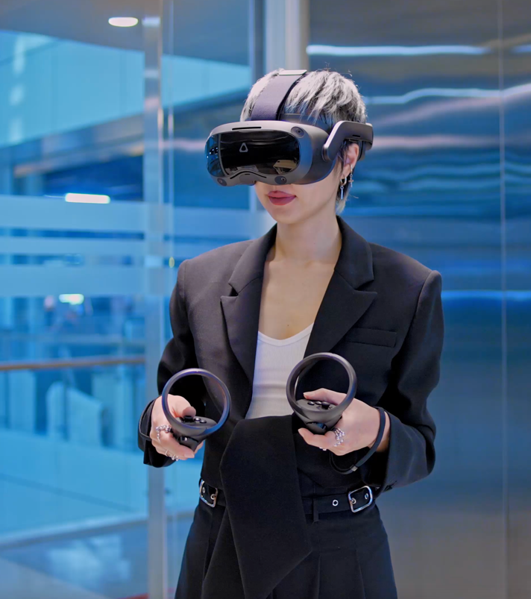
Context and benefits of using 3D and VR for teaching ergonomics
Gamification elements in VR motivate stakeholders while assessing their skills in simulated situations.
Visualization and understanding of abstract concepts and environments
Decision-Making Skills Development with immersive context: to choose the right solution for the right context.

Slide 4
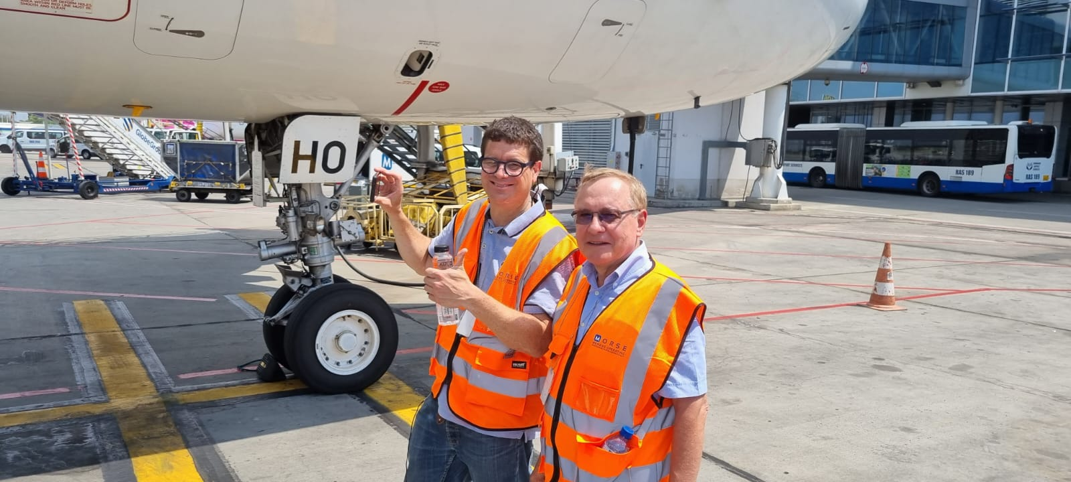
Context and benefits of using 3D and VR for teaching ergonomics
Real life scenarios captured thank to motion capture suit in July 2024 in Bucharest at Henri-Coandă international airport.
  -> special thanks to Christian and his team for the warm welcome!

Slide 5
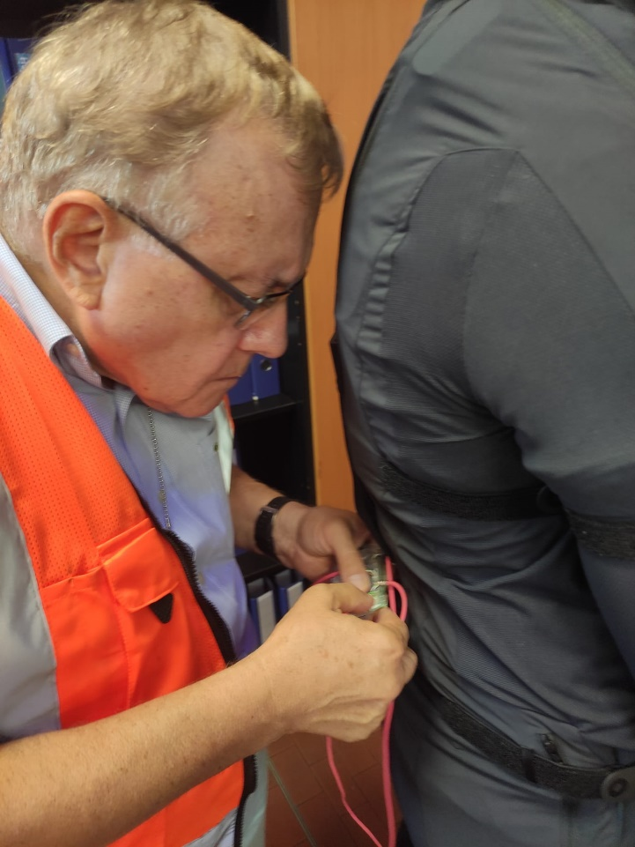
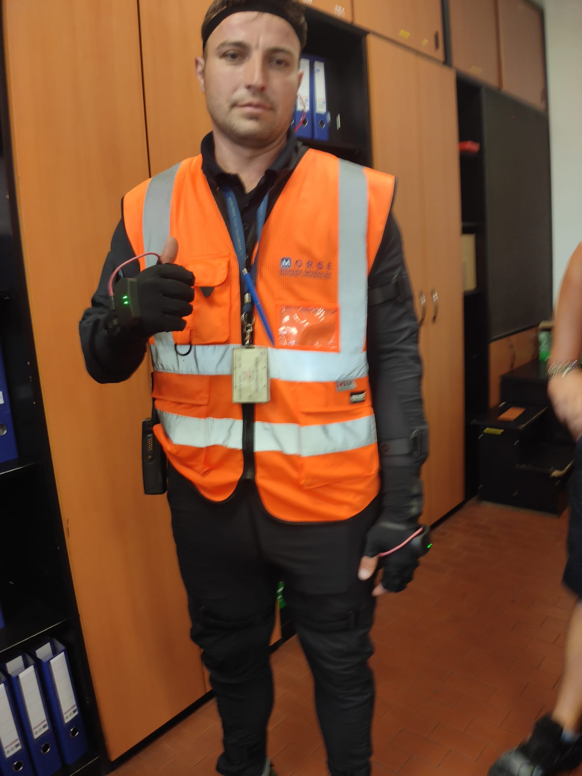
Motion capture: suit calibration

Slide 6
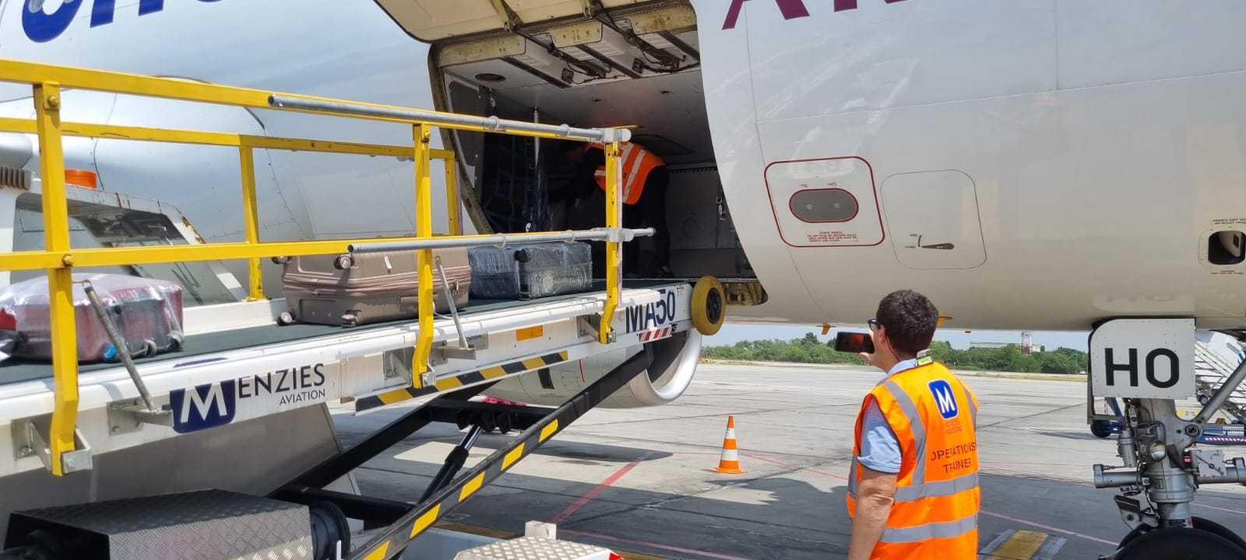
Motion capture: in the aircraft

Slide 7
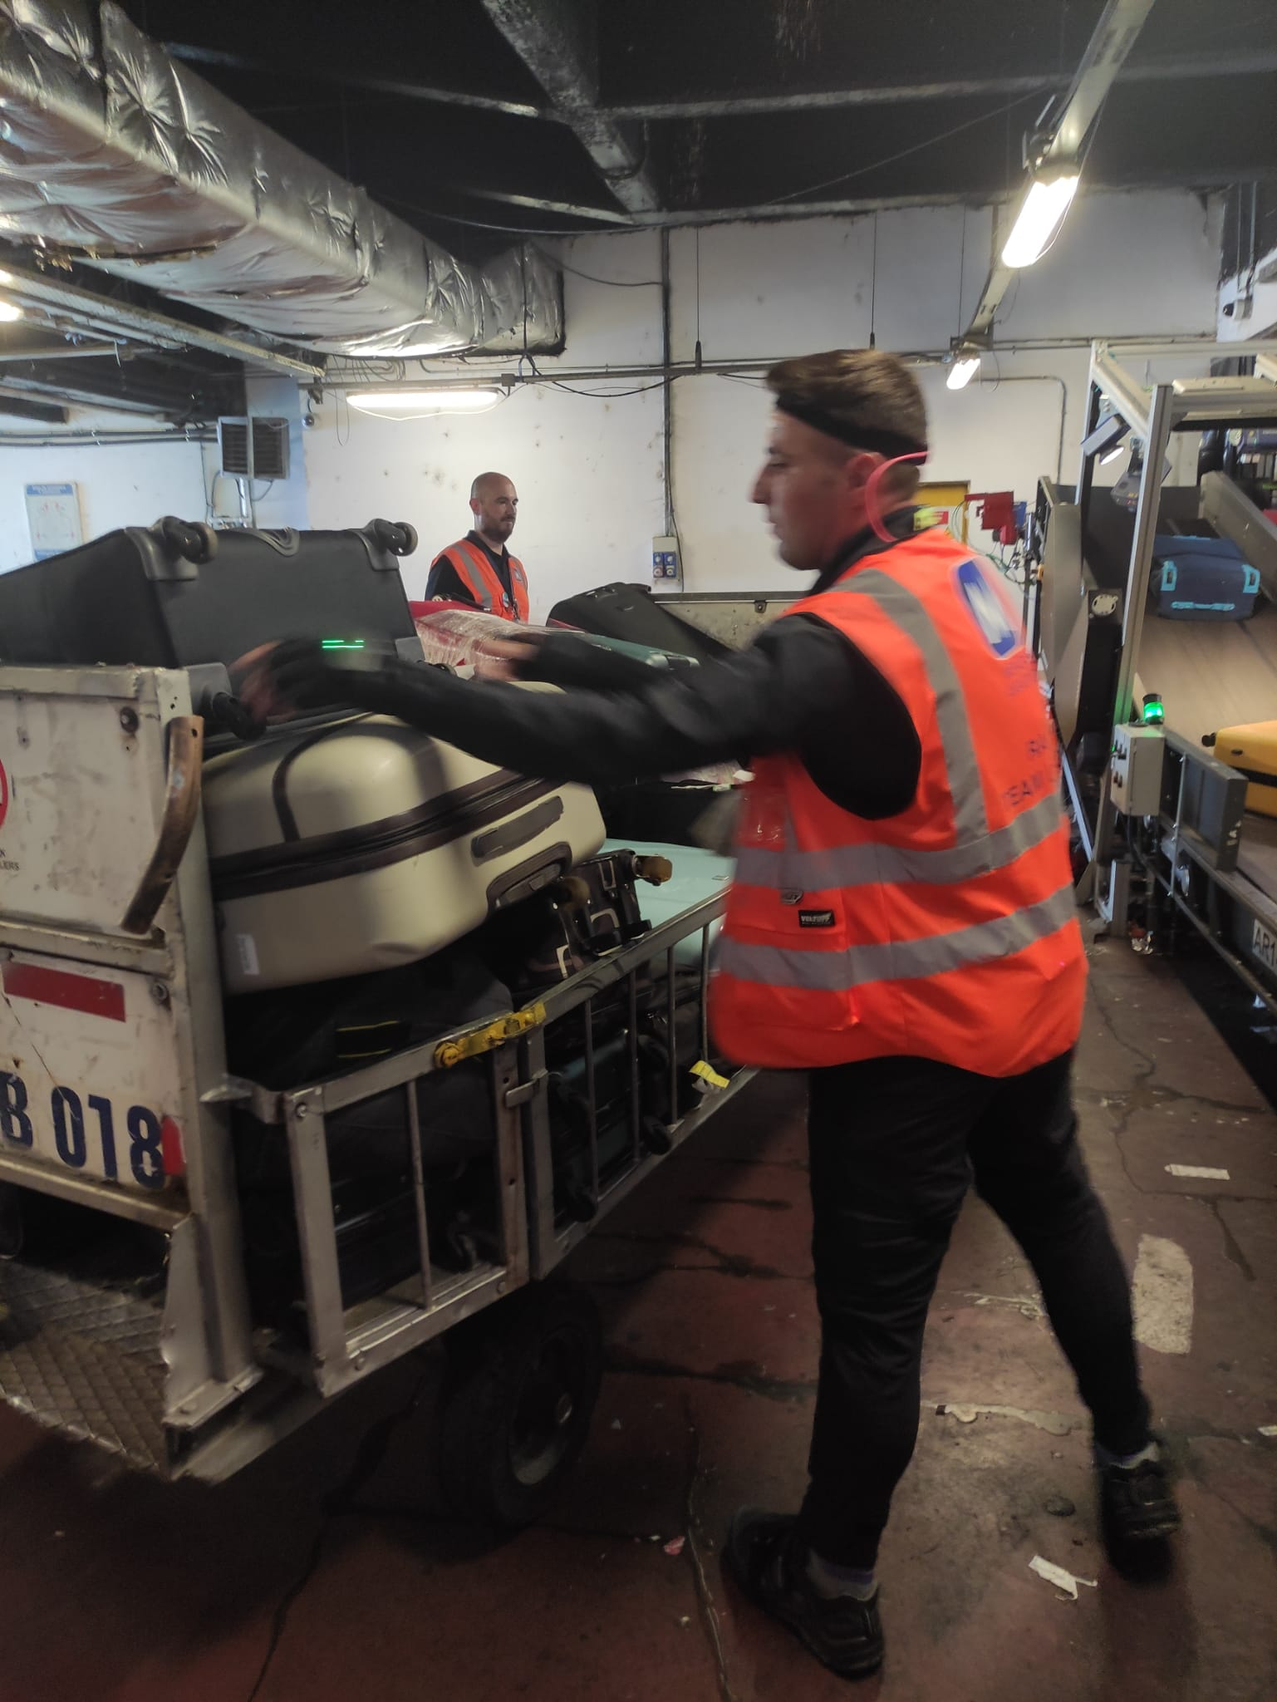
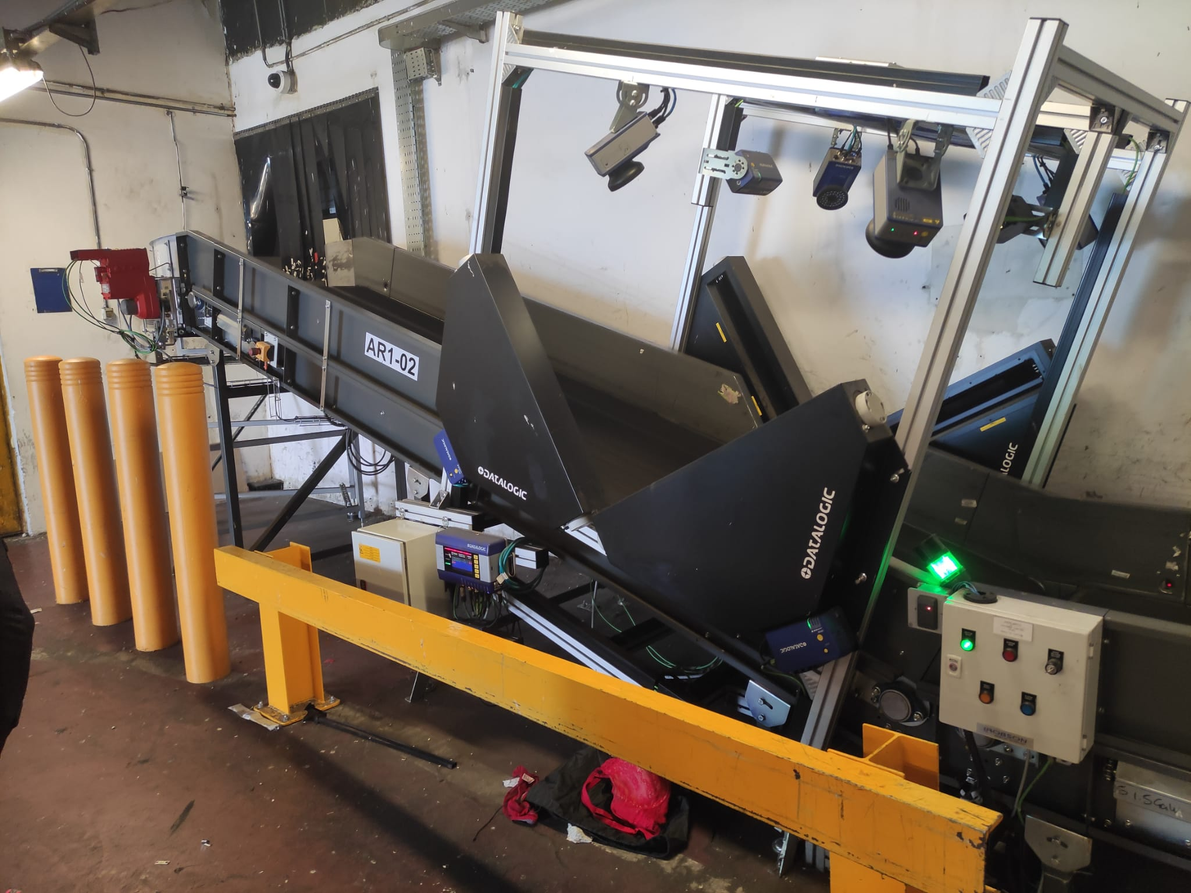
Motion capture: at the baggage handling underground facilities

Slide 8
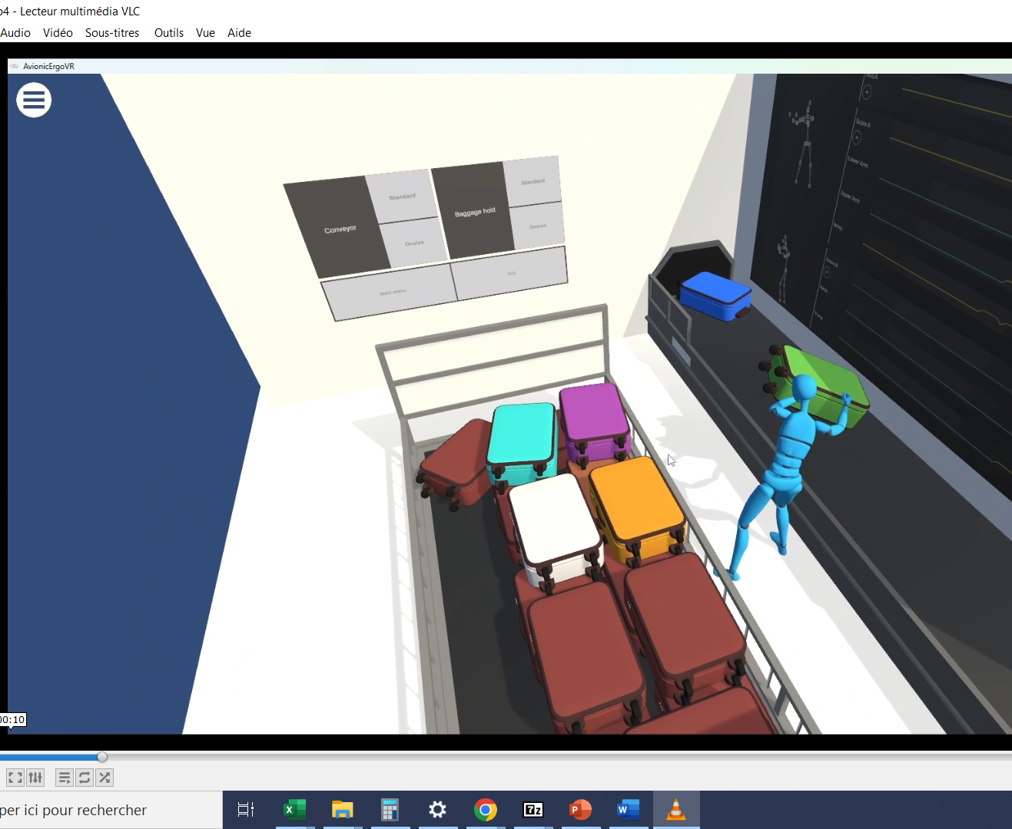
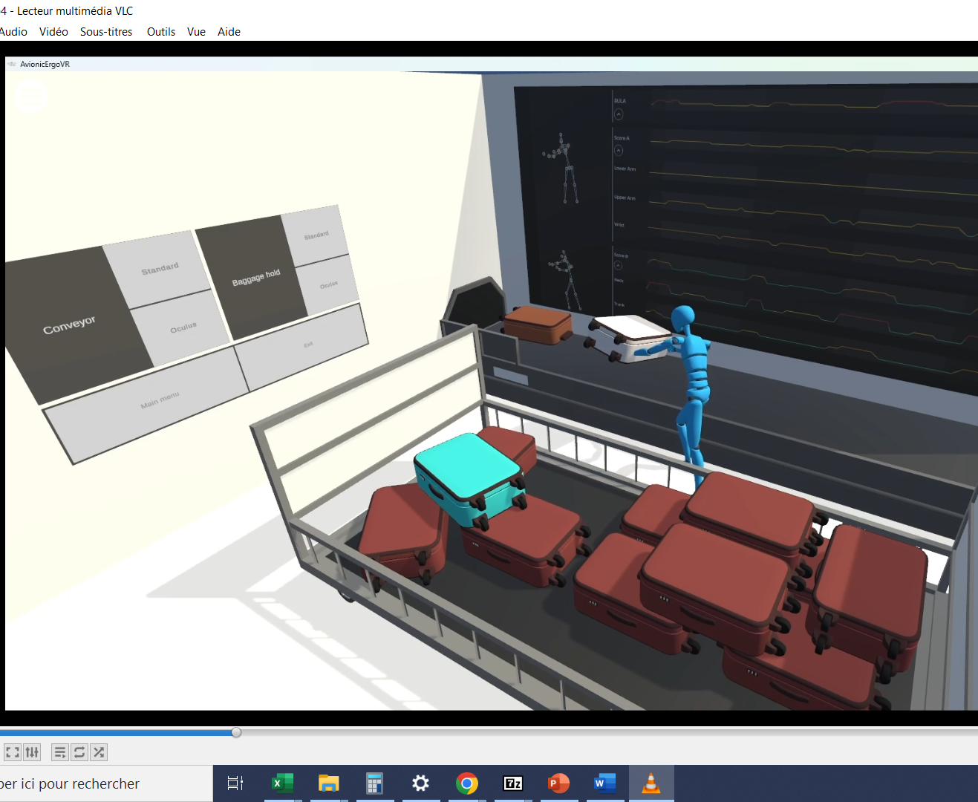
VR rendering

Slide 9
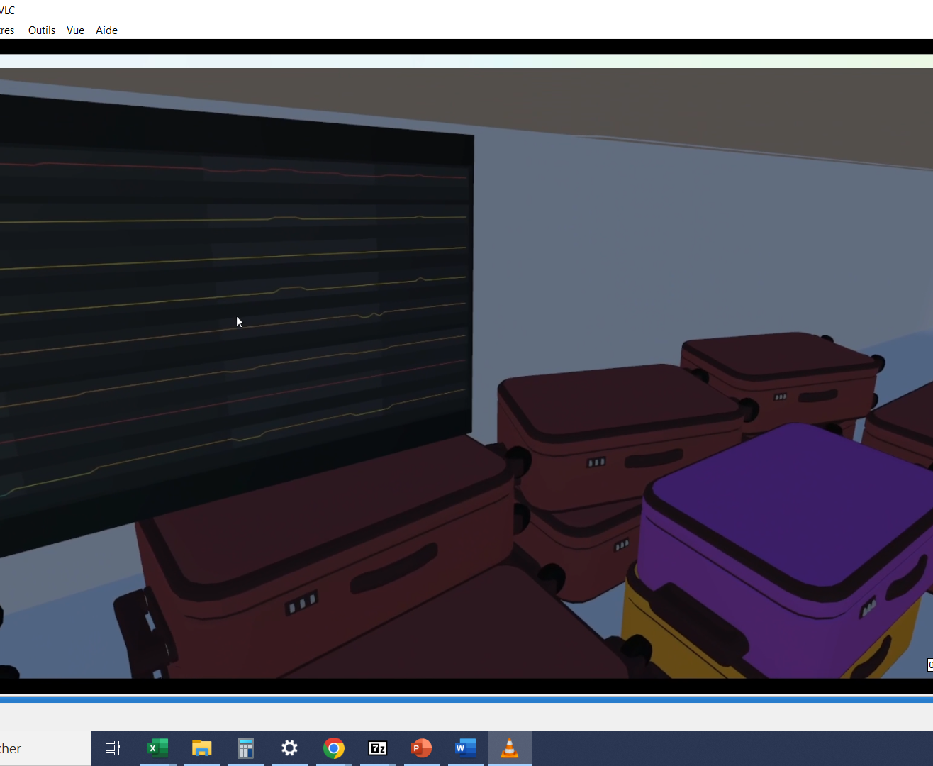
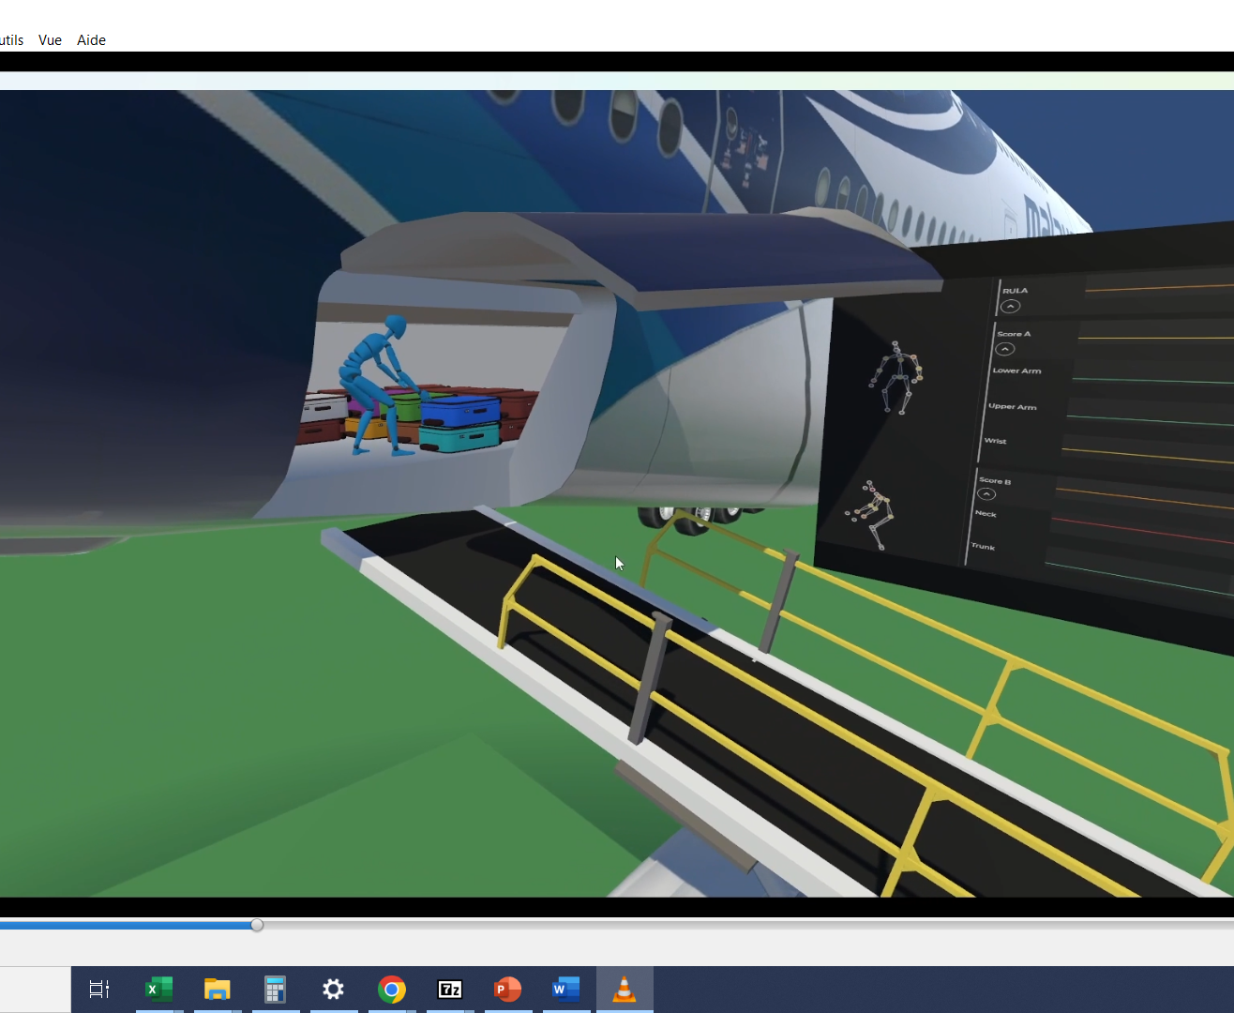
VR rendering with joints scores live visualization (VR headset)

Slide 10

3D scenes and experiential immersive environments delivered
Ergonomics analysis thanks to the technological brick ergonom.io developed by University of Strasbourg and ICube Lab.
Deliverables:
1 immersive scene with VR rendering within the aircraft (gameable with a headset + PC) – bundle available
1 immersive scene with VR rendering with the technical rooms for baggage handling
1 immersive scene with VR rendering for baggage handling within the hold of the aircraft
1 MCQ with

Slide 11
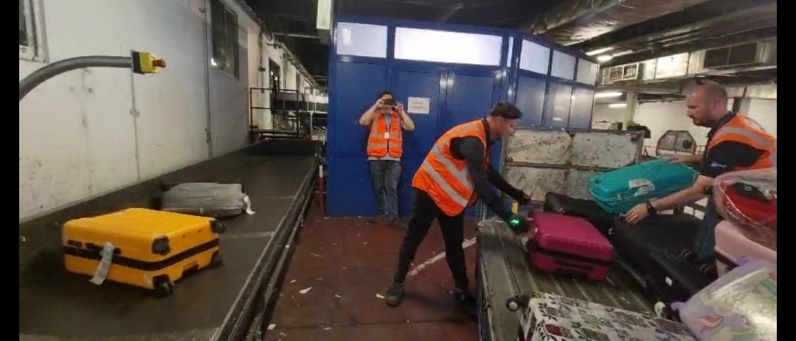
Example

